Slide 1
Scene Labeling Using Beam Search Under Mutex Constraints ID: O-2B-6 Anirban Roy and Sinisa Todorovic Oregon State University

Slide 2
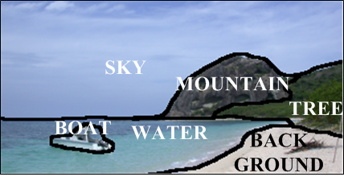
Problem: Semantic Segmentation

Slide 3
Prior Work: Labeling Individual Superpixels
Random forest, Logistic regression
[Payet et al. PAMI 13, Shotton et al. CVPR08, Eslami et al. CVPR12]
Decision Forest: [Shotton et al. CVPR08]

Slide 4
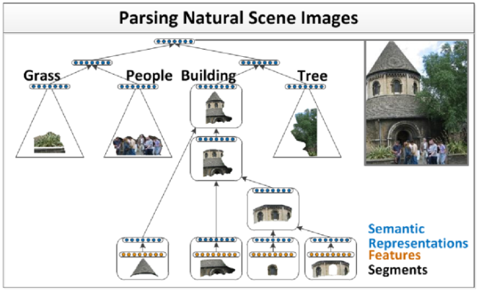
Prior Work: Labeling Individual Superpixels
Deep learning (DL)
[Socher et al. ICML11]
[DL: Socher et al. ICML 11]

Slide 5
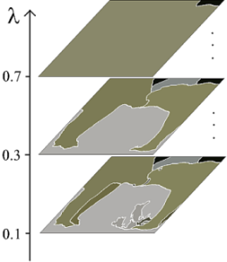
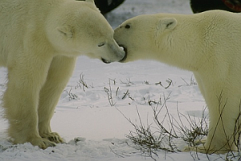
Prior Work: Labeling Individual Superpixels
Original image
Segmentation trees
[ Arbelaez et al. CVPR 12, Todorovic & Ahuja CVPR08, Lim et al. ICCV09]
Hierarchical Segmentation [Arbelaez et al. CVPR 12]

Slide 6
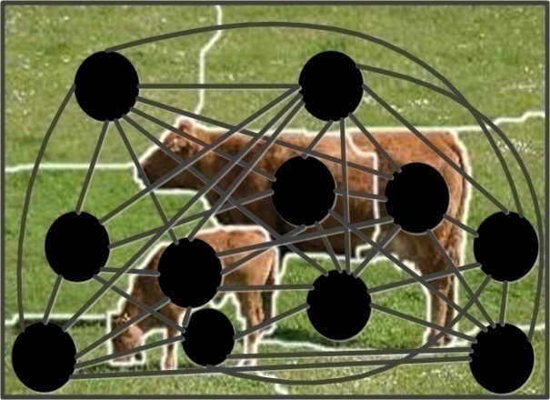
Prior Work: Holistic Approaches
CRF, Hierarchical models
[ Kohli et al. CVPR08, Gould et al. IJCV08, Zhnag et al. CVPR12, Kumar et al. CVPR 10, Lempitsky et al. NIPS11, Mottaghi et al. CVPR13, Zhu et al. PAMI12]
Deep learning (DL) + CRF
[Farabet et al. PAMI13, Kae et al. CVPR11]
[CRF: Gould et al. IJCV08]

Slide 7
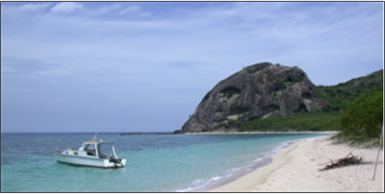
Our Approach
Input Image
Superpixels
Notes:
Animation in 4 steps: 1. org image + superpixels, 2. domain knowledge + CRF, 3. Mutex + CRF inference, 4: final result

Slide 8
Our Approach
Domain
Knowledge
Input Image
Smoothness
Context
CRF
Superpixels
Notes:
Animation in 4 steps: 1. org image + superpixels, 2. domain knowledge + CRF, 3. Mutex + CRF inference, 4: final result

Slide 9
Our Approach
Domain
Knowledge
Mutual exclusion
Input Image
Smoothness
Context
CRF
CRF inference
Superpixels
Notes:
Animation in 4 steps: 1. org image + superpixels, 2. domain knowledge + CRF, 3. Mutex + CRF inference, 4: final result

Slide 10
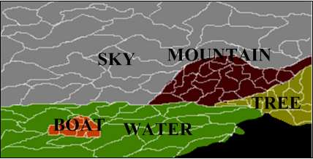
Our Approach
Domain
Knowledge
Mutual exclusion
Input Image
Smoothness
Context
Semantic segmentation
CRF
CRF inference
Superpixels
Notes:
Animation in 4 steps: 1. org image + superpixels, 2. domain knowledge + CRF, 3. Mutex + CRF inference, 4: final result

Slide 11
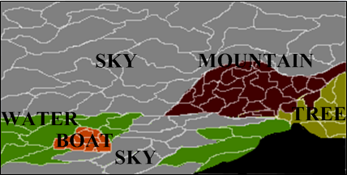
Motivation: Mutex Constraints
Input Image
Semantic segmentation
without Mutex
Key Idea:
Mutual Exclusion constraints should help

Slide 12
Motivation: Mutex Constraints
Input Image
Semantic segmentation
without Mutex
Semantic segmentation
with Mutex
Key Idea:
Mutual Exclusion constraints should help
Note that Context ≠ Mutex

Slide 13
Motivation: Mutex Constraints
Input Image
Semantic segmentation
without Mutex
Semantic segmentation
with Mutex
Key Idea:
Mutex = (object, object, relationship)
{Left, Right, Above, Below, Surrounded by, Nested within, etc.}

Slide 14
Related Work on Mutex Constraints in Different Problems
Event recognition and Activity recognition
[Tran & Davis ECCV08, Brendel et al. CVPR11]
Video segmentation
[Ma & Latecki CVPR12]

Slide 15
How to Incorporate Mutex?
CRF Energy
Smoothness
&
Context
Appearance
Mutex
violations

Slide 16
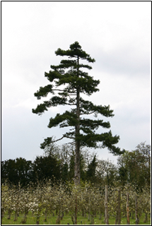
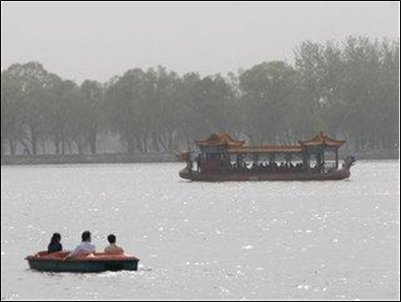
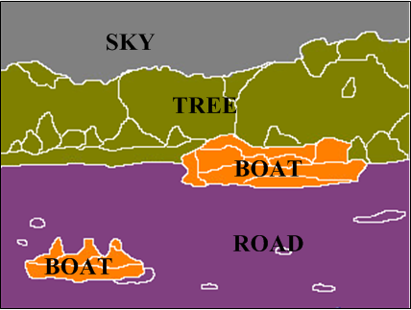
Consequences of Mutex Violation
Input Image
Semantic segmentation
without Mutex
Input Image
Semantic segmentation
without Mutex
Violation of smoothness
➔ Error
Violation of mutex
➔ Serious Error

Slide 17
How to Incorporate Mutex?
CRF Energy
Smoothness
& Context
Appearance
Mutex
violations
Modeling issue:
Violation of kth mutex constraint
=> M_{k} → ∞ => E = ?

Slide 18
How to Incorporate Mutex?
CRF Energy
Smoothness
& Context
Appearance
Mutex
violations
Modeling issue:
Violation of kth mutex constraint
=> M_{k} → ∞ => E = ?

Slide 19
Our Model
CRF Energy
Smoothness
& Context
Appearance
[ Kohli et al. CVPR08, Gould et al. IJCV08, Zhnag et al. CVPR12, Kumar et al. CVPR 10, Lempitsky et al. NIPS11, Mottaghi et al. CVPR13, Zhu et al. PAMI12]
Notes:
References
Script: we just adopt the standard CRF formulation presented in prior work

Slide 20
CRF Inference as QP

Slide 21
CRF Inference as QP
Assignment Vector
Superpixel
Class label

Slide 22
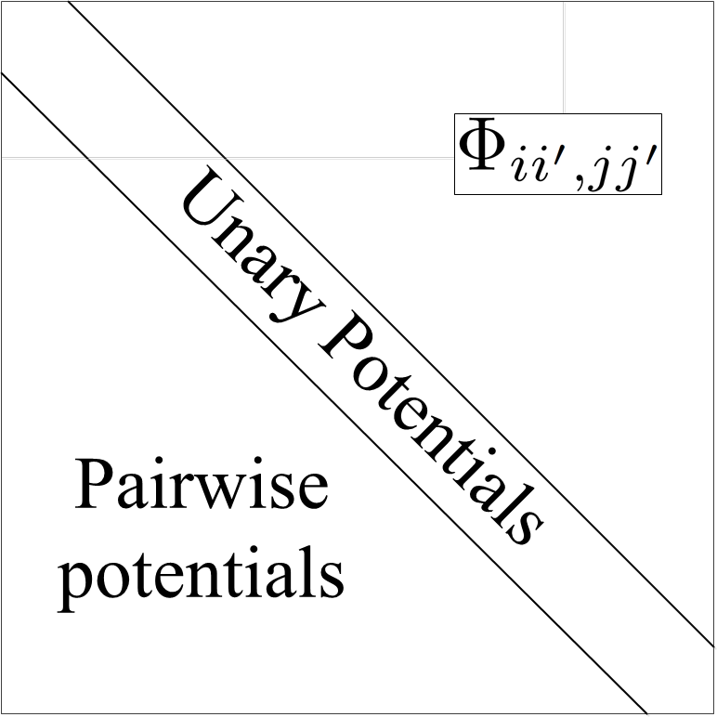
CRF Inference as QP
Superpixel
Class label
_{(j, j’)}
_{(i,i’)}
Matrix of potentials
=
Unary Potentials
Pairwise Potentials
Class label

Slide 23
Formalizing Mutex Constraints
Mutex :
Label i’ i x_{ii’} = 1
Label j’ j x_{jj’} = 0
is assigned to
must not be
assigned to

Slide 24
Formalizing Mutex Constraints
Mutex :
Label i’ i x_{ii’} = 1
Label j’ j x_{jj’} = 0
is assigned to
must not be
assigned to
Which one is better?
Linear option: x_{ii’} + x_{jj’} = 1
Quadratic option: x_{ii’} x_{jj’} = 0
OR

Slide 25
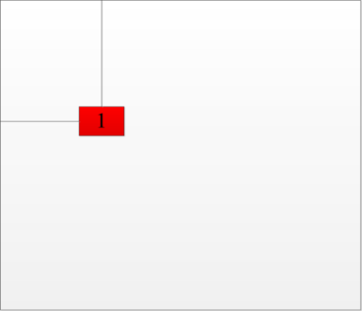
Mutex Constraints
Compact representation:
_{(j,j’)}
_{(i,i’)}
1
Must be
M
Matrix
of mutex

Slide 26
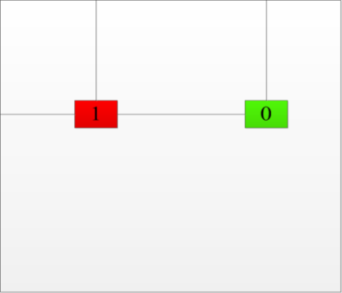
Mutex Constraints
Compact representation:
_{(j,j’)}
_{(k, k’)}
_{(i,i’)}
1
0
Must be
M
Can be
Matrix
of mutex

Slide 27
Inference as QP

Slide 28
Inference as QP
Relaxation?

Slide 29
CRF Inference as a Beam Search
Initial labeling
Candidate
labelings

Slide 30
CRF Inference as a Beam Search
Initial labeling
Candidate
labelings

Slide 31
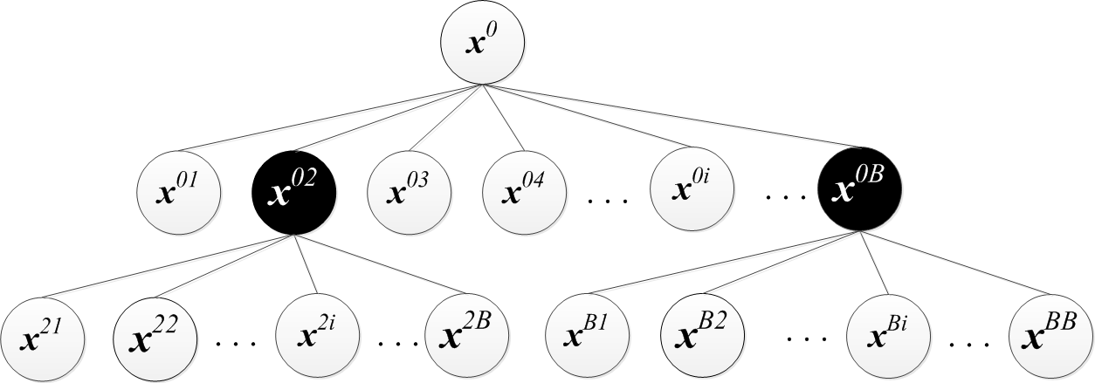
CRF Inference as a Beam Search
Initial labeling
Candidate
labelings

Slide 32
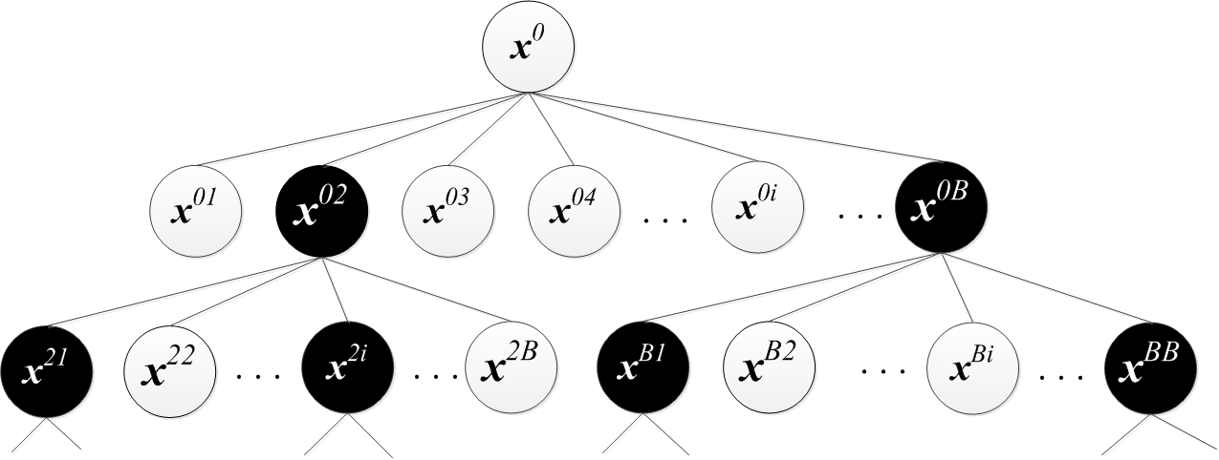
CRF Inference as a Beam Search
Initial labeling
Candidate
labelings

Slide 33
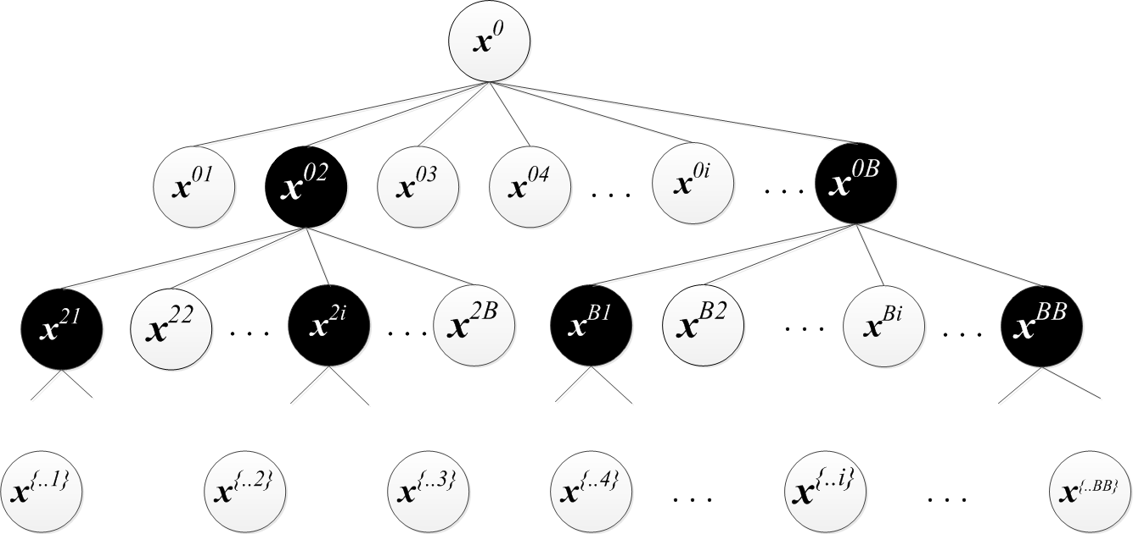
CRF Inference as a Beam Search
Initial labeling
Candidate
labelings

Slide 34
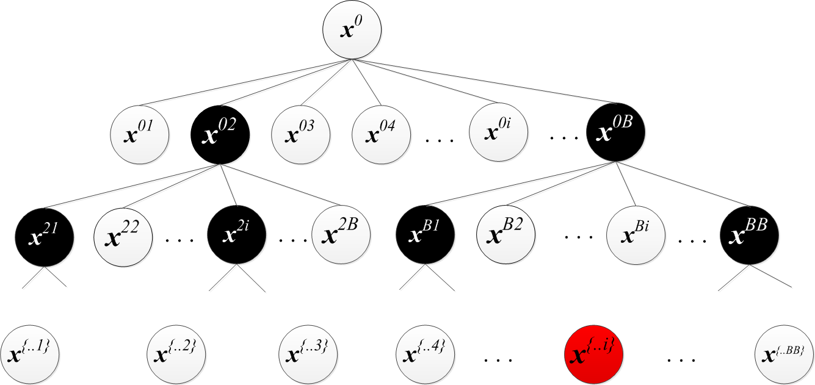
CRF Inference as a Beam Search
Initial labeling
Candidate
labelings
Maximum score

Slide 35
Our Search Framework
STATE: Label assignment that satisfies mutex constraints
SUCCESSOR: Generates new states from previous ones
HEURISTIC: Selects top B states for SUCCESSOR
SCORE: Selects the best state in the beam search

Slide 36
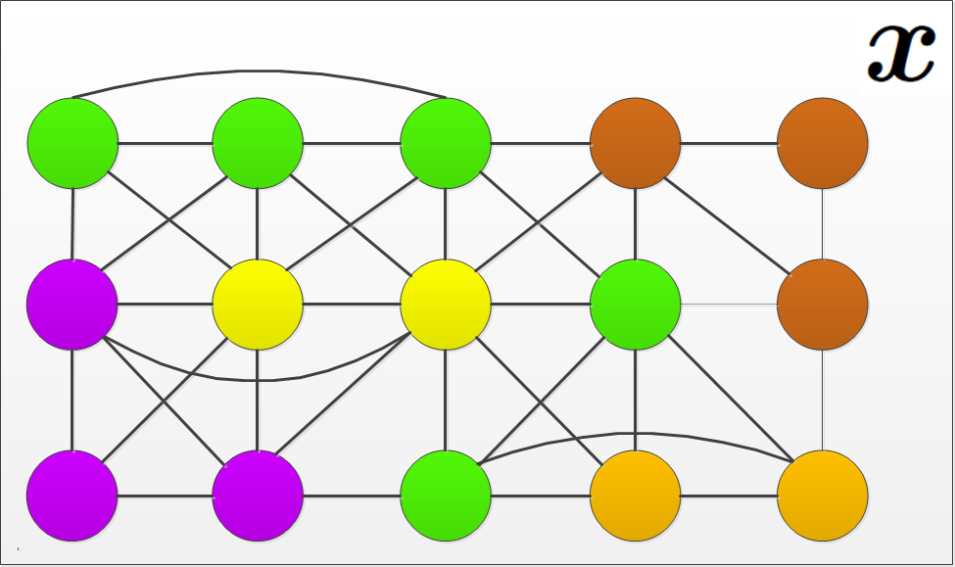
SUCCESSOR Generates New States
STATE:
a labeling assignment

Slide 37
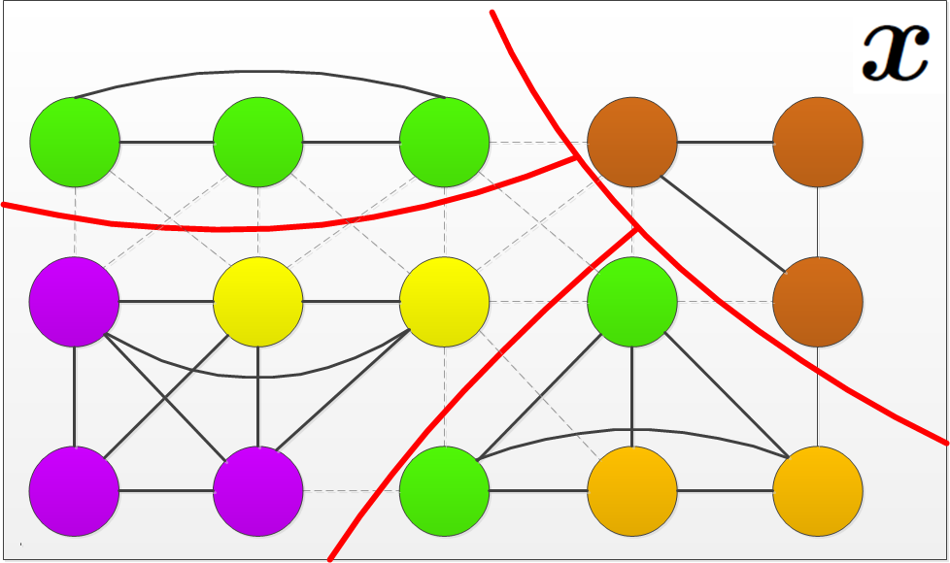
SUCCESSOR Generates New States
Probabilistically cuts edges to get
Connected components of superpixels of same labels

Slide 38
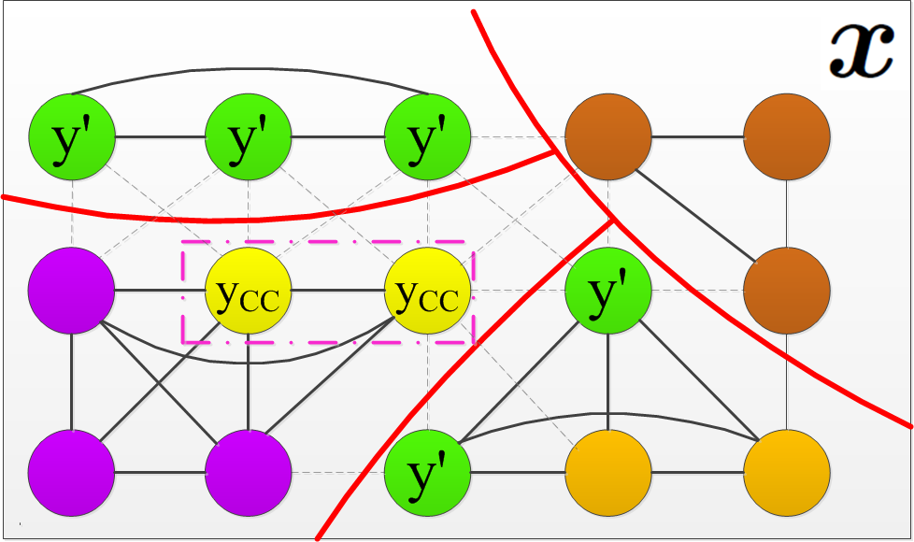
SUCCESSOR Generates New States
Randomly selects a connected components

Slide 39
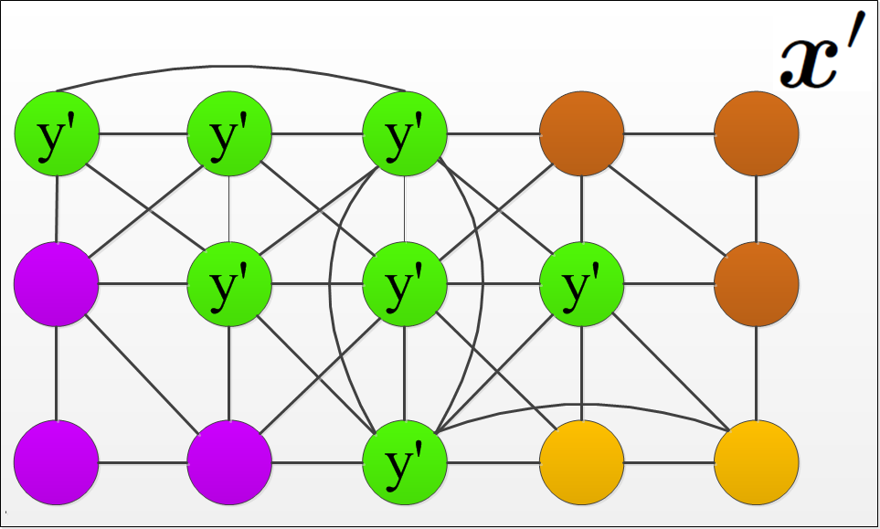
SUCCESSOR Generates New States
Changes labels of the selected connected component
Changes in the labeling of superpixels

Slide 40
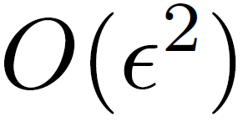
SUCCESSOR Accepting New States
Accepts the new state if it satisfies all constraints
next state
previous state
Efficient computation:

Slide 41
Heuristic and Score Functions
SCORE: Negative CRF energy
HEURISTIC: Again efficient computation

Slide 42
Results

Slide 43
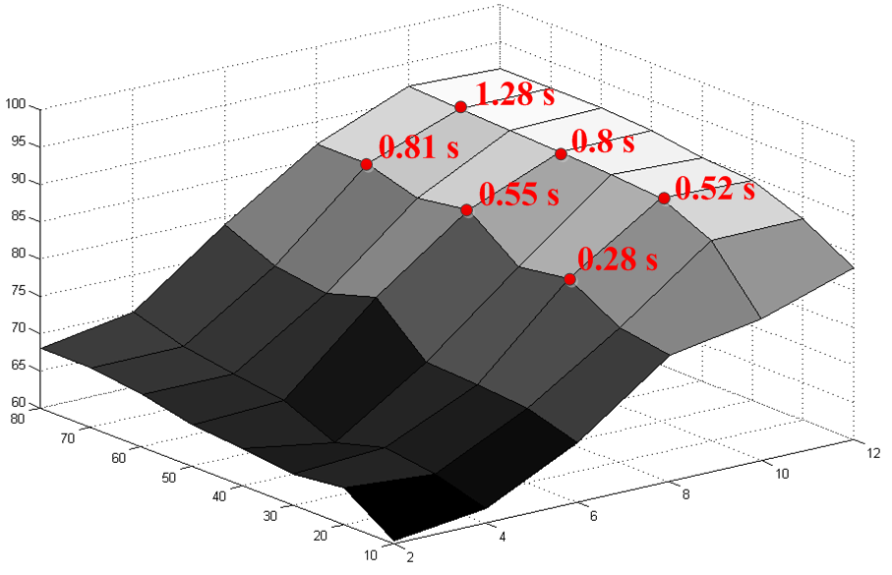
Input Parameter Evaluation
Running Time
Accuracy
# Restarts
Beam Width
The MSRC dataset.

Slide 44
Pixelwise Accuracy (%)
 | Accuracy
Our Approach | 91. 5
CRF w/o mutex | 82.5 | + 9.0
CRF w/ mutex + QP solver | 85.4 | + 5.9
MSRC

Slide 45
Pixelwise Accuracy (%)
 | Accuracy
Our Approach | 81
CRF: Gould, ICCV09 | 76.4 | + 4.6
ConvNet + CRF: Farabet et al. PAMI13 | 81.4 | - 0. 4
Stanford Background

Slide 46
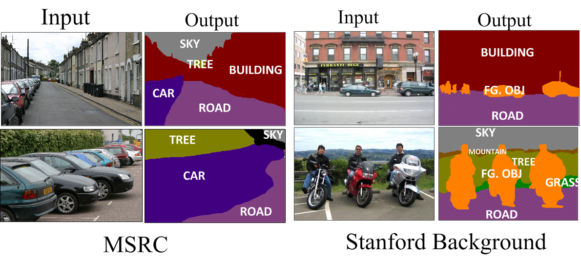
Qualitative Results

Slide 47
Summary
CRF based segmentation with mutex constraints
CRF inference = QP → Solved using beam search
Beam search is:
Efficient
Solves QP directly in the discrete domain
Guarantees that all mutex constraints are satisfied
Robust against parameter variations
Mutex constraints increase accuracy by 9% on MSRC

