Slide 1
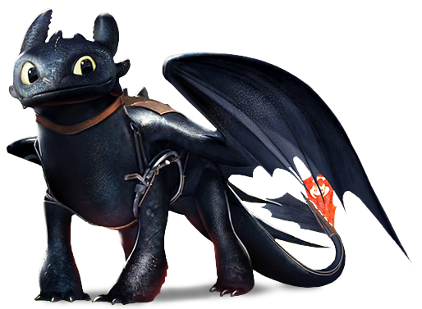
How to Train Your Agent (A Crash Course in Sequential Decision Making with Deep Nets)
Stefan Lee - Fall 2019
Notes:
10:41

Slide 2
Administrative Bits

Slide 3
Discussion Lead Signup
Sign up for 6 more interesting papers by Oct. 2nd
Rank them 1 to 6 (1 being most interested)
https://bit.ly/2nBh9Fz

Slide 4
Team Signup
Sign up your team (maybe just you) by Oct. 4th
1-sentence description of your project direction
I will set time slots for us to meet on Oct 7th.
https://bit.ly/2o84ni9

Slide 5
Plan for Today
Intro and Some Notation
Imitation Learning
Behavior Cloning
Direct Policy Learning
Sketch of Inverse Reinforcement Learning
Reinforcement Learning
Policy-based (REINFORCE, Actor-Critic)
Value-based (Q-Learning)
Model-based

Slide 6
Intro and Notation

Slide 7
A General Embodied Agent
Action
Goal
Agent
Reward
Environment
Observation

Slide 8
A General Embodied Agent
$$a_{t}$$
$$g$$
Action
Goal
$$r_{t}$$
Agent
Reward
$$s_{t}$$
$o_{t}=f(s_{t})$
Environment
Observation

Slide 9
Some Notation
Markov Decision Process (MDP)
Defined as $\left(𝒮, 𝒜, ℛ, ℙ, γ\right)$
$𝒮$ Set of possible states
$𝒜$ Set of possible actions
$R:𝒮×𝒜→Ω_{ℝ}$ Distribution of reward given state-action pair
$ℙ:𝒮×𝒜→Ω_{𝒮}$ Transition function – distribution over next states
$γ$ Discount factor
Life looks like${ (s}_{0}, a_{0}, r_{0}{,s}_{1}, a_{1}, r_{1}, …)$
where $s_{t+1}∼ℙ(s_{t+1}|s_{t},a_{t})$ and $r_{t}∼R(r_{t}|s_{t},a_{t})$

Slide 10
Some Notation
Markov Decision Process (MDP)
Action
Observation
State
Image Credit: Sergey Levine

Slide 11
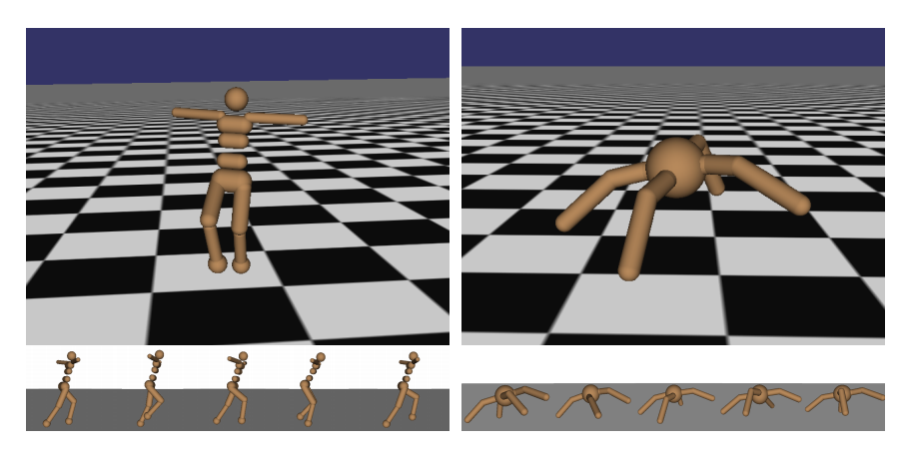
Examples MDPs
Robot Locomotion
Figures copyright John Schulman et al., 2016. Reproduced with permission.
Make the robot move forward
State Space: Angle and position of the joints
Action Space: Torques applied on joints
Reward Function: 1 at each time step upright + forward movement
Slide Credit: Fei-Fei Li, Justin Johnson-CS 231n

Slide 12
Examples MDPs
Atari Games
Figures copyright Volodymyr Mnih et al., 2013. Reproduced with permission.
Complete the game with the highest score
State Space: Raw pixel inputs of the game state
Action Space: Game controls e.g. Left, Right, Up, Down
Reward Function: Score increase/decrease at each time step
Slide Credit: Fei-Fei Li, Justin Johnson-CS 231n

Slide 13
Examples MDPs
PointGoal Visual Navigation
Navigate to the specified point
State Space: Raw pixel inputs
Action Space: Forward, Turn Left, Turn Right
Reward Function: Distance increase/decrease per time step + “It hurts to be alive” penalty

Slide 14
Some Notation
Common Terminology and Definitions
Policy – How should the agent act?
Stochastic policy $π:𝒮→Ω_{𝒜}$ $a_{t}∼π(s_{t})$
Deterministic policy $π:𝒮→𝒜$ $a_{t}=π(s_{t})$
Optimal policy $π^{∗}=argmax_{π}{ 𝔼}_{s_{0}}\left[V_{π}\left(s_{o}\right)\right]$
Value – How good is each state? Or state-action pair?
(State) Value Function $V_{π}\left(s_{t}\right)= 𝔼_{π,ℙ}\left[\sum_{i=t}^{∞}{γ^{i−1}r_{i}}\right]$
Q Function $Q_{π}\left(s_{t},a\right)=R\left(s_{t},a\right)+γ𝔼_{s_{t+1}}\left[V_{π}(s_{t+1})\right]$
Advantage $A_{π}\left(s_{t},a\right)=Q_{π}\left(s_{t},a\right)−V_{π}\left(s_{t}\right)$

Slide 15
Some Notation
Common Terminology and Definitions
Model – What will happen when the agent acts?
Learn to mimic the transition function $M: 𝒮×𝒜→Ω_{𝒮}$
Rollout – What happens if we let the policy act for a while?
Trajectory ${τ=(s}_{t}, a_{t}{,s}_{t+1}, a_{t+1}, …)$
$τ∼\prod{ℙ\left(s_{t+1} | s_{t},a_{t}\right)π(a_{t}|s_{t})}P\left(s_{o}\right)$ often written $τ∼π$
Can also consider states visited by policy: $P\left(s | π\right)$ or $s∼π$

Slide 16
Some Notation
Slides Credit: David Silver

Slide 17
Some Notation
Policy
Slides Credit: David Silver

Slide 18
Some Notation
Value
Slides Credit: David Silver

Slide 19
Some Notation
Model
Slides Credit: David Silver

Slide 20
Getting a Handle on These Definitions
1. If we have a policy $π$ and know the true $Q_{π}\left(s,a\right)$ -- can we derive a new policy $π′$ that is as good or better than $π$?
Recall that $Q_{π}\left(s,a\right)$ is the expected reward of taking action a in state s
Set $π\left(a′ | s\right)=1$ if $a′=argmax{ Q}_{π}\left(s,a\right)$
2. Fill in a simple algorithm to improve a policy:
$r\left(s,a\right)>0$ ?
Increase the probability $π(a|s)$ if ____________________.
$$r\left(s,a\right)<0 ?$$
Decrease the probability $π(a|s)$ if ____________________.
Slides Credit: Sergey Levine

Slide 21
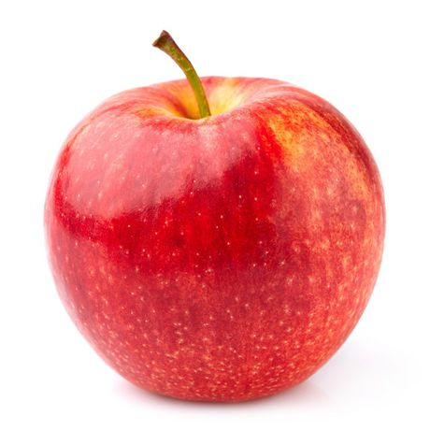
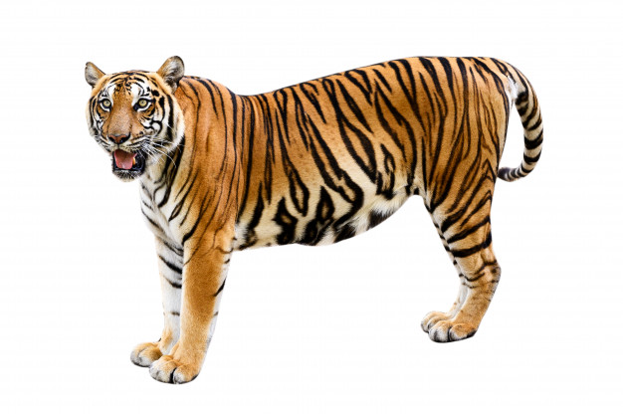
Getting a Handle on These Definitions
+10
0
0
0
-10
+10
0
0
+1
-10
Immediate reward is not a particularly useful signal
in many task settings.

Slide 22
Getting a Handle on These Definitions
1. If we have a policy $π$ and know the true $Q_{π}\left(s,a\right)$ -- can we derive a new policy $π′$ that is as good or better than $π$?
Recall that $Q_{π}\left(s,a\right)$ is the expected reward of taking action a in state s
Set $π\left(a′ | s\right)=1$ if $a′=argmax{ Q}_{π}\left(s,a\right)$
2. Fill in a simple algorithm to improve a policy:
$Q_{π}\left(s,a\right)>V_{π}(s)$
Increase the probability $π(a|s)$ if ____________________.
$Q_{π}\left(s,a\right)<V_{π}(s)$
Decrease the probability $π(a|s)$ if ____________________.
Recall that $V_{π}\left(s\right)$ is the expected reward of following $π$ from state $s$
Slides Credit: Sergey Levine

Slide 23
Getting a Handle on These Definitions
1. If we have a policy $π$ and know the true $Q_{π}\left(s,a\right)$ -- can we derive a new policy $π′$ that is as good or better than $π$?
Recall that $Q_{π}\left(s,a\right)$ is the expected reward of taking action a in state s
Set $π\left(a′ | s\right)=1$ if $a′=argmax{ Q}_{π}\left(s,a\right)$
2. Fill in a simple algorithm to improve a policy:
$A_{π}\left(s,a\right)>0$
Increase the probability $π(a|s)$ if ____________________.
$$A_{π}\left(s,a\right)<0$$
Decrease the probability $π(a|s)$ if ____________________.
Recall $A_{π}\left(s_{t},a\right)=Q_{π}\left(s_{t},a\right)−V_{π}\left(s_{t}\right)$
Slides Credit: Sergey Levine

Slide 24
Getting a Handle on These Definitions
3. Given an accurate deterministic world model $s_{t+1 }=M(s_{t}, a_{t})$ and value function $V_{π}\left(s_{t}\right)$, how should an agent act in state $s_{t}$?
For each possible action $a$,
Compute $V_{π}\left(s_{t+1}\right)$ for $s_{t+1}=M(s_{t}, a)$
Select action with highest value.
Slides Credit: Sergey Levine

Slide 25
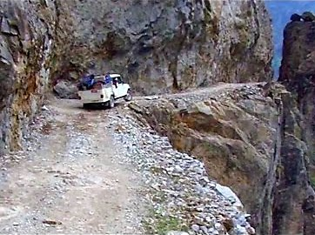
Markov Decision Processes
Challenges of Markov Decision Processes
Reward is very often discontinuous
+1
Turn Right
$$r\left(s,a\right)$$
Turn Left
$r\left(s,a\right)−$ not smooth
-10
$$π_{θ}\left(a=turn right\right)=θ$$
$𝔼_{π_{θ}}\left[r\left(s,a\right)\right]−$ smooth in $θ$

Slide 26
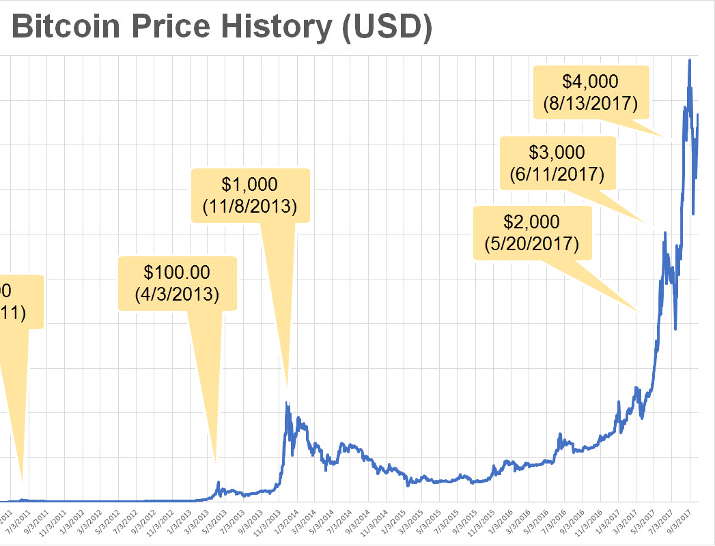
Markov Decision Processes
Challenges of Markov Decision Processes
Reward is often sparse and delayed
Taking an action at time t
Doesn’t pay off till time t+k

Slide 27
Markov Decision Processes
Challenges of Markov Decision Processes
Reward is often sparse and delayed
Taking an action at time t
Doesn’t pay off till time t+k

Slide 28
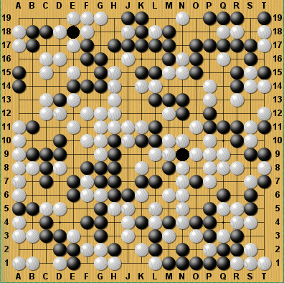
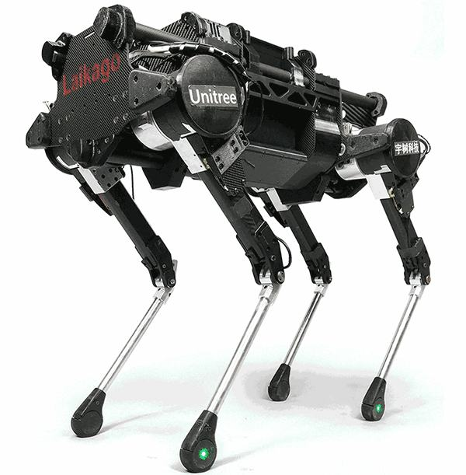
Markov Decision Processes
Challenges of Markov Decision Processes
2.08×10¹⁷⁰ Legal Board Configurations
State and action spaces can be huge
(or infinite)
Notes:
10^70 atoms in the universe

Slide 29
A General Embodied Agent
Imitation Learning
Reinforcement Learning
Have expert demonstrations (possibly interactive)
Environment provides feedback
No examples of optimal policy
Action
Action
Goal
Goal
Agent
Agent
Reward
Environment
Environment
Observation
Observation

Slide 30
A General Embodied Agent
Imitation Learning
Reinforcement Learning
Have expert demonstrations (possibly interactive)
Environment provides feedback
No examples of optimal policy
Action
Action
Goal
Goal
Agent
Agent
Reward
Environment
Environment
Observation
Observation

Slide 31
Imitation Learning

Slide 32
Imitation Learning
Imitation Learning
Assume access to an expert demonstrator $π^{∗}$ at some point or another and to varying levels of interactivity Does not assume reward function is given!

Slide 33
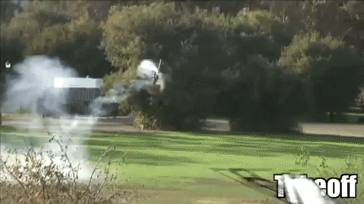
Imitation Learning

Slide 34
Imitation Learning
Imitation Learning
Assume access to an expert demonstrator $π^{∗}$ at some point or another and to varying levels of interactivity
Does not assume reward function is given!
Behavior Cloning / Inverse Reinforcement Learning
Given dataset of expert trajectories $D={\left\{ {\left(s_{0}, a_{0}, s_{1}, a_{1},…, s_{T}, a_{T}\right)}_{i} \right\}}_{i=1}^{N}$
Direct Policy Learning / Interactice Expert
Assume queryable expert $π^{∗}$ during training

Slide 35
Imitation Learning Behavior Cloning

Slide 36
Imitation Learning – Behavior Cloning
Slides Credit: Yisong Yue

Slide 37
Imitation Learning – Behavior Cloning
Behavior Cloning
Given dataset of trajectories $D={\left\{ {\left(s_{0}, a_{0}, s_{1}, a_{1},…, s_{T}, a_{T}\right)}_{i} \right\}}_{i=1}^{N}$ from an expert demonstration policy $π^{∗}$
Break things down to individual state-action pairs $s_{t}, a_{t}$ and directly train a policy $\hat{a_{t}}=π\left(s_{t}\right)$ using supervised learning:
$$θ^{∗}=argmin_{θ}𝔼_{s∼π^{∗}}\left[ L\left(π_{θ}\left(s\right), π^{∗}(s)\right) \right]$$
$$θ^{∗}=argmin_{θ} \sum_{i}{L\left({π_{θ}(a}_{t} | s_{t}\right), π^{∗}(a_{t}|s_{t}))}$$
Interpretations:
Assuming perfect imitation so far, learn to continue imitating perfectly
Minimize 1-step deviation for states the expert visits
Slides Credit: Yisong Yue

Slide 38
Imitation Learning – Behavior Cloning
Behavior Cloning
Strengths:
Dead simple. Seriously. It is just supervised learning.
Works well when minimizing 1-step deviation is sufficient.
Weaknesses:
Compounding errors.
Data distribution miss-match.

Slide 39
Imitation Learning – Behavior Cloning
Data Distribution Miss-match
 | Supervised Learning | Behavior Cloning
Train | $$\left(x,y\right)\sim D$$ | $$\left(s,a\right)\sim π^{∗}$$
Test | $$\left(x,y\right)\sim D$$ | $$\left(s,a\right)\sim π_{θ}$$
Distributions of states the agent will encounter during test may differ from training!
Slides Credit: Katerina Fragkiadaki

Slide 40
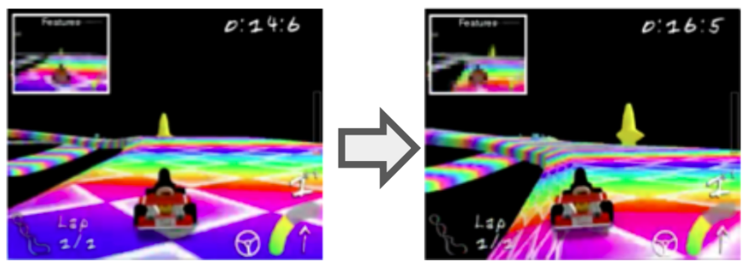
Imitation Learning – Behavior Cloning
Data Distribution Miss-match
Slides Credit: Yisong Yue

Slide 41
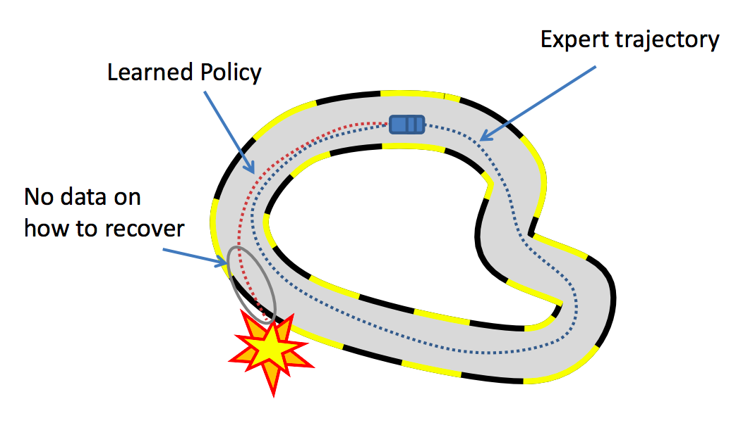
Imitation Learning – Behavior Cloning
Data Distribution Miss-match
Slides Credit: Yisong Yue

Slide 42
Imitation Learning – Behavior Cloning
Compounding Errors
Suppose $π_{θ}$ achieves an error rate of $ε$ for states induced by $π^{∗}$, then over a T length trajectory the expected number of errors is $E_{π}\left[mistakes\right]= {O(T}^{2}ε)$
Efficient reductions for imitation learning, 2010.

Slide 43
Imitation Learning – Behavior Cloning
Behavior Cloning
Use set of demonstrations as if they were targets for a supervised learning task and minimizing 1-step error for your policy. Super simple but has trouble with dataset miss-match.
When to use this?
When the state space is well-covered by the demonstrator.
When recovering from 1-step deviations is easy.
To pre-train before doing a full RL approach.

Slide 44
Imitation Learning Direct Policy Learning

Slide 45
Imitation Learning – Direct Policy Learning
Data Distribution Miss-match
Slides Credit: Yisong Yue

Slide 46
Imitation Learning – Interactive Direct Policy Learning
Why is this a problem for Behavior Cloning?
$$θ^{∗}=argmin_{θ}𝔼_{s∼π^{∗}}\left[ L\left(π_{θ}\left(s\right), π^{∗}(s)\right) \right]$$
Train a policy that behaves the same in states the demonstrations visit.
What if we had a demonstration policy we could query?
$$θ^{∗}=argmin_{θ}𝔼_{s∼π_{θ}}\left[ L\left(π_{θ}\left(s\right), π^{∗}(s)\right) \right]$$
Removes state miss-match, but requires us to evaluate$π^{∗}\left(s\right)$ for arbitrary states.

Slide 47
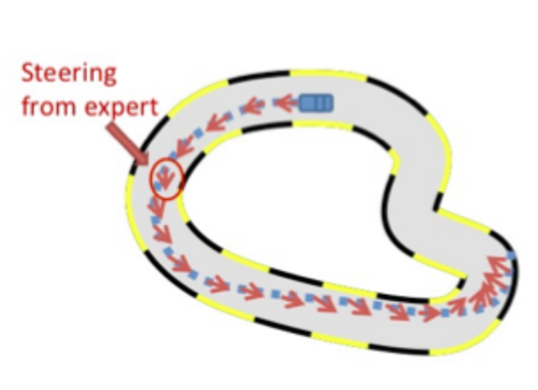
Imitation Learning – Interactive Direct Policy Learning
$$θ^{∗}=argmin_{θ}𝔼_{s∼π_{θ}}\left[ L\left(π_{θ}\left(s\right), π^{∗}(s)\right) \right]$$
A Naïve Algorithm
Estimate policy $π_{θ}$ parameters
Train a policy $π_{θ}^{i}$ using behavior cloning $D_{i}$
Estimate state space $s ∼π_{θ}$ and collect demonstrations
Rollout $π_{θ}^{i}$ to generate a set of states, query
$π^{∗}$ to generate a new dataset $D_{i+1}$
Not guaranteed to converge / might oscillate.

Slide 48
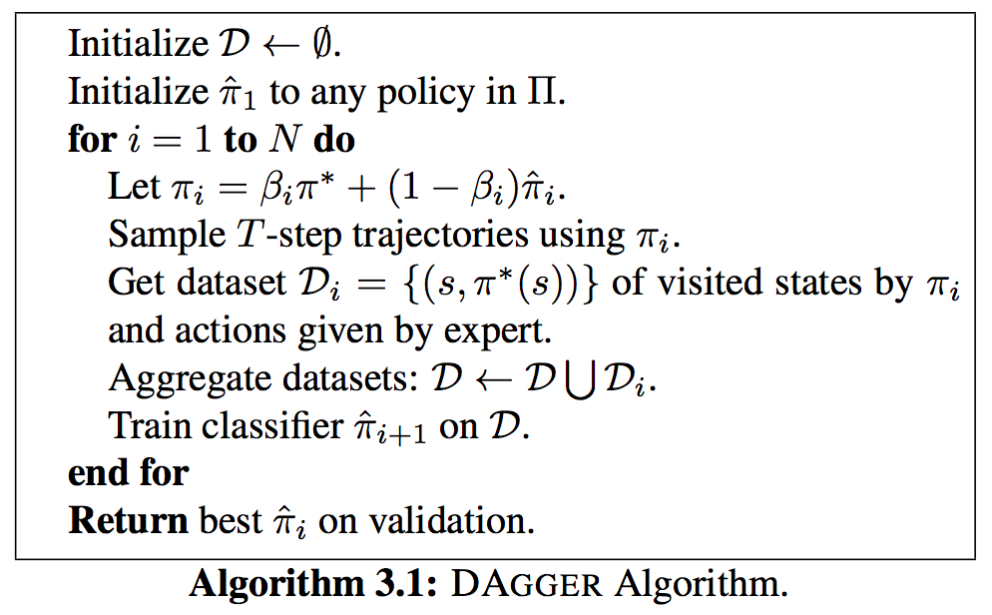
Imitation Learning – Interactive Direct Policy Learning
Collect Data
A Reduction of Imitation Learning and Structured Prediction to No-Regret Online Learning

Slide 49
Imitation Learning – Interactive Direct Policy Learning
Behavior Cloning
A Reduction of Imitation Learning and Structured Prediction to No-Regret Online Learning

Slide 50
Imitation Learning – Interactive Direct Policy Learning
Not an actual convex combination.
Expert chooses controls with probability $β_{i}$
A Reduction of Imitation Learning and Structured Prediction to No-Regret Online Learning

Slide 51
Imitation Learning – Interactive Direct Policy Learning
DAGGER is a Dataset Aggregation based approach.
Alternative approaches do Policy Aggregation
SMILe from Efficient Reductions for Imitation Learning, 2010
SEARN from Search-based Structured Prediction, 2009

Slide 52
Imitation Learning – Interactive Direct Policy Learning
Interactive Direct Policy Learning
Iteratively perform behavior cloning and then query an expert demonstrator to label newly entered states.
When to use this?
When querying the expert is cheap!
Why not just use that expert? Some cases “expert actions” are easy to compute, but their relation to the observed state may not be.
When executing a possibly bad policy is safe.

Slide 53
Imitation Learning Inverse Reinforcement Learning

Slide 54
Imitation Learning – Inverse Reinforcement Learning
Inverse Reinforcement Learning
Given dataset of trajectories $D={\left\{ {\left(s_{0}, a_{0}, s_{1}, a_{1},…, s_{T}, a_{T}\right)}_{i} \right\}}_{i=1}^{N}$ from an expert policy $π^{∗}$, find a reward function $r\left(s,a\right)$ such that:
$$π^{∗}=argmax_{π} 𝔼_{s,a∼π_{θ}}\left[r(s,a)\right]$$
Learn Reward Function
Run RL to Learn Policy
Compare Policy with Expert

Slide 55
Imitation Learning – Inverse Reinforcement Learning
Inverse Reinforcement Learning
Given dataset of trajectories $D={\left\{ {\left(s_{0}, a_{0}, s_{1}, a_{1},…, s_{T}, a_{T}\right)}_{i} \right\}}_{i=1}^{N}$ from an expert policy $π^{∗}$, find a reward function $r\left(s,a\right)$ such that:
$$π^{∗}=argmax_{π} 𝔼_{s,a∼π_{θ}}\left[r(s,a)\right]$$
Learn Reward Function
Run RL to Learn Policy
Compare Policy with Expert

Slide 56
Reinforcement Learning

Slide 57
A General Embodied Agent
Imitation Learning
Reinforcement Learning
Have expert demonstrations (possibly interactive)
Environment provides feedback
No examples of optimal policy
Action
Action
Goal
Goal
Agent
Agent
Reward
Environment
Environment
Observation
Observation

Slide 58
Reinforcement Learning
Approaches to Reinforcement Learning
Policy-based RL
Search directly for the optimal policy $π^{∗}$
Value-based RL
Estimate the optimal action-value function $Q^{∗}(s,a)$
Under some fixed policy (e.g. epsilon-greedy)
Model-based RL
Build a model of the world
State transition, reward probabilities
Plan (e.g. by look-ahead) using model
Slides Credit: Dhruv Batra

Slide 59
Reinforcement Learning
Deep Reinforcement Learning
Policy-based RL
Learn a policy network $π\left(s;θ^{∗}\right)≈π^{∗}(s)$ parameterized by $θ$
Value-based RL
Learn a network $Q\left(s,a;θ^{∗}\right)≈Q^{∗}(s,a)$ parameterized by $θ$
Under some fixed policy (e.g. epsilon-greedy)
Model-based RL
Learn a transition function $M\left(s;θ^{∗}\right)≈ℙ(s)$
Plan (e.g. by look-ahead) using model
Slides Credit: Dhruv Batra

Slide 60
Policy-Based RL REINFORCE

Slide 61
Policy-Based Reinforcement Learning
Goal: Learn a policy network $π\left(s;θ^{∗}\right)$ such that:
$$θ^{∗}=argmax_{θ} 𝔼_{π_{θ},ℙ}\left[\sum_{i}{γ^{i−1}r(s_{i},a_{i})}\right]$$
$$J(θ)$$
How to optimize $θ$ to maximize $J\left(θ\right)$?
Gradient Ascent! $θ^{′}=θ+{α∇}_{θ} J\left(θ\right)$
Slides Credit: Dhruv Batra

Slide 62
Policy Gradient Methods
$$= \int_{τ}{p\left(τ;θ\right)r\left(τ\right) dτ }$$
$$J\left(θ\right)= 𝔼_{τ∼π_{θ}}\left[r(τ)\right]$$
Lets write
Where $r(τ)$ is the reward of trajectory $τ=(s_{0}, a_{0}, s_{1},a_{1},s_{2},…)$
$p\left(τ;θ\right)= \prod{p\left(s_{t+1} | s_{t}, a_{t}\right)}π_{θ}(a_{t}, s_{t})$
Slides Credit: Dhruv Batra

Slide 63
Policy Gradient Methods
$$J\left(θ\right)=\int_{τ}{p\left(τ;θ\right)r\left(τ\right)dτ }$$
Expected rewards of policy $π\left(⋅ | ⋅ ;θ\right)$:
$$∇_{θ}J\left(θ\right)=\int_{τ}{∇_{θ}p\left(τ;θ\right)r\left(τ\right)dτ }$$
Lets differentiate with respect to $θ$:
Intractable
Slides Credit: Dhruv Batra

Slide 64
REINFORCE Algorithm
$$∇_{θ}J\left(θ\right)=\int_{τ}{∇_{θ}p\left(τ;θ\right) r\left(τ\right) dτ }$$
(Williams, 1992)
Lets differentiate with respect to $θ$:
A useful identity/trick:
$$\frac{p\left(τ;θ\right) }{p\left(τ;θ\right) }$$
$$=p\left(τ;θ\right) \frac{∇_{θ}p\left(τ;θ\right)}{p\left(τ;θ\right)}$$
$$∇_{θ}p\left(τ;θ\right)$$
$$=p\left(τ;θ\right)∇_{θ}log{p\left(τ;θ\right)}$$
1
Slides Credit: Dhruv Batra

Slide 65
REINFORCE Algorithm
$$∇_{θ}J\left(θ\right)=\int_{τ}{∇_{θ}p\left(τ;θ\right) r\left(τ\right) dτ }$$
(Williams, 1992)
Lets differentiate with respect to $θ$:
$$∇_{θ}J\left(θ\right)=\int_{τ}{p\left(τ;θ\right) ∇_{θ}log{p\left(τ;θ\right)}r\left(τ\right) dτ }$$
Slides Credit: Dhruv Batra

Slide 66
REINFORCE Algorithm
$$∇_{θ}J\left(θ\right)=\int_{τ}{∇_{θ}p\left(τ;θ\right) r\left(τ\right) dτ }$$
(Williams, 1992)
Lets differentiate with respect to $θ$:
$$∇_{θ}J\left(θ\right)=\int_{τ}{p\left(τ;θ\right) ∇_{θ}log{p\left(τ;θ\right) r(τ)}dτ }$$
$$∇_{θ}J\left(θ\right)=𝔼_{τ∼π_{θ}}\left[r(τ) ∇_{θ}log{p\left(τ;θ\right)}\right]$$
Slides Credit: Dhruv Batra

Slide 67
REINFORCE Algorithm
(Williams, 1992)
$$∇_{θ}J\left(θ\right)=∇_{θ}𝔼_{τ∼π_{θ}}\left[r(τ)\right]$$
Transformed the gradient of an expectation
into the expectation of a gradient
$$∇_{θ}J\left(θ\right)=𝔼_{τ∼π_{θ}}\left[r(τ) ∇_{θ}log{p\left(τ;θ\right)}\right]$$

Slide 68
REINFORCE Algorithm
(Williams, 1992)
$$∇_{θ}J\left(θ\right)=𝔼_{τ∼π_{θ}}\left[r(τ) ∇_{θ}log{p\left(τ;θ\right)}\right]$$
Computing
$∇_{θ}log{p\left(τ;θ\right)}$:
$p\left(τ;θ\right)= \prod{p\left(s_{t+1} | s_{t}, a_{t}\right)}π_{θ}(a_{t}, s_{t})$
$$\log{p\left(τ;θ\right)}=\sum{\log{p\left(s_{t+1} | s_{t}, a_{t}\right)}+\log{π_{θ}(a_{t}, s_{t}) } }$$
$$∇_{θ}log{p\left(τ;θ\right)}=\sum{∇_{θ}\log{π_{θ}(a_{t}, s_{t}) } }$$
No model needed! Model-free RL.

Slide 69
REINFORCE Algorithm
(Williams, 1992)
$$∇_{θ}J\left(θ\right)=𝔼_{τ∼π_{θ}}\left[\sum_{ s_{i},a_{i} ∈τ}{∇_{θ}log π(a_{i}|s_{i};θ)}r(τ)\right]$$
Monte Carlo Approximation:
$$∇_{θ}J\left(θ\right)≈\sum_{n}{\sum_{ s_{i},a_{i} ∈τ_{n}}{∇_{θ}\log{π\left(a_{i} | s_{i};θ\right)}}r(τ_{n})}$$

Slide 70
REINFORCE Algorithm
(Williams, 1992)
Intuition:
$$∇_{θ}J\left(θ\right)≈\sum_{n}{\sum_{ s_{i},a_{i} ∈τ_{n}}{∇_{θ}\log{π\left(a_{i} | s_{i};θ\right)}}r(τ_{n})}$$
If trajectory reward is positive, push up the probabilities of the action
If trajectory reward is negative, push down the probabilities of the action
All actions in trajectory move in same direction based on reward?!?
I know it seems too simple but it averages out.
Slides Credit: Dhruv Batra

Slide 71
REINFORCE Algorithm
(Williams, 1992)
REINFORCE Algorithm
(Williams, 1992)
While not converged:
Perform rollout to collect trajectory $τ=(s_{0}, a_{0}, s_{1},a_{1},s_{2},…)$ and reward $r\left(τ\right)$
Compute gradient estimate $∇_{θ}J\left(θ\right)≈\sum_{n}{\sum_{ s_{i},a_{i} ∈τ_{n}}{∇_{θ}\log{π\left(a_{i} | s_{i};θ\right)}}r(τ_{n})}$
Update policy parameters $θ^{′}=θ+{α∇}_{θ} J\left(θ\right)$

Slide 72
REINFORCE In Action
Pong from Pixels
Image Credit: http://karpathy.github.io/2016/05/31/rl/

Slide 73
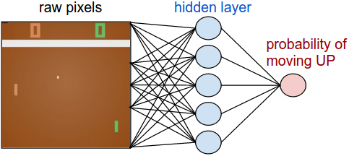
REINFORCE In Action
Pong from Pixels
Image Credit: http://karpathy.github.io/2016/05/31/rl/

Slide 74
REINFORCE In Action
Image Credit: http://karpathy.github.io/2016/05/31/rl/

Slide 75
REINFORCE in action: Recurrent Attention Model (RAM)
Objective: Image Classification
Take a sequence of “glimpses” selectively focusing on regions of the image, to predict class
Inspiration from human perception and eye movements
Saves computational resources => scalability
Able to ignore clutter / irrelevant parts of image
State: Glimpses seen so far
Action: (x,y) coordinates (center of glimpse) of where to look next in image
Reward: 1 at the final timestep if image correctly classified, 0 otherwise
glimpse
[Mnih et al. 2014]
Slide Credit: Fei-Fei Li, Justin Johnson, Serena Yeung, CS 231n
Notes:
Selectively focus on parts of the image, build up information as you look around

Slide 76
REINFORCE in action: Recurrent Attention Model (RAM)
Objective: Image Classification
Take a sequence of “glimpses” selectively focusing on regions of the image, to predict class
Inspiration from human perception and eye movements
Saves computational resources => scalability
Able to ignore clutter / irrelevant parts of image
State: Glimpses seen so far
Action: (x,y) coordinates (center of glimpse) of where to look next in image
Reward: 1 at the final timestep if image correctly classified, 0 otherwise
glimpse
Glimpsing is a non-differentiable operation => learn policy for how to take glimpse actions using REINFORCE
Given state of glimpses seen so far, use RNN to model the state and output next action
[Mnih et al. 2014]
Slide Credit: Fei-Fei Li, Justin Johnson, Serena Yeung, CS 231n
Notes:
Selectively focus on parts of the image, build up information as you look around

Slide 77
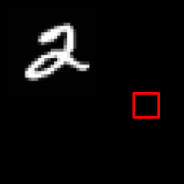
REINFORCE in action: Recurrent Attention Model (RAM)
(x₁, y₁)
Input image
NN
[Mnih et al. 2014]
Slide Credit: Fei-Fei Li, Justin Johnson, Serena Yeung, CS 231n

Slide 78
REINFORCE in action: Recurrent Attention Model (RAM)
(x₁, y₁)
(x₂, y₂)
Input image
NN
NN
[Mnih et al. 2014]
Slide Credit: Fei-Fei Li, Justin Johnson, Serena Yeung, CS 231n

Slide 79
REINFORCE in action: Recurrent Attention Model (RAM)
(x₁, y₁)
(x₂, y₂)
(x₃, y₃)
Input image
NN
NN
NN
[Mnih et al. 2014]
Slide Credit: Fei-Fei Li, Justin Johnson, Serena Yeung, CS 231n

Slide 80
REINFORCE in action: Recurrent Attention Model (RAM)
(x₁, y₁)
(x₂, y₂)
(x₃, y₃)
(x₄, y₄)
Input image
NN
NN
NN
NN
[Mnih et al. 2014]
Slide Credit: Fei-Fei Li, Justin Johnson, Serena Yeung, CS 231n

Slide 81
REINFORCE in action: Recurrent Attention Model (RAM)
(x₁, y₁)
(x₂, y₂)
(x₃, y₃)
(x₄, y₄)
(x₅, y₅)
Softmax
Input image
NN
y=2
NN
NN
NN
NN
[Mnih et al. 2014]
Slide Credit: Fei-Fei Li, Justin Johnson, Serena Yeung, CS 231n

Slide 82
What’s wrong with policy gradients?
$$∇_{θ}J\left(θ\right)≈\sum_{n}{\sum_{ s_{i},a_{i} ∈τ_{n}}{∇_{θ}\log{π\left(a_{i} | s_{i};θ\right)}}r(τ_{n})}$$
High variance! Trajectories are long samples.
Rewards are often sparse and for the whole trajectory.

Slide 83
Reducing Variance
Causality:
Policy at time $t^{′}$can’t affect rewards at time $t<t^{′}$
$$∇_{θ}J\left(θ\right)≈\sum_{n}{\sum_{ s_{i},a_{i} ∈τ_{n}}{∇_{θ}\log{π\left(a_{i} | s_{i};θ\right)}}r(τ_{n})}$$
$$∇_{θ}J′\left(θ\right)≈\sum_{n}{\sum_{ s_{i},a_{i} ∈τ_{n}}{∇_{θ}\log{π\left(a_{i} | s_{i};θ\right)}}\left(\sum_{t=i}{γ^{i−t}r\left(s_{t},a_{t}\right)}\right)}$$
Slides Credit: Sergey Levine

Slide 84
Reducing Variance
Baselines:
What happens if the reward of “good samples” is negative?

Slide 85
Reducing Variance
Baselines:
What if the variance in reward is huge?
$$∇_{θ}J\left(θ\right)≈\sum_{n}{\sum_{ s_{i},a_{i} ∈τ_{n}}{∇_{θ}\log{π\left(a_{i} | s_{i};θ\right)}}r(τ_{n})}$$
-0.01
1000

Slide 86
Reducing Variance
Baselines:
$$∇_{θ}J\left(θ\right)≈\sum_{n}{\sum_{ s_{i},a_{i} ∈τ_{n}}{∇_{θ}\log{π\left(a_{i} | s_{i};θ\right)}}\left[r\left(τ_{n}\right)−b\right]}$$
Baseline
$$b=\frac{1}{N}\sum{r(τ)}$$
Average reward:
Are we allowed to do this? Still solving the same problem?
Unbiased in Expectation!
Slides Credit: Sergey Levine

Slide 87
Policy Gradient Methods
REINFORCE Recap:
Simple algorithm that formalizes the notion ”repeat actions that lead to high rewards, avoid actions that lead to low rewards”. The approach is model-free. Big problems are with variance of the estimate, applying causality and baselines can help.
When to use this?
When reward functions are well-defined and simulation is cheap.
If you don’t have time to implement the next thing we will talk about.

Slide 88
Policy-Based RL Actor-Critic Methods

Slide 89
REINFORCE Algorithm
(Williams, 1992)
REINFORCE Algorithm
(Williams, 1992)
While not converged:
Perform rollout to collect trajectory $τ=(s_{0}, a_{0}, s_{1},a_{1},s_{2},…)$ and reward $r\left(τ\right)$
Compute gradient estimate $∇_{θ}J\left(θ\right)≈\sum_{n}{\sum_{ s_{i},a_{i} ∈τ_{n}}{∇_{θ}\log{π\left(a_{i} | s_{i};θ\right)}}r(τ_{n})}$
Update policy parameters $θ^{′}=θ+{α∇}_{θ} J\left(θ\right)$

Slide 90
Actor-Critic Methods
Causality:
$$∇_{θ}J\left(θ\right)≈\sum_{n}{\sum_{ s_{i},a_{i} ∈τ_{n}}{∇_{θ}\log{π\left(a_{i} | s_{i};θ\right)}}\left(\sum_{t=i}{γ^{i−t}r\left(s_{t},a_{t}\right)}\right)}$$
“reward from here”
Better estimate of expected rewards from a state-action pair?
$$Q_{π}\left(s_{t},a_{t}\right)=r\left(s_{t}, a_{t}\right)+ γ𝔼_{s_{t+1}\sim ℙ}\left[V_{π}(s_{t+1})\right]$$
Slides Credit: Sergey Levine

Slide 91
Actor-Critic Methods
$$∇_{θ}J\left(θ\right)≈\sum_{n}{\sum_{ s_{i},a_{i} ∈τ_{n}}{∇_{θ}\log{π\left(a_{i} | s_{i};θ\right)}}\left(Q_{π}\left(s_{t},a_{t}\right)\right)}$$
What about a baseline?
$$V_{π}\left(s_{t}\right)= 𝔼_{π}\left[\sum_{i=t}{γ^{i−t}}r(s_{i},a_{i})\right]$$
Advantage:
$$A_{π}\left(s_{t}, a_{t}\right)= Q_{π}\left(s_{t},a_{t}\right) −V_{π}\left(s_{t}\right)$$
How much better than average is this action?

Slide 92
Actor-Critic Methods
$$∇_{θ}J\left(θ\right)≈\sum_{n}{\sum_{ s_{i},a_{i} ∈τ_{n}}{∇_{θ}\log{π\left(a_{i} | s_{i};θ\right)}}\left(A_{π}\left(s_{t},a_{t}\right)\right)}$$
$$Q_{π}\left(s_{t},a_{t}\right)$$
$$A_{π}\left(s_{t}, a_{t}\right)=r\left(s_{t}, a_{t}\right)+ γV_{π}(s_{t+1})−V_{π}(s_{t})$$
$$A_{π}\left(s_{t}, a_{t}\right)=r\left(s_{t}, a_{t}\right)+ γ𝔼_{s_{t+1}\sim ℙ}\left[V_{π}(s_{t+1})\right]−V_{π}(s_{t})$$
Just need to estimate the value function! Let’s throw a neural network at it!

Slide 93
Actor-Critic Methods
$$π(a_{t}|s_{t})$$
$$\hat{V} (s_{t})$$
Agent
Agent predicts both action probabilities and value estimates
$$s_{t}$$

Slide 94
Actor-Critic Methods
$$π(a_{t}|s_{t})$$
$$\hat{V} (s_{t})$$
Gradient step for parameters with respect to policy parameters:
$$∇_{θ}J\left(θ\right)≈\sum_{n}{\sum_{ s_{i},a_{i} ∈τ_{n}}{∇_{θ}\log{π\left(a_{i} | s_{i};θ\right)}}\left({\hat{A}}_{π}\left(s_{t},a_{t}\right)\right)}$$
Agent
How to train the value estimator?
$$ℒ_{V}\left(θ\right)={\left\|\hat{V} \left(s_{t}\right)−V_{π}^{∗}\left(s_{t}\right)\right\|}^{2}$$
$$s_{t}$$
$$V_{π}^{∗}\left(s_{t}\right)= 𝔼_{π}\left[\sum_{i=t}{γ^{i−t}}r(s_{i},a_{i})\right]≈ \sum_{n}{\sum_{i=t}{γ^{i−t}}r(s_{i},a_{i})}$$

Slide 95
Actor-Critic Methods
$$π(a_{t}|s_{t})$$
$$\hat{V} (s_{t})$$
Gradient step for parameters with respect to policy parameters:
$$∇_{θ}J\left(θ\right)≈\sum_{n}{\sum_{ s_{i},a_{i} ∈τ_{n}}{∇_{θ}\log{π\left(a_{i} | s_{i};θ\right)}}\left({\hat{A}}_{π}\left(s_{t},a_{t}\right)\right)}$$
Agent
How to train the value estimator?
$$ℒ_{V}\left(θ\right)={\left\|\hat{V} \left(s_{t}\right)−\sum_{i=t}{γ^{i−t}}r(s_{i},a_{i})\right\|}^{2}$$
$$s_{t}$$
$$V_{π}^{∗}\left(s_{t}\right)= 𝔼_{π}\left[\sum_{i=t}{γ^{i−t}}r(s_{i},a_{i})\right]≈ \sum_{n}{\sum_{i=t}{γ^{i−t}}r(s_{i},a_{i})}$$
Just supervised regression with data $\left\{{ s}_{t}, \sum_{i=t}{γ^{i−t}}r\left(s_{i},a_{i}\right) \right\}$

Slide 96
Actor-Critic Methods
Advantage Actor-Critic (A2C) Algorithm
While not converged:
Perform rollout to collect trajectory $τ=(s_{0}, a_{0}, s_{1},a_{1},s_{2},…)$ and reward $r\left(τ\right)$
Fit ${\hat{V}}_{π}\left(s\right)$ to sampled rewards
Evaluate ${\hat{A}}_{π}\left(s_{t}, a_{t}\right)=r\left(s_{t}, a_{t}\right)+{\hat{V}}_{π}(s_{t+1})−{\hat{V}}_{π}(s_{t})$
Compute gradient estimate $∇_{θ}J\left(θ\right)≈\sum_{n}{\sum_{ s_{i},a_{i} ∈τ_{n}}{∇_{θ}\log{π\left(a_{i} | s_{i};θ\right)}}{\hat{A}}_{π}\left(s_{t}, a_{t}\right)}$
Update policy parameters $θ^{′}=θ+{α∇}_{θ} J\left(θ\right)$

Slide 97
Actor-Critic Methods – Bootstrap Targets / Temporal Differences
$$π(a_{t}|s_{t})$$
$$\hat{V} (s_{t})$$
$$ℒ_{V}\left(θ\right)={\left\|\hat{V} \left(s_{t}\right)−V_{π}^{∗}\left(s_{t}\right)\right\|}^{2}$$
Agent
$$V_{π}^{∗}\left(s_{t}\right)= 𝔼_{π}\left[\sum_{i=t}{γ^{i−t}}r(s_{i},a_{i})\right]≈ \sum_{n}{\sum_{i=t}{γ^{i−t}}r(s_{i},a_{i})}$$
$$ℒ_{V}\left(θ\right)={\left\|\hat{V} \left(s_{t}\right)−\sum_{i=t}{γ^{i−t}}r(s_{i},a_{i})\right\|}^{2}$$
$$s_{t}$$
high variance!

Slide 98
Actor-Critic Methods – Bootstrap Targets / Temporal Differences
Bootstrap target:
$$π(a_{t}|s_{t})$$
$$\hat{V} (s_{t})$$
$$ℒ_{V}\left(θ\right)={\left\|\hat{V} \left(s_{t}\right)−V_{π}^{∗}\left(s_{t}\right)\right\|}^{2}$$
Agent
$$V_{π}^{∗}\left(s_{t}\right)=𝔼_{π}\left[r\left(s_{t}, a_{t}\right)+γV_{π}^{∗}\left(s_{t+1}\right)\right]$$
Monte Carlo
$$≈r\left(s_{t}, a_{t}\right)+γV_{π}^{∗}\left(s_{t+1}\right)$$
Value Estimate
$$≈r\left(s_{t}, a_{t}\right)+γ{\hat{V}}_{π}\left(s_{t+1}\right)$$
$$s_{t}$$
”biased bootstrap estimate”
This is a temporal difference target. Biased but lower variance.

Slide 99
Actor-Critic Methods – Bootstrap Targets / Temporal Differences
$$π(a_{t}|s_{t})$$
$$\hat{V} (s_{t})$$
Bootstrap target:
$$ℒ_{V}\left(θ\right)={\left\|\hat{V} \left(s_{t}\right)−\left[r\left(s_{t}, a_{t}\right)+γ{\hat{V}}_{π}\left(s_{t+1}\right)\right]\right\|}^{2}$$
Agent
$$V_{π}^{∗}\left(s_{t}\right)=𝔼_{π}\left[r\left(s_{t}, a_{t}\right)+γV_{π}^{∗}\left(s_{t+1}\right)\right]$$
$$≈r\left(s_{t}, a_{t}\right)+γ{\hat{V}}_{π}\left(s_{t+1}\right)$$
$$s_{t}$$
”biased bootstrap estimate”
Just supervised regression with data $\left\{{ s}_{t}, r\left(s_{i},a_{i}\right)+γ{\hat{V}}_{π}\left(s_{i+1}\right)\right\}$

Slide 100
Actor-Critic Methods – Bootstrap Targets / Temporal Differences
$$ℒ_{V}\left(θ\right)={\left\|\hat{V} \left(s_{t}\right)−\left[r\left(s_{t}, a_{t}\right)+γ{\hat{V}}_{π}\left(s_{t+1}\right)\right]\right\|}^{2}$$
Temporal Differences (TD)
$$n=1$$
$$n=2$$
$$\hat{V} \left(s_{t}\right)$$
$$\hat{V} \left(s_{t}\right)$$
$$r\left(s_{i}, a_{i}\right)$$
$$r\left(s_{t}, a_{t}\right)$$
$${γ\hat{V}}_{π}\left(s_{i+1}\right)$$
`
`
$$γr\left(s_{t+1}, a_{t+1}\right)$$
$${γ^{2}\hat{V}}_{π}\left(s_{i+2}\right)$$
`

Slide 101
Actor-Critic Methods – Bootstrap Targets / Temporal Differences
$$ℒ_{V}\left(θ\right)={\left\|\hat{V} \left(s_{t}\right)−\left[r\left(s_{t}, a_{t}\right)+γr\left(s_{t}, a_{t}\right)+γ^{2}{\hat{V}}_{π}\left(s_{t+1}\right)\right]\right\|}^{2}$$
Temporal Differences (TD)
$$n=1$$
$$n=2$$
$$n=3$$
$$n=T$$
$$\hat{V} \left(s_{t}\right)$$
$$\hat{V} \left(s_{t}\right)$$
…
$$\hat{V} \left(s_{t}\right)$$
$$r\left(s_{i}, a_{i}\right)$$
$$r\left(s_{t}, a_{t}\right)$$
$${γ\hat{V}}_{π}\left(s_{i+1}\right)$$
`
`
`
`
$$γr\left(s_{t+1}, a_{t+1}\right)$$
$$\sum_{i=t}{γ^{i−t}}r(s_{i},a_{i})$$
$${γ^{2}\hat{V}}_{π}\left(s_{i+2}\right)$$
`
`
`
`
`

Slide 102
Actor-Critic Methods – Bootstrap Targets / Temporal Differences
$$ℒ_{V}\left(θ\right)={\left\|\hat{V} \left(s_{t}\right)−\left[r\left(s_{t}, a_{t}\right)+γr\left(s_{t}, a_{t}\right)+γ^{2}{\hat{V}}_{π}\left(s_{t+1}\right)\right]\right\|}^{2}$$
Temporal Differences (TD)
$$n=1$$
$$n=2$$
$$n=3$$
$$n=T$$
$$\hat{V} \left(s_{t}\right)$$
$$\hat{V} \left(s_{t}\right)$$
…
$$\hat{V} \left(s_{t}\right)$$
More generally, let $ℒ_{V}^{n}\left(θ\right)$ be
$$ℒ_{V}^{n}\left(θ\right)={\left\|\hat{V} \left(s_{t}\right)−\left[\sum_{i=t}^{n−1}{γ^{i−t}r(s_{i},a_{i})}+γ^{n}{\hat{V}}_{π}\left(s_{n}\right)\right]\right\|}^{2}$$
$$r\left(s_{i}, a_{i}\right)$$
$$r\left(s_{t}, a_{t}\right)$$
$${γ\hat{V}}_{π}\left(s_{i+1}\right)$$
`
`
`
`
$$γr\left(s_{t+1}, a_{t+1}\right)$$
$$\sum_{i=t}{γ^{i−t}}r(s_{i},a_{i})$$
$${γ^{2}\hat{V}}_{π}\left(s_{i+2}\right)$$
`
`
`
`
`

Slide 103
Policy Gradient Methods
Actor-Critic Recap:
Policy gradient method that trades off variance for bias in gradient estimates by using a simultaneously learned value function. With clever choices of baselines, we repeat actions that are better than average and avoid those that are worse (through advantage estimate).
Bonus Concept: Temporal differences can provide targets for value functions with different bias and variance.
When to use this?
When reward functions are well-defined and simulation is cheap.
Any time you are doing policy gradients, might as well do this.

Slide 104
Policy Gradient Methods
EMERGENT TOOL USE FROM MULTI-AGENT AUTOCURRICULA, 2019
https://openai.com/blog/emergent-tool-use/

Slide 105
Value-Based RL Deep Q-Learning

Slide 106
Value-Based RL – Deep Q-Learning
Earlier today….
1. If we have a policy $π$ and know the true $Q_{π}\left(s,a\right)$ -- can we derive a new policy $π′$ that is as good or better than $π$?
Recall that $Q_{π}\left(s,a\right)$ is the expected reward of taking action a in state s
Set $π\left(a′ | s\right)=1$ if $a′=argmax{\hat{Q}}_{π}\left(s,a\right)$
If we can estimate $Q_{π}\left(s,a\right)$ why do we even need an explicit policy?

Slide 107
Value-Based RL – Deep Q-Learning
If we can estimate $Q_{π}^{∗}\left(s,a\right)$ why do we even need an explicit policy?
$$ℒ_{Q}\left(θ\right)={\left\|{\hat{Q}}_{π}\left(s_{t},a_{t}\right)−Q_{π}^{∗}\left(s_{t},a_{t}\right)\right\|}^{2}$$
$${\hat{Q}}_{π} (s_{t})$$
$$Q_{π}^{∗}\left(s_{t}\right)=r\left(s_{t}, a_{t}\right)+γV_{π}^{∗}(s_{t+1})$$
Deep
Net
Recall our implicit policy is $a′=argmax{ Q}_{π}\left(s,a\right)$
$V_{π}^{∗}\left(s_{t}\right)=𝔼_{π}\left[Q_{π}^{∗}(s_{t},a_{t})\right]=\max_{a}{Q_{π}^{∗}(s_{t},a_{t})}$
$$s_{t}$$
$$ℒ_{Q}\left(θ\right)≈{\left\|{\hat{Q}}_{π}\left(s_{t},a_{t}\right)−\left[r\left(s_{t}, a_{t}\right)+\max_{a}{{\hat{Q}}_{π}(s_{t+1},a_{t+1})}\right]\right\|}^{2}$$

Slide 108
Value-Based RL – Deep Q-Learning
Simplest DQN Algorithm
While not converged:
Perform rollout to collect trajectory $τ=(s_{0}, a_{0}, s_{1},a_{1},s_{2},…)$ and reward $r\left(τ\right)$
Compute loss from samples $ℒ_{Q}\left(θ\right)≈{\left\|{\hat{Q}}_{π}\left(s_{t},a_{t}\right)−\left[r\left(s_{t}, a_{t}\right)+\max_{a}{{\hat{Q}}_{π}(s_{t+1},a_{t+1})}\right]\right\|}^{2}$
Update Q-network parameters $θ^{′}=θ+{α∇}_{θ}ℒ_{Q}\left(θ\right)$ with gradient decent

Slide 109
Value-Based RL – Deep Q-Learning
Weaknesses in our Simple DQN:
Limited exploration:
Perform rollout to collect trajectory $τ=(s_{0}, a_{0}, s_{1},a_{1},s_{2},…)$ and reward $r\left(τ\right)$
Recall our implicit policy $π_{θ}$ is $a′=argmax{ Q}_{π_{θ}}\left(s,a\right)$
10
0
0
0
S
1
1
1
1
1
$$ℒ_{Q}\left(θ\right)≈{\left\|{\hat{Q}}_{π}\left(s_{t},a_{t}\right)−\left[r\left(s_{t}, a_{t}\right)+\max_{a}{{\hat{Q}}_{π} (s_{t+1},a_{t+1})}\right]\right\|}^{2}$$

Slide 110
Value-Based RL – Deep Q-Learning
$ε$-greedy policy:
$${π_{ε}(s}_{t})=\left\{\begin{matrix}argmax_{a} {\hat{Q}}_{π_{θ} }\left(s_{t}, a\right) & with probability ϵ \\ \sim uniform over A & with probabiliy 1−ϵ\end{matrix}\right.$$

Slide 111
Value-Based RL – Deep Q-Learning
Off-policy DQN:
While not converged:
Rollout $π_{ε}$to collect trajectory $τ=(s_{0}, a_{0}, s_{1},a_{1},s_{2},…)$ and reward $r\left(τ\right)$
Compute loss from samples $ℒ_{Q}\left(θ\right)≈{\left\|{\hat{Q}}_{π_{θ}}\left(s_{t},a_{t}\right)−\left[r\left(s_{t}, a_{t}\right)+\max_{a}{{\hat{Q}}_{π_{θ}}(s_{t+1},a_{t+1})}\right]\right\|}^{2}$
Update Q-network parameters $θ^{′}=θ+{α∇}_{θ}ℒ_{Q}\left(θ\right)$ with gradient decent
Exploration policy is $π_{ε}$, but we evaluate based on $π_{θ}$
On-policy: Exploration policy == evaluation policy
Off-policy: Exploration policy != evaluation policy

Slide 112
Value-Based RL – Deep Q-Learning
$ε$-greedy vs. argmax:
Consider the cliff-walking game:
-1
-1
-1
-1
-1
-1
-1
-1
-1
-1
-1
-1
-1
-1
-1
-1
-1
-1
-1
-1
10
-100
-100
-100
-100
-100
-100
-100
-100
Goal

Slide 113
Value-Based RL – Deep Q-Learning
Weaknesses in our Simple DQN:
Examples in a trajectory are correlated
$τ=(s_{0}, a_{0}, r_{0}, s_{1},a_{1},r_{1}, s_{2},a_{2}, r_{2},…)$
…
Gradient updates are highly correlated and can lead to oscillation.

Slide 114
Value-Based RL – Deep Q-Learning
Experience Replay:
Idea: collect a buffer of trajectories and then randomly sample transitions to perform our update
$${Replay Buffer= \left\{\left(s_{t}^{j}, a_{t}^{j}, r_{t}^{j}, s_{t+1}^{j}\right)\right\}}_{j}$$
$$batch \sim Replay Buffer$$

Slide 115
Value-Based RL – Deep Q-Learning
Off-policy DQN with Experience Replay:
While not converged:
Rollout $π_{ε}$to collect trajectory $τ=(s_{0}, a_{0}, s_{1},a_{1},s_{2},…)$ and reward $r\left(τ\right)$
Store transitions $(s_{t}, a_{t}, r_{t}, s_{t+1})$ in replay buffer $B$
Sample $N$ transitions from $B$ and compute $ℒ_{Q}\left(θ\right)≈\sum_{n=1}^{N}{{\left\|{\hat{Q}}_{π_{θ}}\left(s_{t}^{n},a_{t}^{n}\right)−\left[r\left(s_{t}^{n}, a_{t}^{n}\right)+\max_{a}{{\hat{Q}}_{π_{θ}}(s_{t+1}^{n},a_{t+1}^{n})}\right]\right\|}^{2}}$
Update Q-network parameters $θ^{′}=θ+{α∇}_{θ}ℒ_{Q}\left(θ\right)$ with gradient decent
Tends to be more sample efficient than policy-gradient methods because transitions are valid targets forever.

Slide 116
Value-Based RL – Deep Q-Learning
Weaknesses in our Simple DQN:
Chasing a non-stationary target:
$$ℒ_{Q}\left(θ\right)≈\sum_{n=1}^{N}{{\left\|{\hat{Q}}_{π_{θ}}\left(s_{t}^{n},a_{t}^{n}\right)−\left[r\left(s_{t}^{n}, a_{t}^{n}\right)+\max_{a}{{\hat{Q}}_{π_{θ}}(s_{t+1}^{n},a_{t+1}^{n})}\right]\right\|}^{2}}$$
Same network producing both.
Each update changes the targets.

Slide 117
Value-Based RL – Deep Q-Learning
Target networks:
Idea: Keep an old version of parameters around to estimate targets
Fixed Target Network
$${\hat{Q}}_{π} (s_{t};θ)$$
$${\hat{Q}}_{π} (s_{t};θ_{old})$$
Deep
Net
$$ℒ_{Q}\left(θ\right)≈\sum_{n=1}^{N}{{\left\|{\hat{Q}}_{π_{θ}}\left(s_{t}^{n},a_{t}^{n}\right)−\left[r\left(s_{t}^{n}, a_{t}^{n}\right)+\max_{a}{{\hat{Q}}_{π_{θ}}(s_{t+1}^{n},a_{t+1}^{n})}\right]\right\|}^{2}}$$
Deep
Net (copy)
Re-copy the target network weights periodically.
$$s_{t}$$
$$s_{t}$$

Slide 118
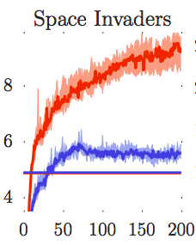
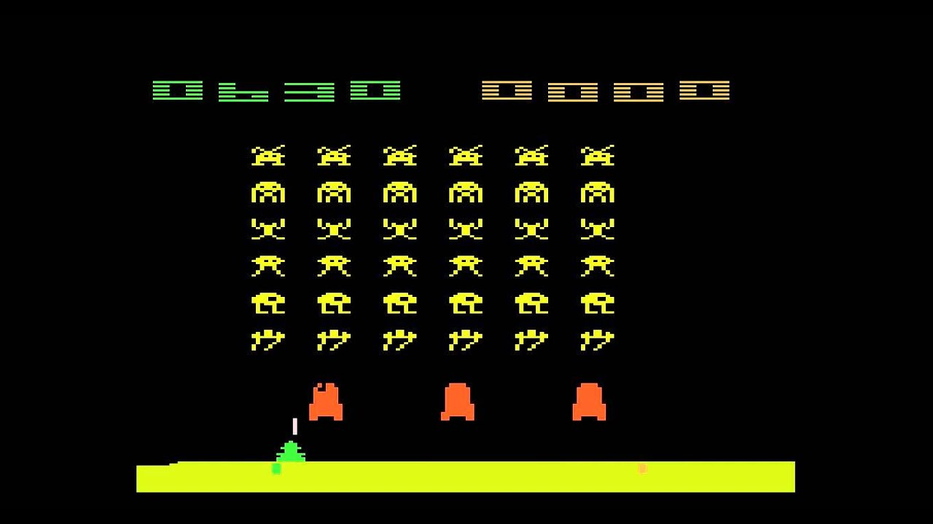
Value-Based RL – Double Q-Learning
Weaknesses in DQN:
Tends to overestimates action values:
$$ℒ_{Q}\left(θ\right)≈{\left\|{\hat{Q}}_{π}\left(s_{t},a_{t}\right)−\left[r\left(s_{t}, a_{t}\right)+\max_{a}{Q_{π}^{∗}(s_{t+1},a_{t+1})}\right]\right\|}^{2}$$
DQN Estimate
DQN True Value

Slide 119
Value-Based RL – Deep Q-Learning
Deep Q-Learning:
Assume an implicit greedy policy and just learn its action-value function. The approach is model-free and fairly general but does require some tricks to overcome a few problems during training.
Bonus Concept: Experience replay to reduce correlation in examples is broadly applicable.
When to use this?
When reward functions are well-defined but rollouts are more expensive.
Worried about sample efficiency and have strong exploration policy.
… don’t mind trying to get it stable … which is a challenge sometimes

Slide 120
Model-based RL

Slide 121
Model-based RL
All the previous RL methods we discussed are model-free algorithms:
Action
Goal
?
Agent
Reward
Environment
Observation
If we can estimate a model$s_{t+1}\sim f\left( s_{t},a_{t}\right)$, can we be more efficient?

Slide 122
Model-based RL
If we can estimate a model $s_{t+1}\sim f\left( s_{t},a_{t}\right)$, can we be more efficient?
Dynamics are reward independent – changing reward function isn’t a problem!
Slides Credit: Sergey Levine

Slide 123
Model-based RL
Model-based Control Algorithm
Run base policy (possibly random or human) to collect samples
Fit a model $f\left( s_{t},a_{t}\right)$ using least squares or some other loss
Backprop through $f\left(s_{t},a_{t}\right)$ to optimize policy parameters
As with Behavior Cloning, we may suffer
from state distribution miss-match.
Slides Credit: Sergey Levine

Slide 124
Model-based RL
Model-based Control Algorithm (Iterative)
Run base policy (possibly random or human) to collect samples
While not converged:
Fit a model $f\left( s_{t},a_{t}\right)$ using least squares or some other loss
Backprop through $f\left( s_{t},a_{t}\right)$ to optimize policy parameters
Run this backprop derived policy and add samples to training set
Luckily, the world is an oracle with respect to the model! No need to worry about querying an expert.
Slides Credit: Sergey Levine

Slide 125
Model-based RL
Model Predictive Control Algorithm (Iterative)
Run base policy (possibly random or human) to collect samples
While not converged:
Fit a model $f\left( s_{t},a_{t}\right)$ using least squares or some other loss
Backprop through $f\left( s_{t},a_{t}\right)$ to optimize policy parameters
Run this backprop derived policy and add samples to training set
Take a step with this policy then refit based on current state
A bit expensive to run this optimization every step.
Slides Credit: Sergey Levine

Slide 126
Value-Based RL – Deep Q-Learning
Model-Based Reinforcement Learning from Pixels with Structured Latent Variable Models 2019
https://bair.berkeley.edu/blog/2019/05/20/solar/

Slide 127
Value-Based RL – Deep Q-Learning
Learning Latent Dynamics for Planning from Pixels 2019
https://planetrl.github.io

Slide 128
Model-based RL:
Model-based Recap:
Learn the dynamics model and then optimize for long-term rewards through it (aka plan!). Very sample efficient and can be self-supervised. Some initial work does it directly in pixel space (including goal specification).
When to use this?
When dynamics are unknown (e.g. physical systems) but modelable
Very worried about sample efficiency (e.g. robotics)
Want to transfer to different goals

Slide 129
Plan for Today – Deep Reinforcement Learning
Intro and Some Notation
Imitation Learning
Behavior Cloning
Direct Policy Learning
Sketch of Inverse Reinforcement Learning
Reinforcement Learning
Policy-based (REINFORCE, Actor-Critic)
Value-based (Q-Learning)
Model-based

Slide 130
Paper for this Module

Slide 131
Paper: Proximal Policy Optimization Algorithms

Slide 132
Paper: Proximal Policy Optimization Algorithms
Recall policy gradients:
$$∇_{θ}J\left(θ\right)=𝔼_{τ∼π_{θ}}\left[r(τ) ∇_{θ}log{p\left(τ;θ\right)}\right]$$
- Sample inefficient, each trajectory only good for one update.
Can we keep trajectories around?

Slide 133
Paper: Proximal Policy Optimization Algorithms
Importance Sampling
$$𝔼_{x\sim P}\left[f(x)\right]=𝔼_{x\sim Q}\left[\frac{P(x)}{Q(x)}f(x)\right]$$
$$∇_{θ}J\left(θ\right)=𝔼_{τ∼π_{θ_{old}}}\left[\frac{π(τ;θ)}{π(τ;θ_{old})}r(τ) ∇_{θ}log{p\left(τ;θ\right)}\right]$$

Slide 134
Paper: Proximal Policy Optimization Algorithms
$$∇_{θ}J\left(θ\right)=𝔼_{τ∼π_{θ_{old}}}\left[\frac{π(τ;θ)}{π(τ;θ_{old})}r(τ) ∇_{θ}log{p\left(τ;θ\right)}\right]$$
$$\frac{π(τ;θ)}{π(τ;θ_{old})}=\prod{\frac{π(a_{t}|s_{t};θ)}{π(a_{t}|s_{t};θ_{old})}}$$
Dangerous! Exploding / vanishing gradients.

