Slide 1
Instruction-guided Visual Navigation
Stefan Lee - Fall 2019

Slide 2
We were talking about Visual Navigation
Visual Navigation: Navigate from A to B in environment E using egocentric perception.
A
B

Slide 3
We’ve been talking about visual navigation
B
[10m,-2m]
lamp
A

Slide 4
We’ve been talking about visual navigation
B
[10m,-2m]
lamp
A

Slide 5
We’ve been talking about visual navigation
A
B

Slide 6
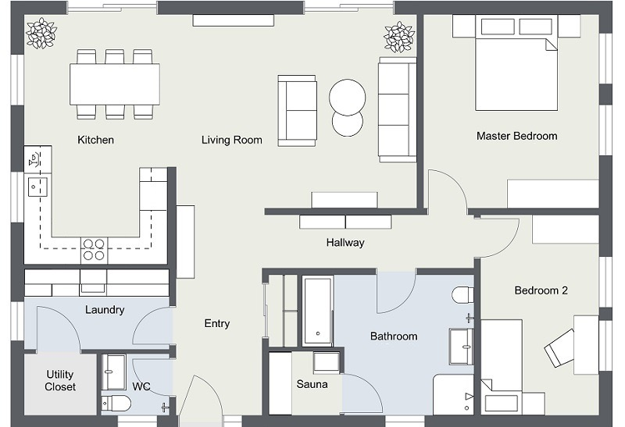
Instruction-guided Visual Navigation
A
B
Go left around the table along the back wall and turn right at the fireplace. Continue to the hallway and take a right. Take the first left into the bedroom and go to the right bedside table.

Slide 7
Instruction-guided Visual Navigation
A
B
Go left around the table along the back wall and turn right at the fireplace. Continue to the hallway and take a right. Take the first left into the bedroom and go to the right bedside table.
Head towards the kitchen and take a left after the table. Turn right and then immediate left to enter a hallway. Go to the bedroom on the left and stand to the right of the bed.

Slide 8
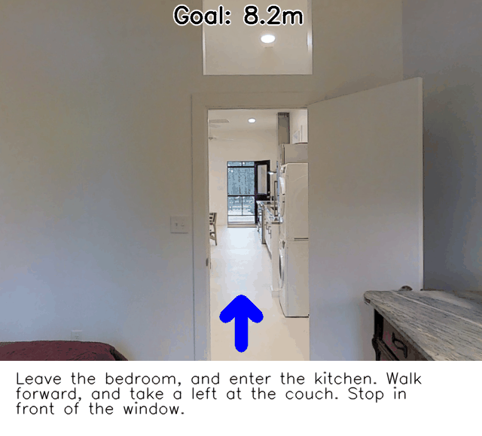
Instruction-guided Visual Navigation

Slide 9
Instruction-guided Visual Navigation
Major Settings
Vision-and-Language Navigation
Indoor environments from the Matterport3D dataset + human directions
Vision-and-Language Navigation: Interpreting visually-grounded navigation instructions in real environments arxiv.org/abs/1711.07280
StreetLearn
Google Street View + Google Maps directions
The StreetLearn Environment and Dataset arxiv.org/abs/1903.01292
Learning To Follow Directions in Street View arxiv.org/abs/1903.00401
Touchdown: Natural Language Navigation and Spatial Reasoning in Visual Street Environments arxiv.org/abs/1811.12354
LANI
Simulated quadcopter in an open environment with landmark objects
Mapping Navigation Instructions to Continuous Control Actions with Position-Visitation Prediction arxiv.org/abs/1811.04179

Slide 10
Vision-and-Language Navigation (VLN)
Matterport3D Simulator
Simulator based on Matterport3D dataset (Chang et. al. 2017)
Contains 10,800 panoramic images / 90 buildings
Example: matterport.com/3d-space/pennsylvania-craftsman-home/
Slide Credit: Peter Anderson

Slide 11
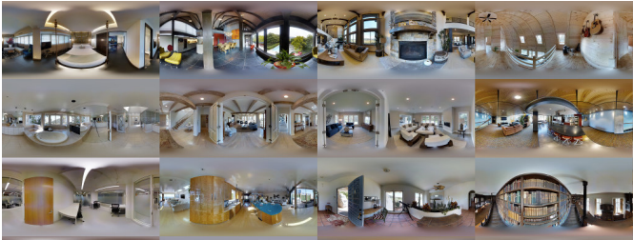
Vision-and-Language Navigation (VLN) – Room2Room Dataset

Slide 12
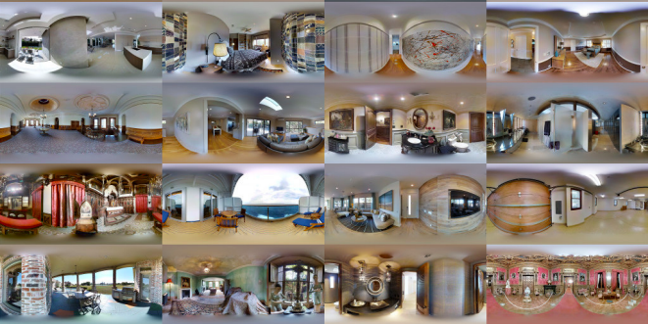
Vision-and-Language Navigation (VLN) – Room2Room Dataset

Slide 13
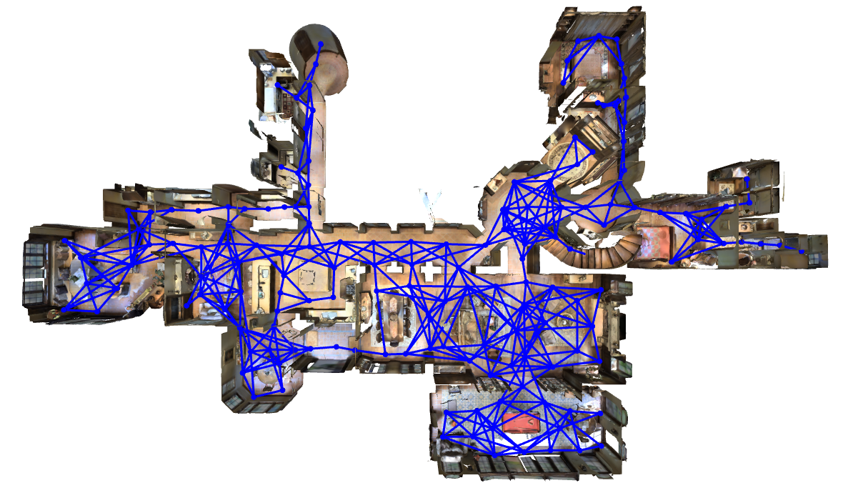
Vision-and-Language Navigation (VLN)
Matterport3D Simulator
Feasible trajectories determined by navigation graph
Slide Credit: Peter Anderson

Slide 14
Vision-and-Language Navigation (VLN) – Room2Room Dataset
Room2Room Dataset

Slide 15
Vision-and-Language Navigation (VLN) – Room2Room Dataset
Nodes
Panoramas
117 on average
Edges:
Checks for clear ray-trace between nodes in the full mesh
< 5 meters apart
Manual cleaning
Average degree 4.1

Slide 16
Vision-and-Language Navigation (VLN) – Room2Room Dataset
Nodes
Panoramas
117 on average
Edges:
Checks for clear ray-trace between nodes in the full mesh
< 5 meters apart
Manual cleaning
Average degree 4.1
Paths:
Two different rooms
> 5 meters paths
4-6 edges

Slide 17
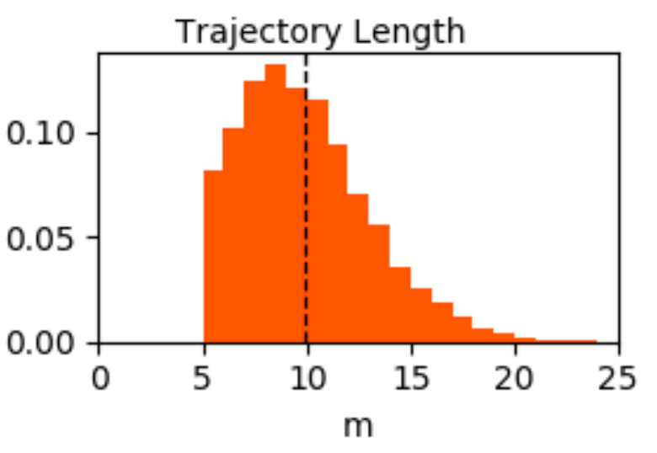
Vision-and-Language Navigation (VLN) – Room2Room Dataset
Nodes
Panoramas
117 on average
Edges:
Checks for clear ray-trace between nodes in the full mesh
< 5 meters apart
Manual cleaning
Average degree 4.1
Paths:
Two different rooms
> 5 meters paths
4-6 edges

Slide 18
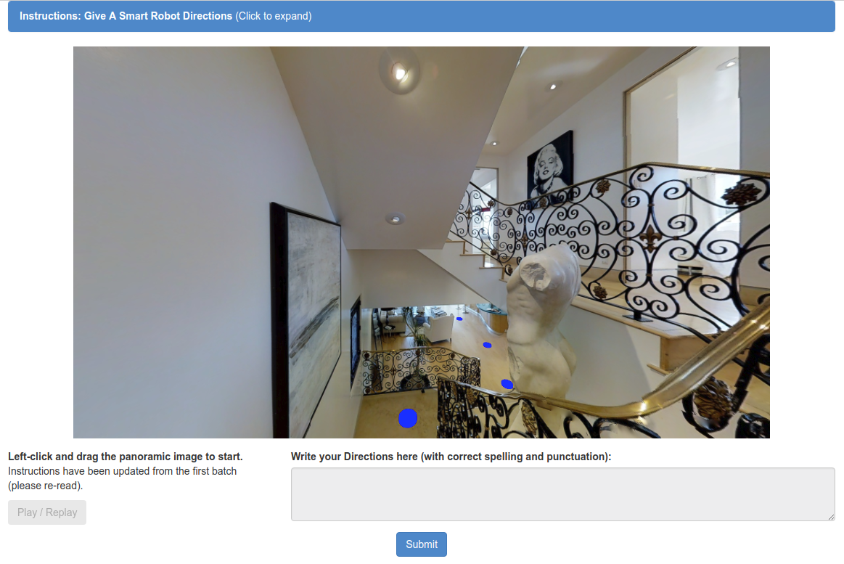
Vision-and-Language Navigation (VLN) – Room2Room Dataset
Annotation Task:
Given a fly-through and pan/tilt controls, give natural language instruction to get to goal
3 workers per trajectory
Amazon Mechanical Turk:
>400 US-based workers with strong HIT history
1600 hours of effort
21,567 instructions

Slide 19
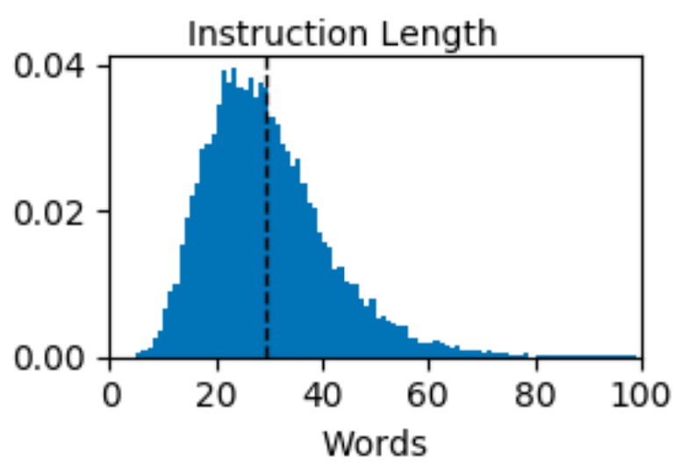
Vision-and-Language Navigation (VLN) – Room2Room Dataset
Annotation Task:
Given a fly-through and pan/tilt controls, give natural language instruction to get to goal
3 workers per trajectory
Amazon Mechanical Turk:
>400 US-based workers with strong HIT history
1600 hours of effort
21,567 instructions

Slide 20
Vision-and-Language Navigation (VLN) – Room2Room Dataset
Instruction for same trajectory:
Go past the ovens and the counter and wait just before you go outside.
Walk through the kitchen towards the living room. Walk around the island and step onto the patio near the two chairs and stop in the patio doorway.
Exit the kitchen by walking past the ovens and then head right, stopping just at the doorway leading to the patio outside.

Slide 21
Vision-and-Language Navigation (VLN) – Room2Room Dataset
Instruction for same trajectory:
Turn and enter the living room area. Go past the table and sofas and stop in the foyer in front of the front door.
Turn around and exit the room. Walk around the sofa and enter the hallway. Wait by the side table.
Exit the room through the doorway nearest you, and continue into the adjacent room, exiting the room via the exit to your left.

Slide 22
Vision-and-Language Navigation (VLN) – Room2Room Dataset
Instruction for same trajectory:
Walk along the insulated bare walls towards the window ahead in the next room. Walk through the unfinished room and through the door on the other side of the room that leads to a finished hallway. Walk into the first open door in the hall that leads to a bedroom with photo art on the wall near the entrance of classic black and white scenes.
Walk forward past the window then turn right and enter the hallway. Enter the first bedroom on your right. wait near the bed.
Walk forward and take a right. Enter the hallway through the door on the right. Take the first left into a bedroom. Stop once you are in the bedroom.

Slide 23
Vision-and-Language Navigation (VLN) -- Evaluation
Evaluation

Slide 24
Vision-and-Language Navigation (VLN) -- Evaluation
Original Metrics:
Trajectory Length (m)
Navigation Error (m)
Success (%)
Oracle Success (%)

Slide 25
Vision-and-Language Navigation (VLN) -- Evaluation
train
val-seen
val-unseen
test
61 Environments
11 Environments
18 Environments
14,025
Instructions
1020
Instructions
2349
Instructions
4173
Instructions
4675
Trajectories
340
Trajectories
783
Trajectories
1391
Trajectories

Slide 26
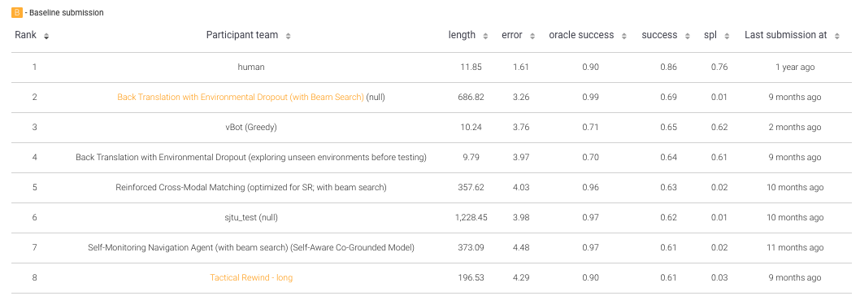
Vision-and-Language Navigation (VLN) -- Evaluation
Leaderboard hosted on EvalAI

Slide 27
Vision-and-Language Navigation (VLN) -- State and Action Space
State and Action Space

Slide 28
Vision-and-Language Navigation (VLN) -- State and Action Space
Agent
Egocentric camera
Actions:
Turn: left/right 30
Tilt: up/down 30
Forward (?)
Stop

Slide 29
Vision-and-Language Navigation (VLN) – Model and Training
Model and Training

Slide 30
Our Attentive Recurrent Agent – Context Attention
Recurrent
+ Context Attention
Context Encoder
RNN
$$a_{t}$$
Exit
$$h_{T}$$
$$c_{t}$$
FC
the
RNN
$$h_{T−1}$$
Attention
$${h′}_{t−1}$$
RNN
$${h′}_{t}$$
$$a_{t−1}$$
.
.
.
.
.
.
.
.
.
CNN
wait.
RNN
$$h_{0}$$
$$I_{t}$$

Slide 31
Vision-and-Language Navigation (VLN) -- State and Action Space
Teacher Forcing
Ignore agent action, continue on GT path
Just behavior cloning

Slide 32
Vision-and-Language Navigation (VLN) -- State and Action Space
Teacher Forcing
Ignore agent action, continue on GT path
Just behavior cloning

Slide 33
Vision-and-Language Navigation (VLN) -- State and Action Space
Teacher Forcing
Ignore agent action, continue on GT path
Just behavior cloning

Slide 34
Vision-and-Language Navigation (VLN) -- State and Action Space
Teacher Forcing
Ignore agent action, continue on GT path
Just behavior cloning

Slide 35
Vision-and-Language Navigation (VLN) -- State and Action Space
Teacher Forcing
Ignore agent action, continue on GT path
Just behavior cloning

Slide 36
Vision-and-Language Navigation (VLN) -- State and Action Space
Teacher Forcing
Ignore agent action, continue on GT path
Just behavior cloning
Student Forcing:
Agent acts, oracle is queried to find next step
Online DAGGER

Slide 37
Vision-and-Language Navigation (VLN) -- State and Action Space
Teacher Forcing
Ignore agent action, continue on GT path
Just behavior cloning
Student Forcing:
Agent acts, oracle is queried to find next step
Online DAGGER

Slide 38
Vision-and-Language Navigation (VLN) -- State and Action Space
Teacher Forcing
Ignore agent action, continue on GT path
Just behavior cloning
Student Forcing:
Agent acts according to its policy, oracle is queried to find next step back to path
Online DAGGER

Slide 39
Vision-and-Language Navigation (VLN) – Results
Results

Slide 40
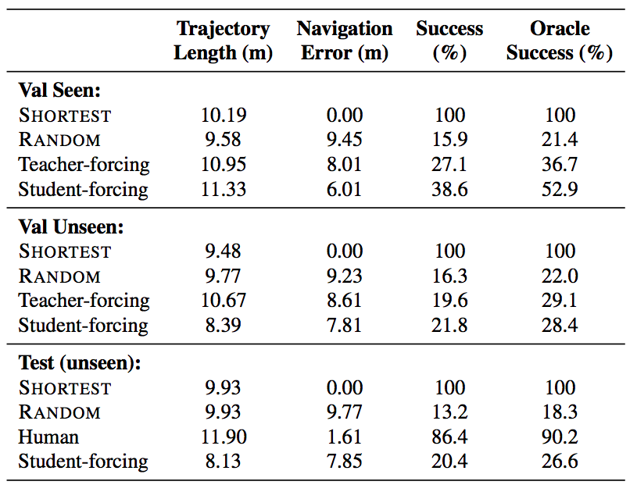
Vision-and-Language Navigation (VLN) – Results

Slide 41
Vision-and-Language Navigation (VLN) – Results
Important Follow-up Work

Slide 42
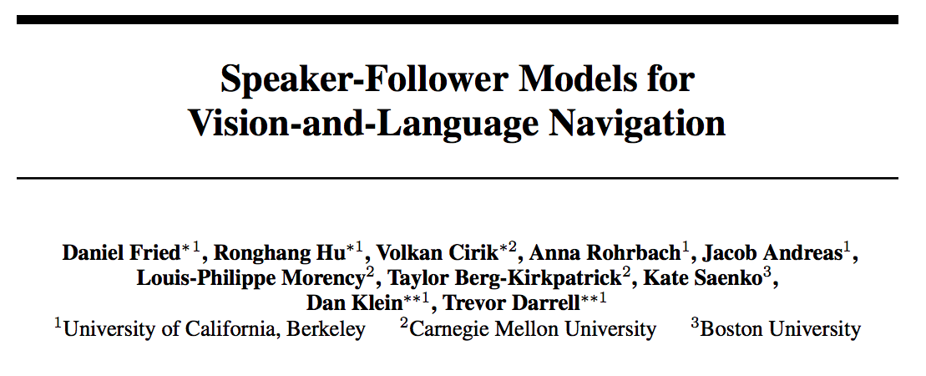
Vision-and-Language Navigation (VLN) – Important Follow-up Work

Slide 43
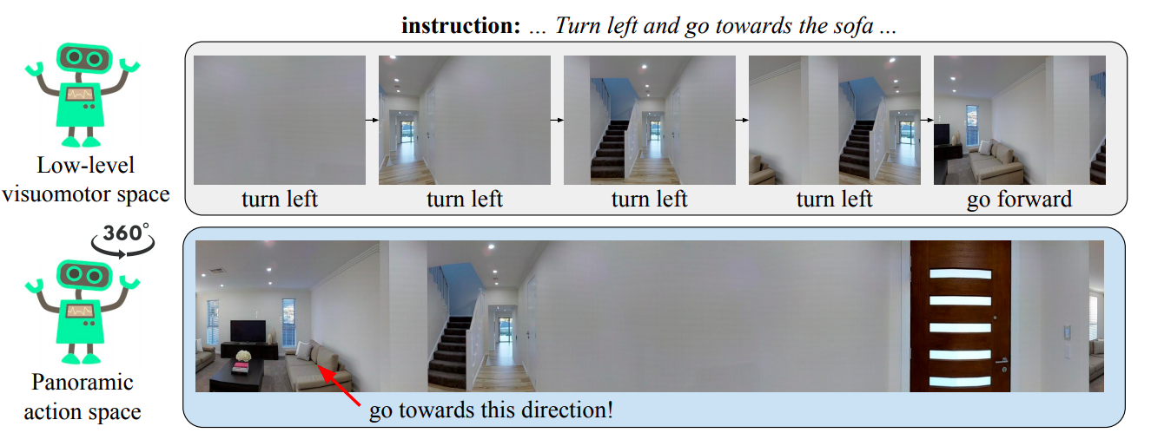
Vision-and-Language Navigation (VLN) – Important Follow-up Work

Slide 44
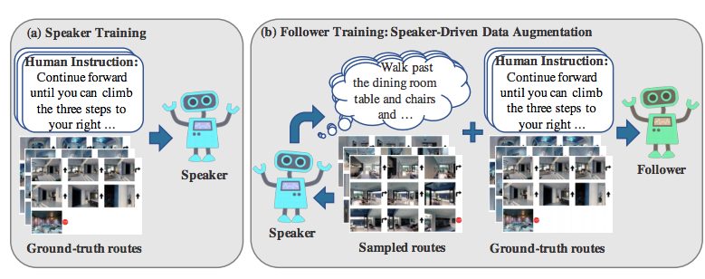
Vision-and-Language Navigation (VLN) – Important Follow-up Work

Slide 45
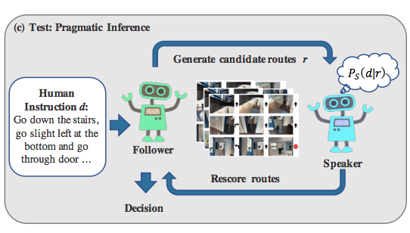
Vision-and-Language Navigation (VLN) – Important Follow-up Work

Slide 46
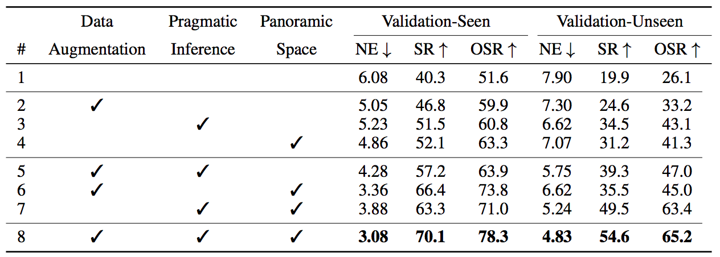
Vision-and-Language Navigation (VLN) – Important Follow-up Work

Slide 47
Vision-and-Language Navigation (VLN) – Important Follow-up Work

Slide 48
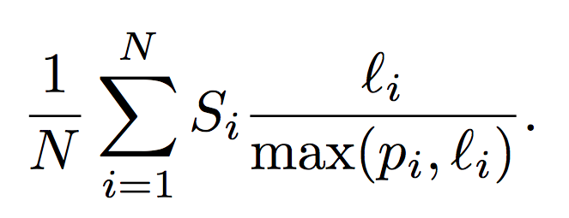
Vision-and-Language Navigation (VLN) – Important Follow-up Work
Success weighted by Path Length
Cares not only about success, but also efficiency
Binary Success
Shortest Path Length
Average Over Episodes
Agent Path Length

Slide 49
Instruction Guided Visual Navigation
Papers in this Module

Slide 50
Instruction Guided Visual Navigation (Readings)
Mapping Navigation Instructions to Continuous Control Actions with Position-Visitation Prediction
Reinforced Cross-Modal Matching and Self-Supervised Imitation Learning for Vision-Language Navigation
Vision-and-Dialog Navigation
Effective and General Evaluation for Instruction Conditioned Navigation using Dynamic Time Warping

Slide 51
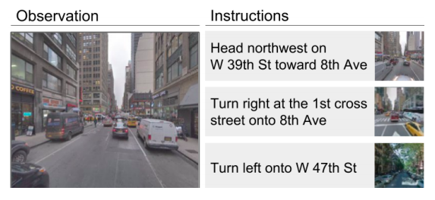
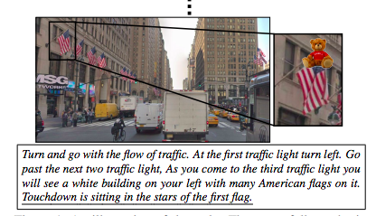
Instruction-guided Visual Navigation: StreetLearn
StreetLearn
Google Street View + Google Maps directions
The StreetLearn Environment and Dataset arxiv.org/abs/1903.01292
Learning To Follow Directions in Street View arxiv.org/abs/1903.00401
Touchdown: Natural Language Navigation and Spatial Reasoning in Visual Street Environments arxiv.org/abs/1811.12354

Slide 52
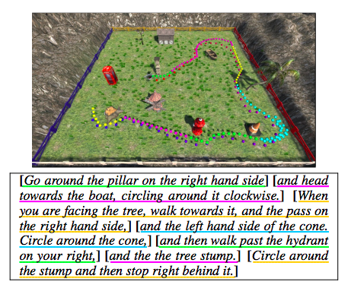
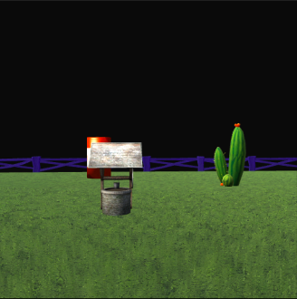
Instruction-guided Visual Navigation
LANI
Simulated quadcopter in an open environment with landmark objects
Mapping Instructions to Actions in 3D Environments with Visual Goal Prediction https://arxiv.org/abs/1809.00786
Mapping Navigation Instructions to Continuous Control Actions with Position-Visitation Prediction arxiv.org/abs/1811.04179

