Slide 1
Unsupervised Cross-Dataset Adaptation via Probabilistic Amodal 3D Human
Pose Completion
Jogendra N Kundu*, Rahul Venkatesh*, Jay Patravali*
R. Venkatesh Babu
* equal contribution
IEEE 2020 Winter Conference on Applications of Computer Vision
Notes:
ZHello everyone, My name is Jay. I am going to present “Unsupervised Cross-Dataset Adaptation via Probabilistic Amodal 3D Human Pose Completion”. A joint work with my colleagues at Indian Institute of Science. 15s

Slide 2
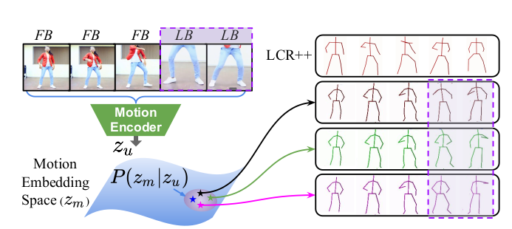
Motivation
Performance of 3D pose estimation approaches highly relies on availability of annotated training samples..
These approaches are prone to failure in presence of occlusions, view-point variations and camera motion. Secondly, performance does not generalize across in-the-wild datasets.
Prior works [14, 39] demonstrate good performance on pose estimation but are unable to handle uncertainty in natural videography.
In contrast to deterministic methods such as LCR++ [43], our probabilistic model generates multiple plausible pose sequences.
Rogez, et al. “Lcr-net++: Multi-person 2d and 3d pose detection in natural images”, CVPR 2017
Notes:
prior works on 3D pose estimation rely heavily on availability of labelled data and are also prone to failures in presence of uncertainty such as occlusions, view-point variations and camera motion. Secondly, performance does not generalize across in-the-wild datasets 19s

Slide 3
Our Approach - What’s new ?
We propose a novel probabilistic amodal pose completion framework to enable generation of multiple plausible pose-filling outcomes.
We realize cross-dataset transfer of motion representation to unconstrained and unannotated video-clips through effective use of self-supervision.
Notes:
We propose probabilistic amodal pose completion framework to generate plausible poses in presense of uncertainty and realize cross-dataset transfer of human motion representation across unlabelled video-clips through effective use of self-supervision. 17s

Slide 4
Train a view-invariant pose embedding
Disentangles difficulties of modeling global position, camera-view and joint-location with respect to a single pelvis root.
Notes:
It’s a three stage archictecture, in the first stage we learn an image to pose embedding

Slide 5
Random Unconstrained Video Augmentations
Simulate diverse natural videography found in in-the-wild videos by performing smooth scale, focus variations, time variations are also incorporated with fast and slow camera movements.
Notes:
To simulate natural videography found in in-the-wild videos we perform augmentations on our video data 9s

Slide 6
Probabilistic Video Motion embedding
Add random factor to Bi-LSTM feature embedding to model the uncertainty in partially visible frames.
Notes:
We have a video motion encoder decoder setup, in which we add to the motion encoding a random vector o handle uncertainty in partially visible frames 10s

Slide 7
Dataset Selection + Pretraining
Dataset chosen with maximum diversity and dynamics in human motion sequence

Slide 8
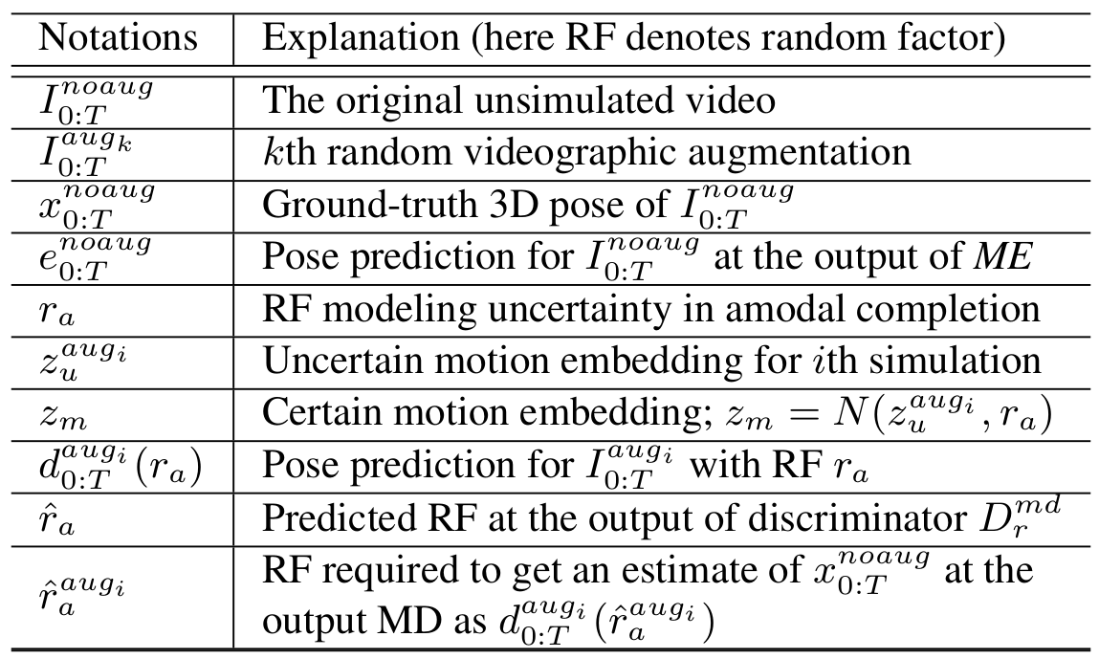
Training Phase-1
The parameters of Motion encoder ME, Motion Decoder MD and Project layer N are first trained using samples from both and enforcing loss only for the visible time-steps.
Notes:
First we train motion encoder decoder using labelled data enforcing loss on the fully visible frames 5s

Slide 9
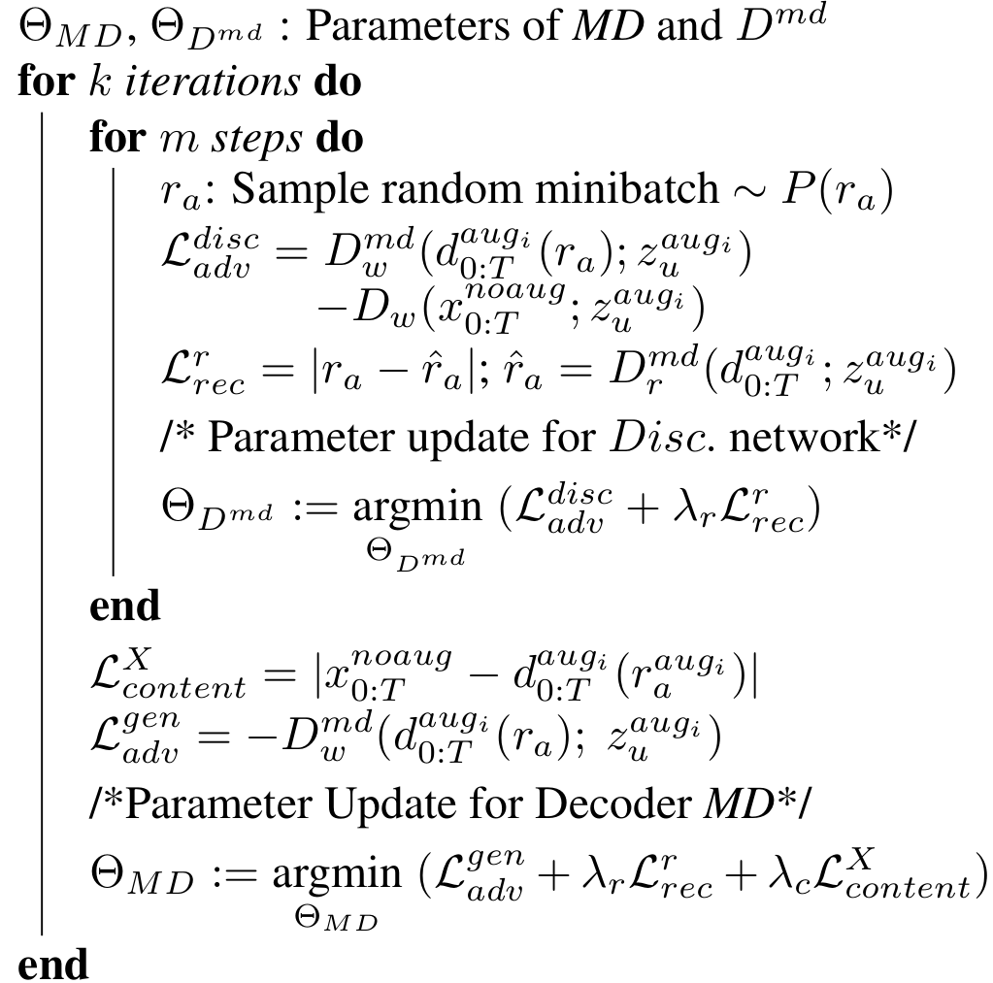
Training Phase-2
N, MD are fine-tuned along with the newly introduced discriminator
using an adversarial training given in Algorithm below
Notes:
Then we introduce adversarial training losses as shown in algorithm 5s

Slide 10
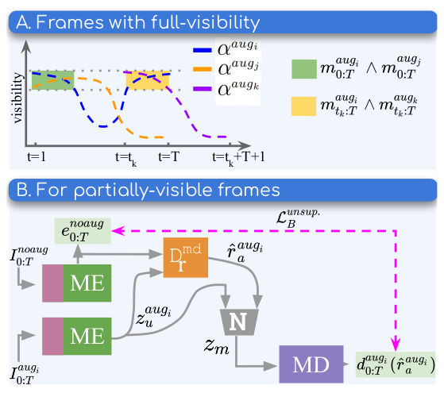
Self-Supervision Losses
Train in-the-wild un-annotated data by establishing correspondences:
1. different augmentation schemes
Full-visibility frames
2. Temporal shift
3. no augmentation -- pose prediction
Partial visible frames
Notes:
To train natural unlabeled data, we leverage self-supervision losses that enforce correspondences across different augmentation scheme for both partial and fully visible frames. 10s

Slide 11
Training Phase-3: Cross-Dataset Adaptation
Train in-the-wild un-annotated data
by establishing correspondences:
1. different augmentation schemes
Full-visibility frames
2. Temporal shift
Cross-data Training
3. no augmentation -- pose prediction
Partial visible frames
Notes:
We achieve cross-dataset adaptation, through effective application of self-supervised and supervised losses by training alternating batches of unlabelled and labelled data. 9s

Slide 12
Qualitative Results (MADS + Youtube)
Qualitative results on probabilistic amodal limb completion on unconstrained in-the-wild dataset , (top panel A and B) (bottom panel C and D).
Purple dotted line indicates examples where diverse predictions are obtained only for the joints that are truncated in the given image.
Notes:
Here we present qualitative results where the First row is input video with augmentations. We can see ground truth pose sequence in second row match our full body predictions. The purple box enclose plausible pose predictions for the truncated joints 15s

Slide 13
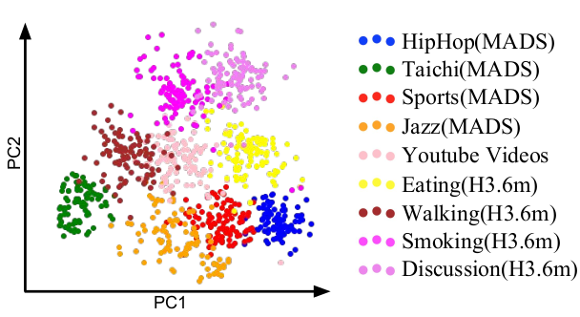
Qualitative Results (MADS + Youtube)
PCA plot from
shows generalizability of the learned motion representation across datasets with diverse action categories.
Additionally, it shows that our model learns a common embedding space for multiple datasets.
Diversity of motion classes among the selected dataset
Notes:
To show the generalizability of the learned motion representatation across datasets with diverse action categories we plot a pca. This show that our model learns a common embedding space for multiple datasets. 10s

Slide 14
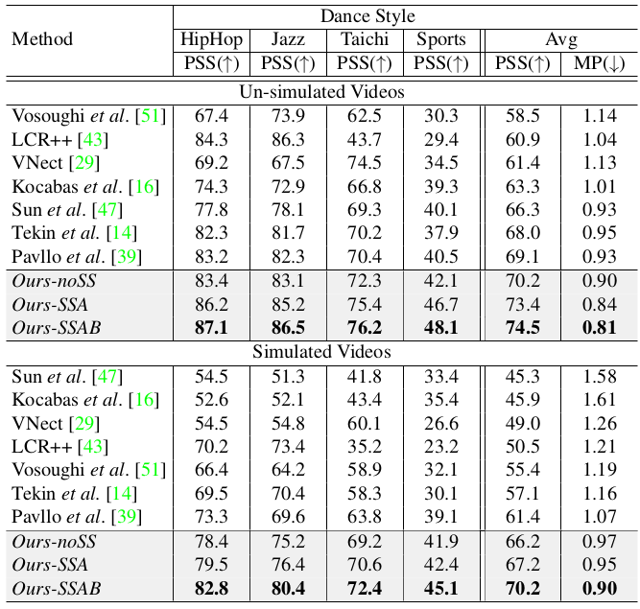
3D Pose Estimation - Results
For PSS (Pose Structure Score) the higher (↑) the better, and for MPJPE the lower (↓) the better. MPJPE here is abbreviated as MP.
Notes:
ZQuantitative results on 3D pose estimation are shown by comparing 3 variants of our method The first Ours-noSS is one from training phase-1 and phase-2 without SS. OurSSA is when self-supervised losses for full body frames. Finally, OurSSAB is combining partial and full-body SS losse, which we can see gives the highest performance beating outher SOTA methods. These are all tested MADS dataset not used during the supervised learning phase, therefore a cross-dataset performance. 20s

Slide 15
3D Pose Estimation - Results
For PSS (Pose Structure Score) the higher (↑) the better, and for MPJPE the lower (↓) the better. MPJPE here is abbreviated as MP.
Notes:
We compare 3 variants of our method The first Ours-noSS is one from training phase-1 and phase-2. OurSSA is applying self-supervised losses for full body frames. Finally, OurSSAB is SS losses for partial and full-body that outperforms SOTA methods. These are all tested on MADS dataset not used during the supervised learning phase, therefore it is cross-dataset adaptation. 20s

Slide 16
Summary
Probabilistic Amodal Completion Framework: disentangles the uncertainty inherent in unconstrained natural videos, and enables the application of effective self-supervised losses.
Proposed model achieve cross-dataset adaptation for human motion representation.
State-of-the-art results on tasks such as pose estimation, particularly on datasets not seen during training, substantiates our model’s generalizability and robustness.
Notes:
In conclusion we present novel method for probabilistic pose completion that disentangles the uncertainty in natural videos. Through our method we are able to learn a robust human motion representation that achieves cross dataset adaptation. Finally we obtain State-of-the-art results on pose estimation task on datasets not seen in training. 20s

Slide 17
Thank You
Unsupervised Cross-Dataset Adaptation via Probabilistic Amodal 3D Human Pose Completion
More results and figures on our poster.
Notes:
Thank you and happy to share more details on our poster 4s

