Slide 1
Finding Better Wide-Baseline Stereo Solutions using Feature Quality
Stephen Nuske, Jay Patravali*
*Work done while at the Robotics Institute, Carnegie Mellon University.

Slide 2
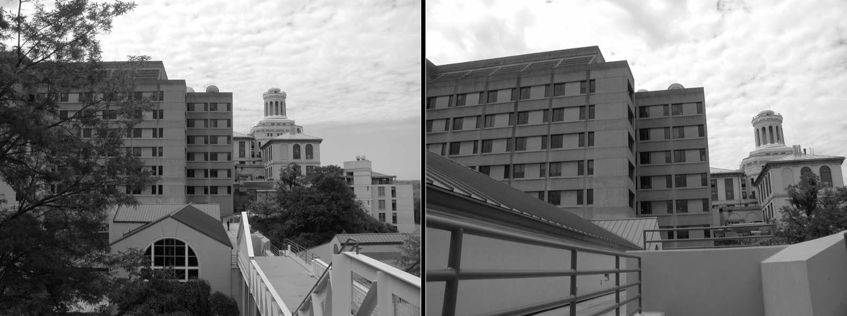

Motivation
Computing geometry between wide-baseline image pairs is difficult.
Fraction of inliers from a set of matched correspondence is very small ($\sim$10%).
Wide-Baseline Monocular Image Pair

Slide 3
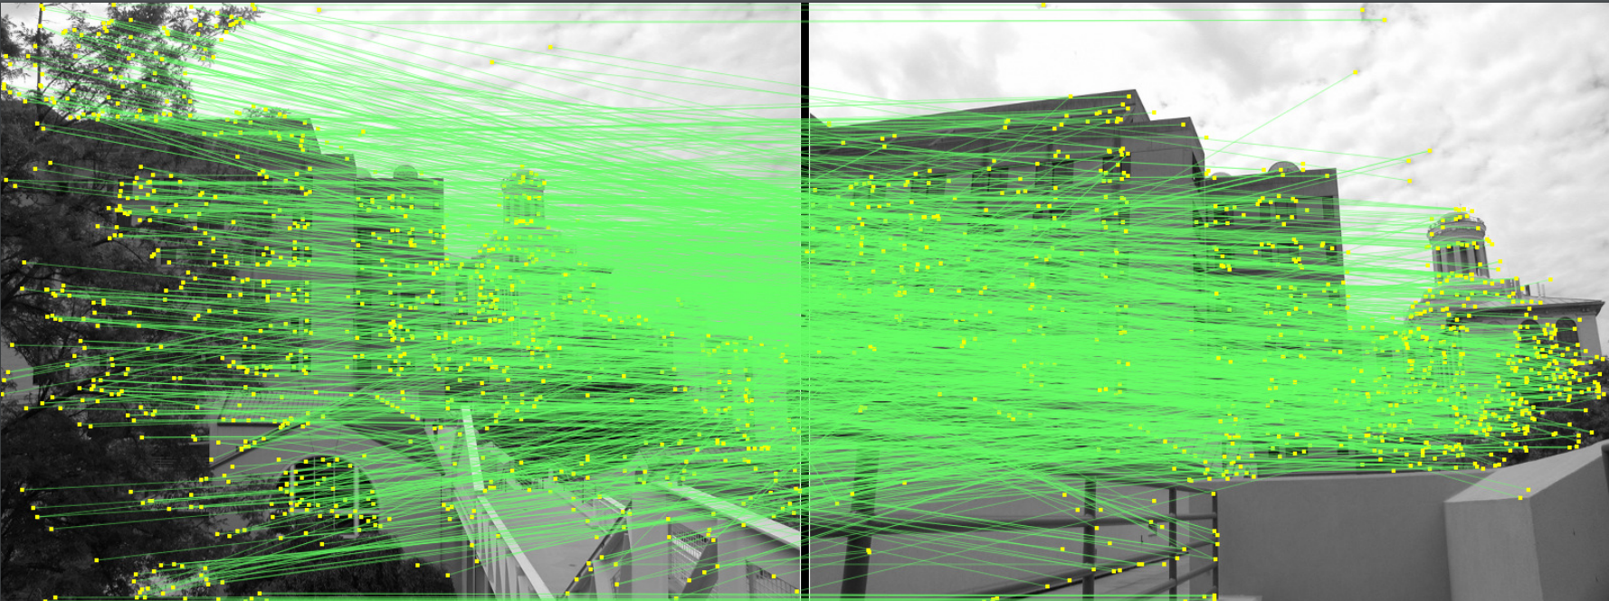
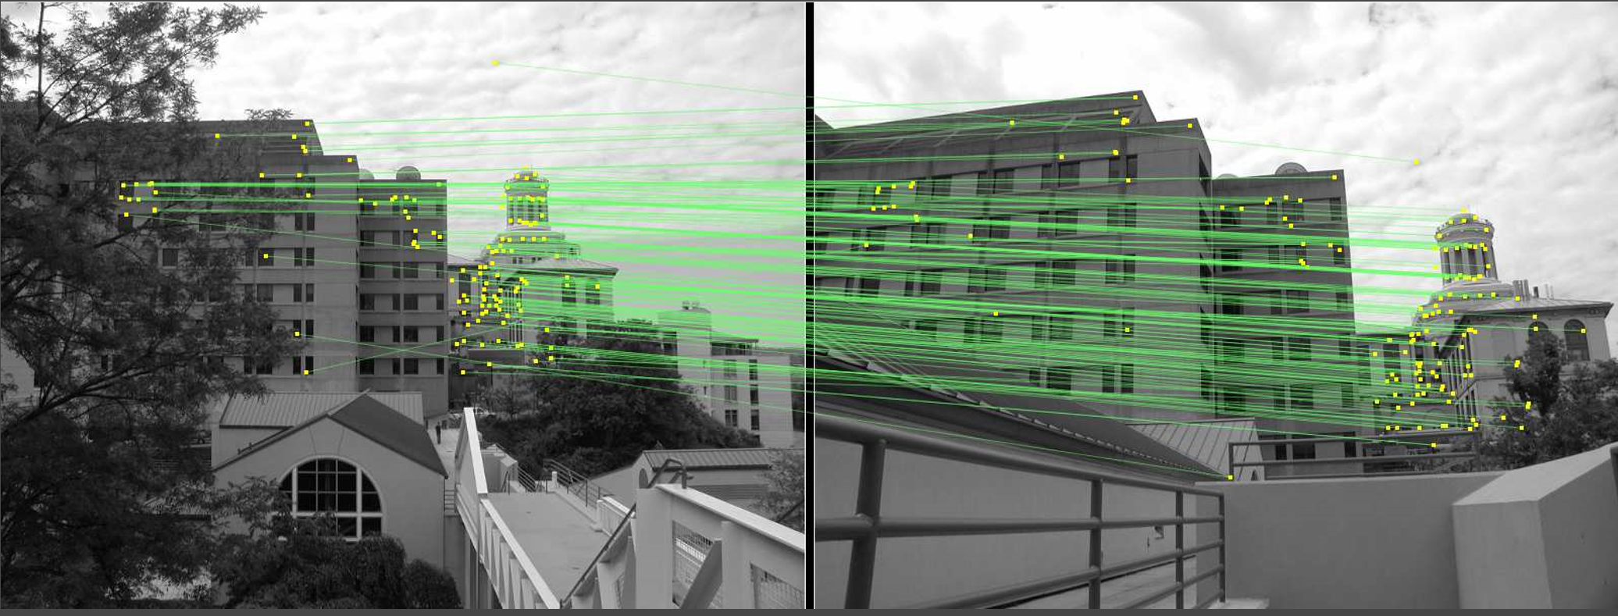

Motivation
Computing geometry between wide-baseline image pairs is difficult.
Fraction of inliers from a set of matched correspondence is very small ($\sim$10%).
Matched Correspondences Inliers

Slide 4
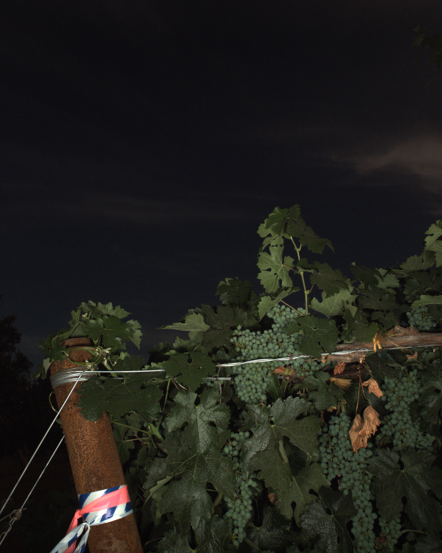
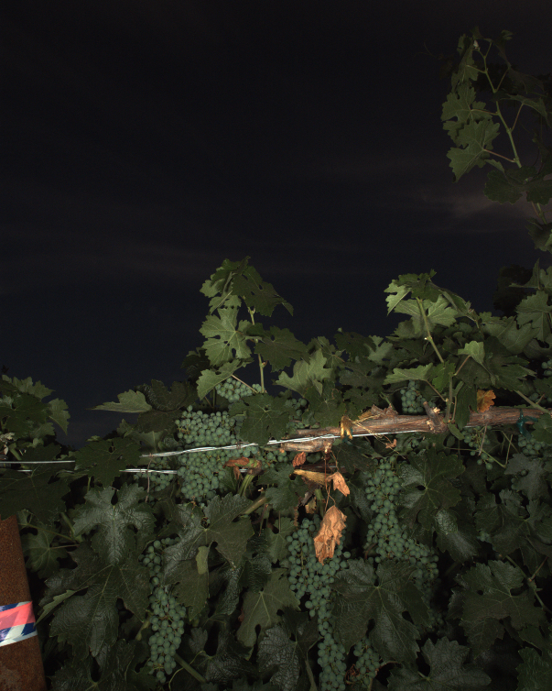
Motivation
Computing geometry between wide baseline image pairs is difficult.
Many false matches can pass the inlier test causing bad solutions to appear as good solutions.
Wide-Baseline Stereo Image Pair (Grape Dataset)

Slide 5
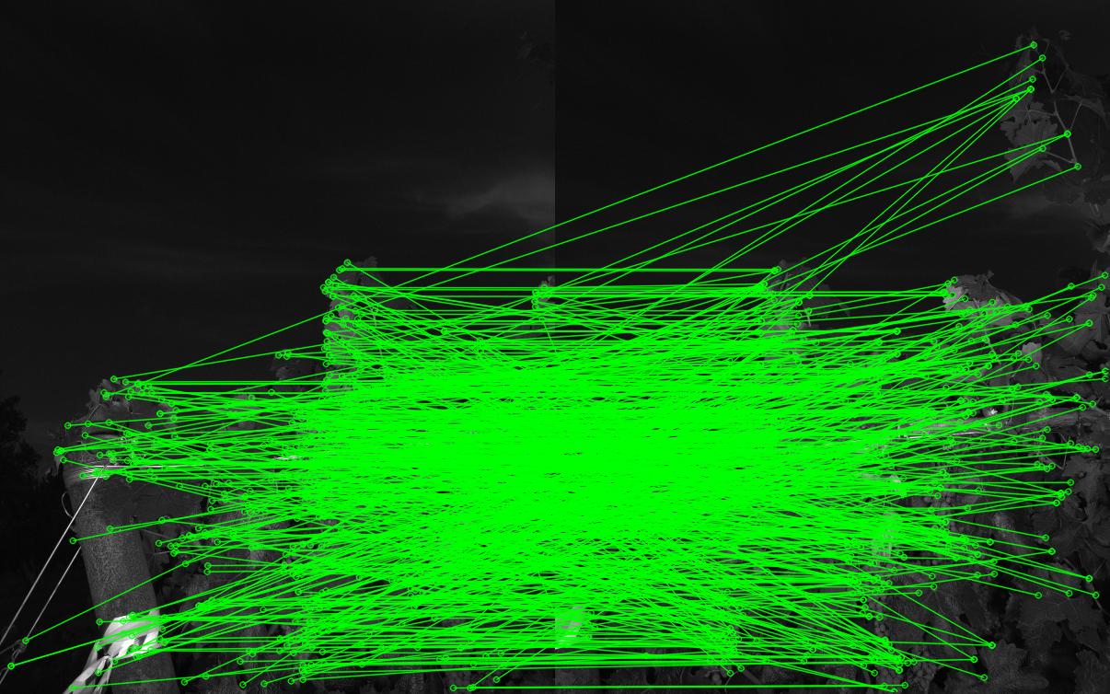
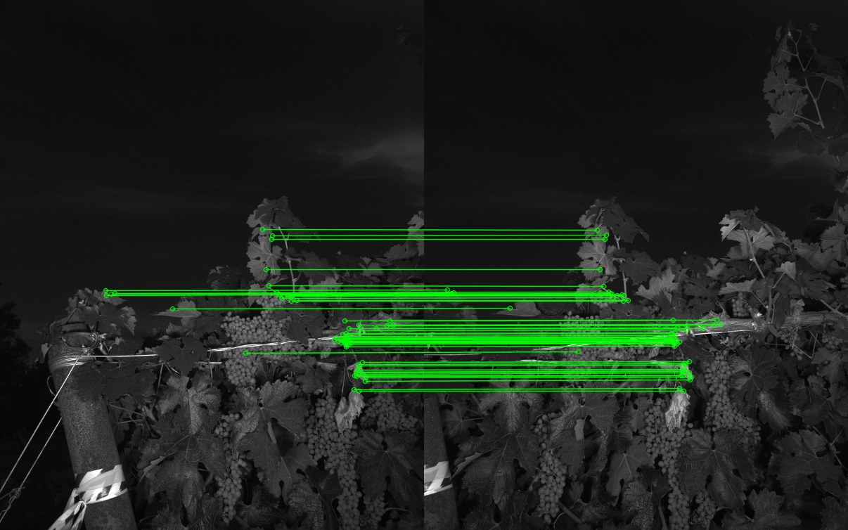
Motivation
Computing geometry between wide baseline image pairs is difficult.
Many false matches can pass the inlier test causing bad solutions to appear as good solutions.
Matched Correspondences Inliers

Slide 6
Contributions
New method to compute appropriate feature weights for guided sampling.
New metric to evaluate geometry solutions.
Both Wide-Baseline Monocular and Stereo.

Slide 7
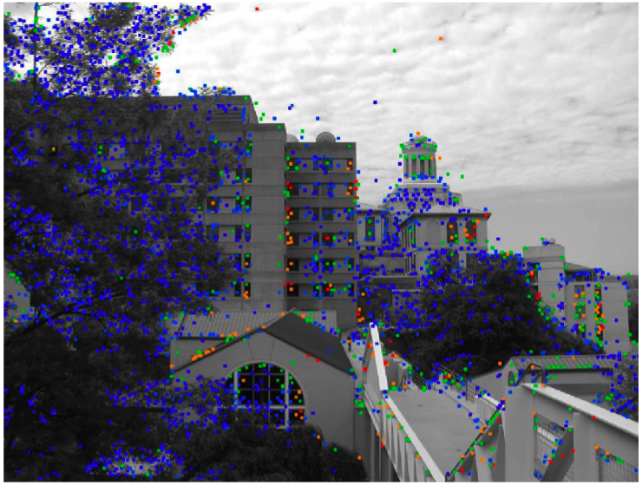
Weighted Sampling
Old Approach
  Considers only one or two correspondences
  Does not differentiate between semi-distinct and highly repeated features
Feature uniqueness
  Considers all features at once
  Range of weightings from very distinct to very repeated

Slide 8
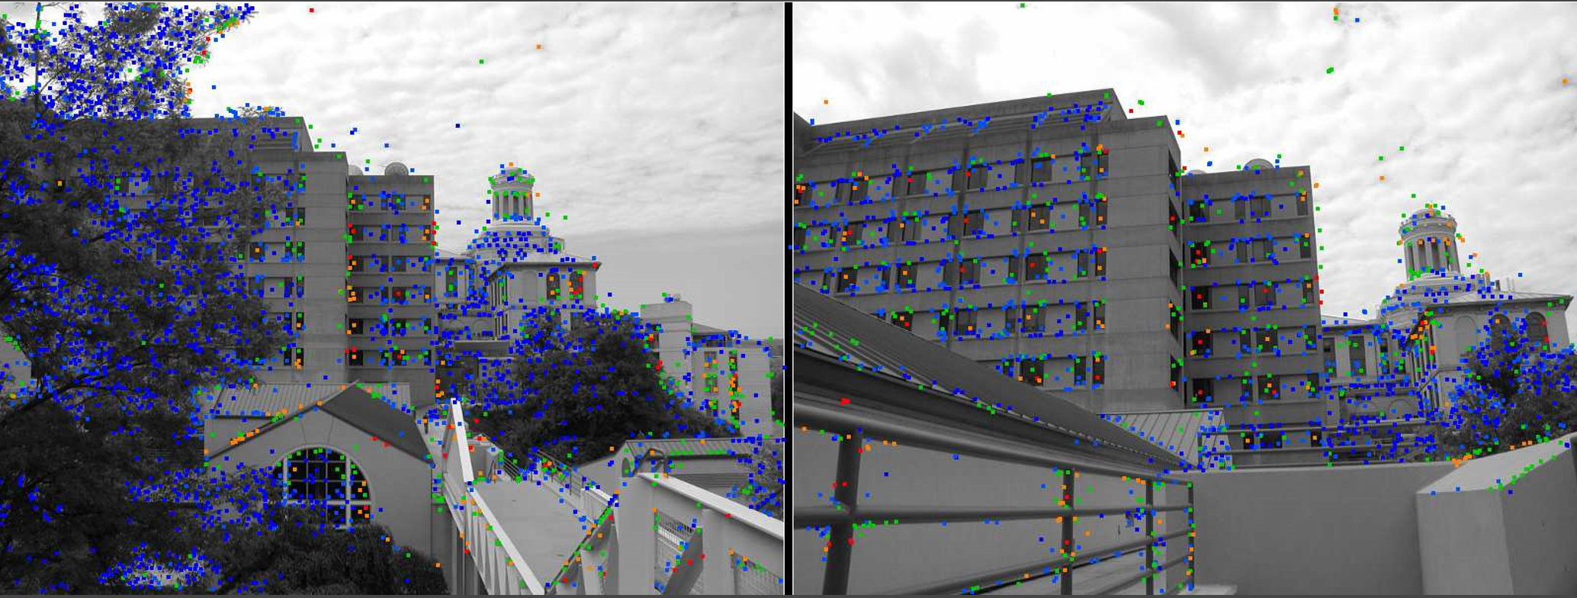
Monocular: Uniqueness Example #1
Going from Blue(repetitive) to red(unique)

Slide 9
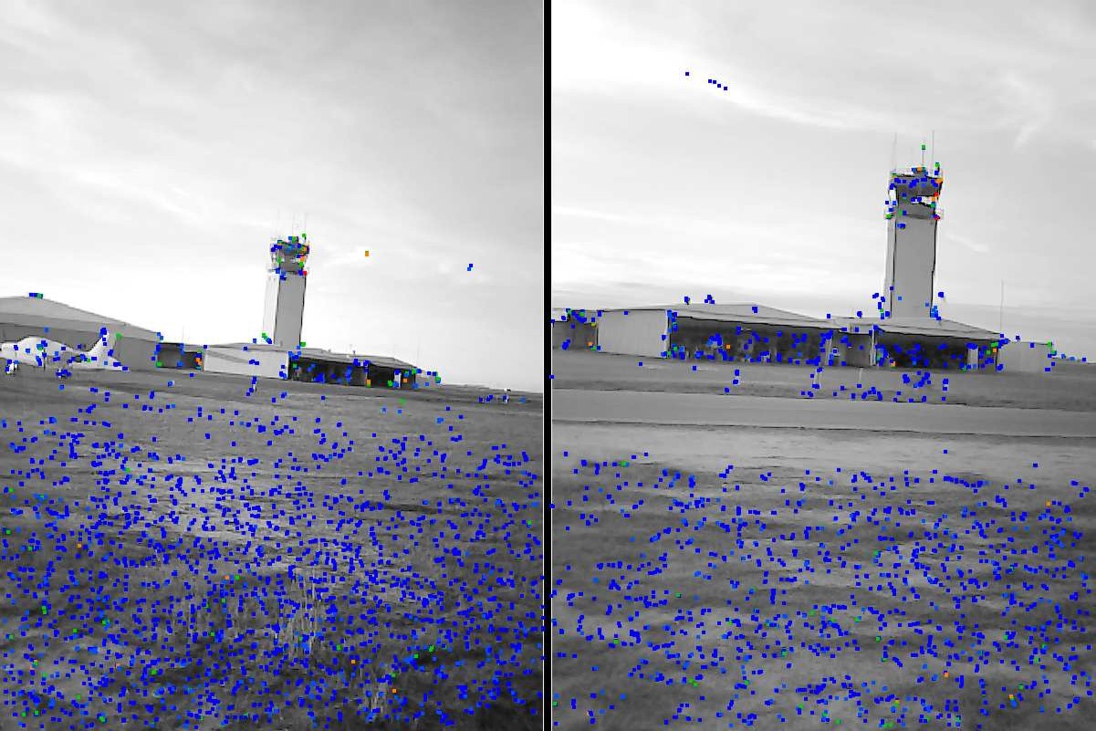
Uniqueness Example #2

Slide 10
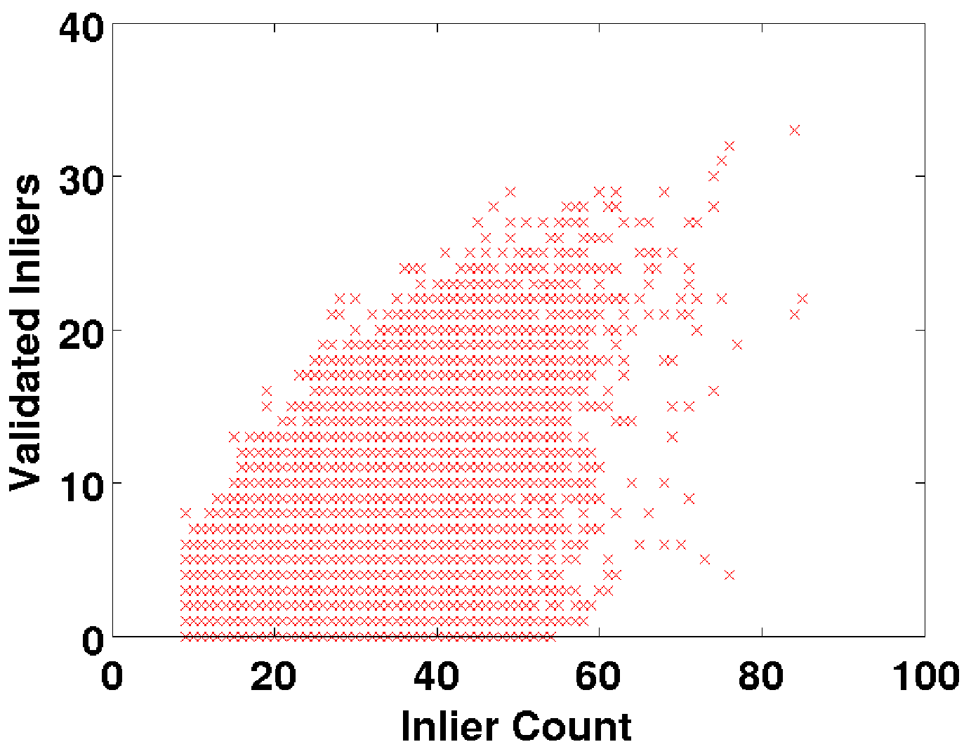
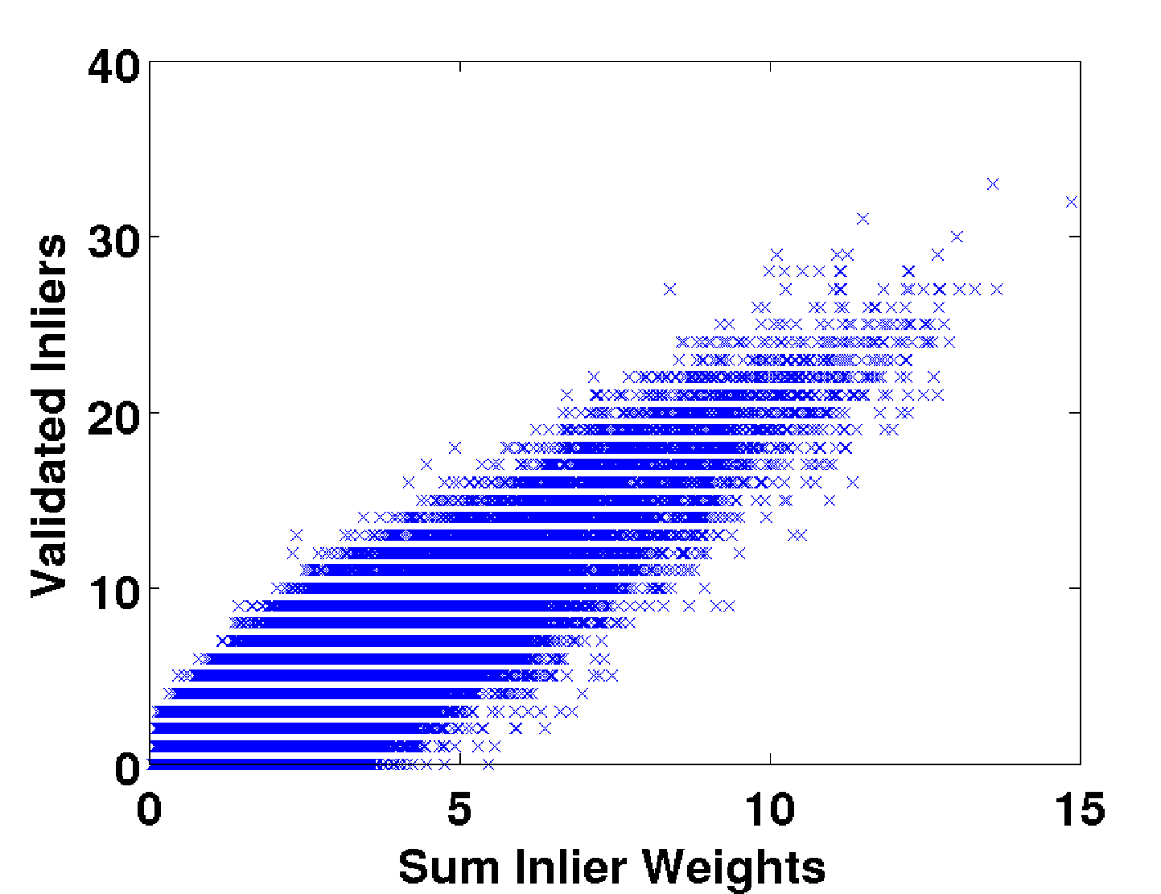
Hypothesis Evaluation and Accuracy score for a million iterations
RANSAC UNIQSAC
Traditional approach
Evaluate by size of consensus set
Our approach
Compute sum of feature uniqueness weights in consensus set

Slide 11
Hypothesis Evaluation and Accuracy score for a million iterations
RANSAC UNIQSAC
Inaccuracies Linear Correlation

Slide 12
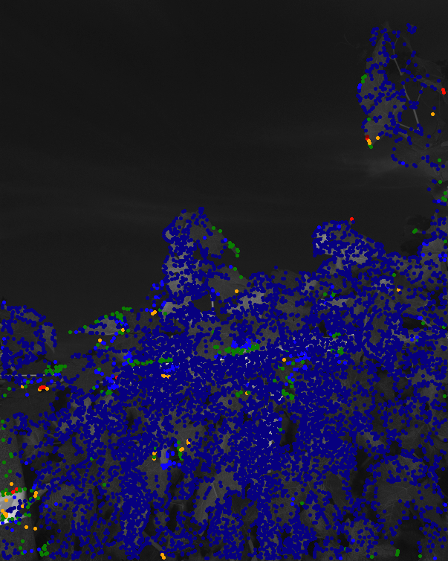
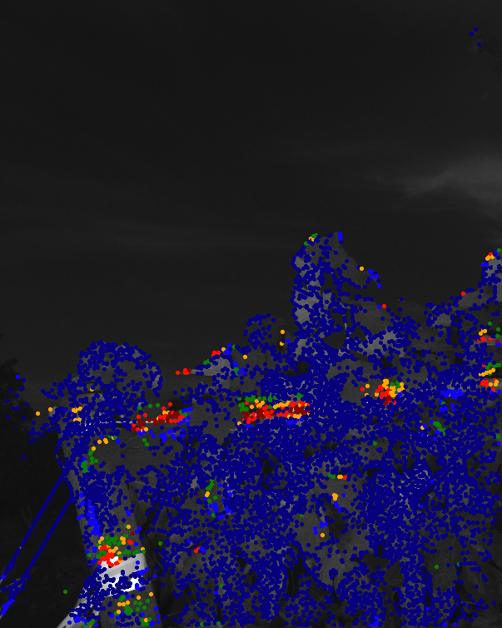
Similarly, for Wide-baseline Stereo
Grape Dataset

Slide 13
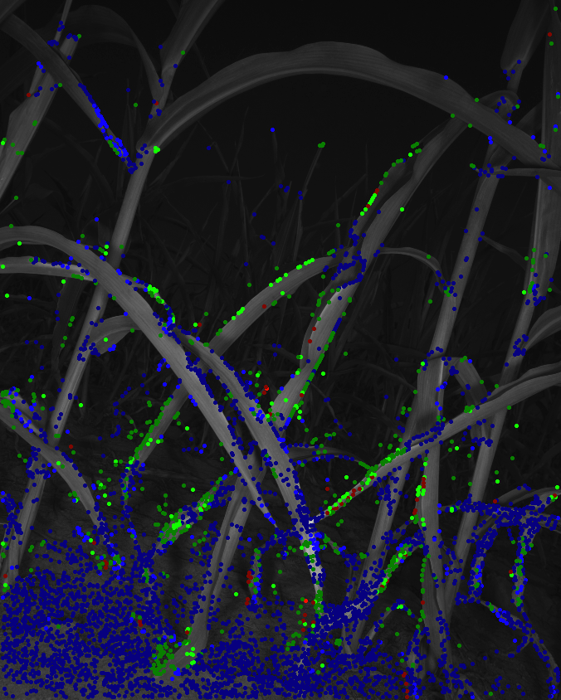
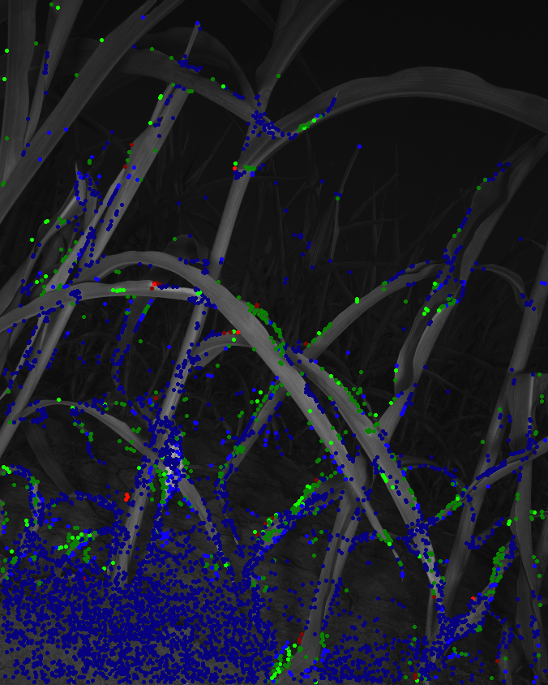
Stereo: Uniqueness Example #2
Sorghum Field

Slide 14
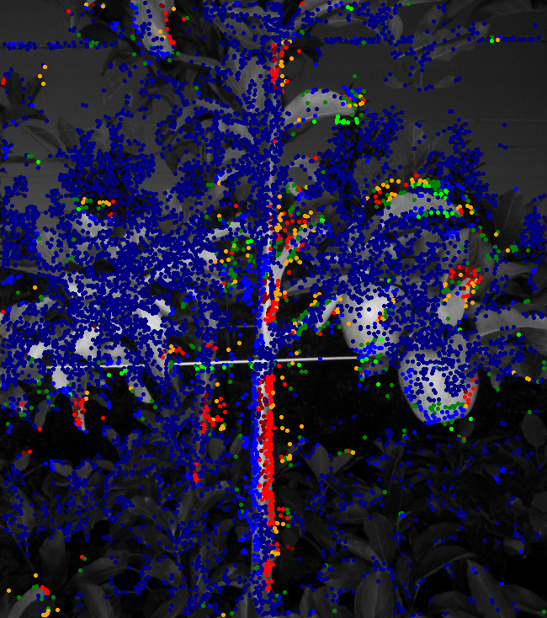
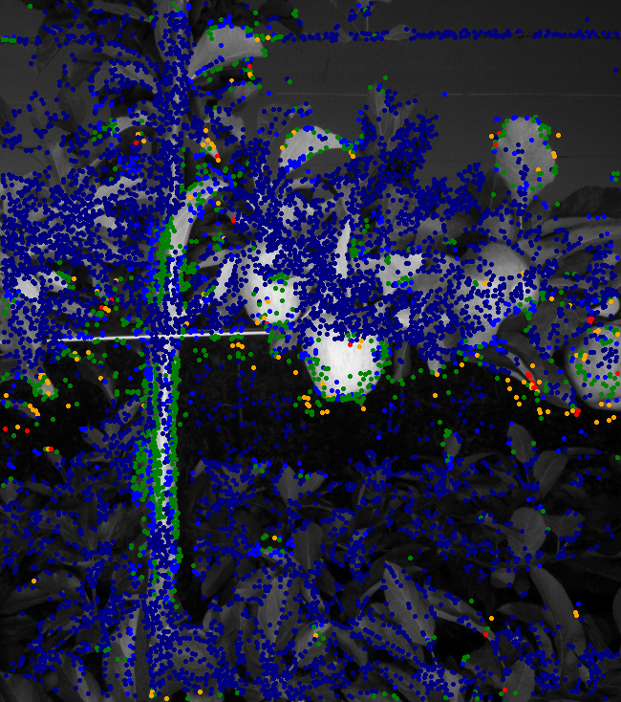
Uniqueness Example #3
Apple Orchard

Slide 15
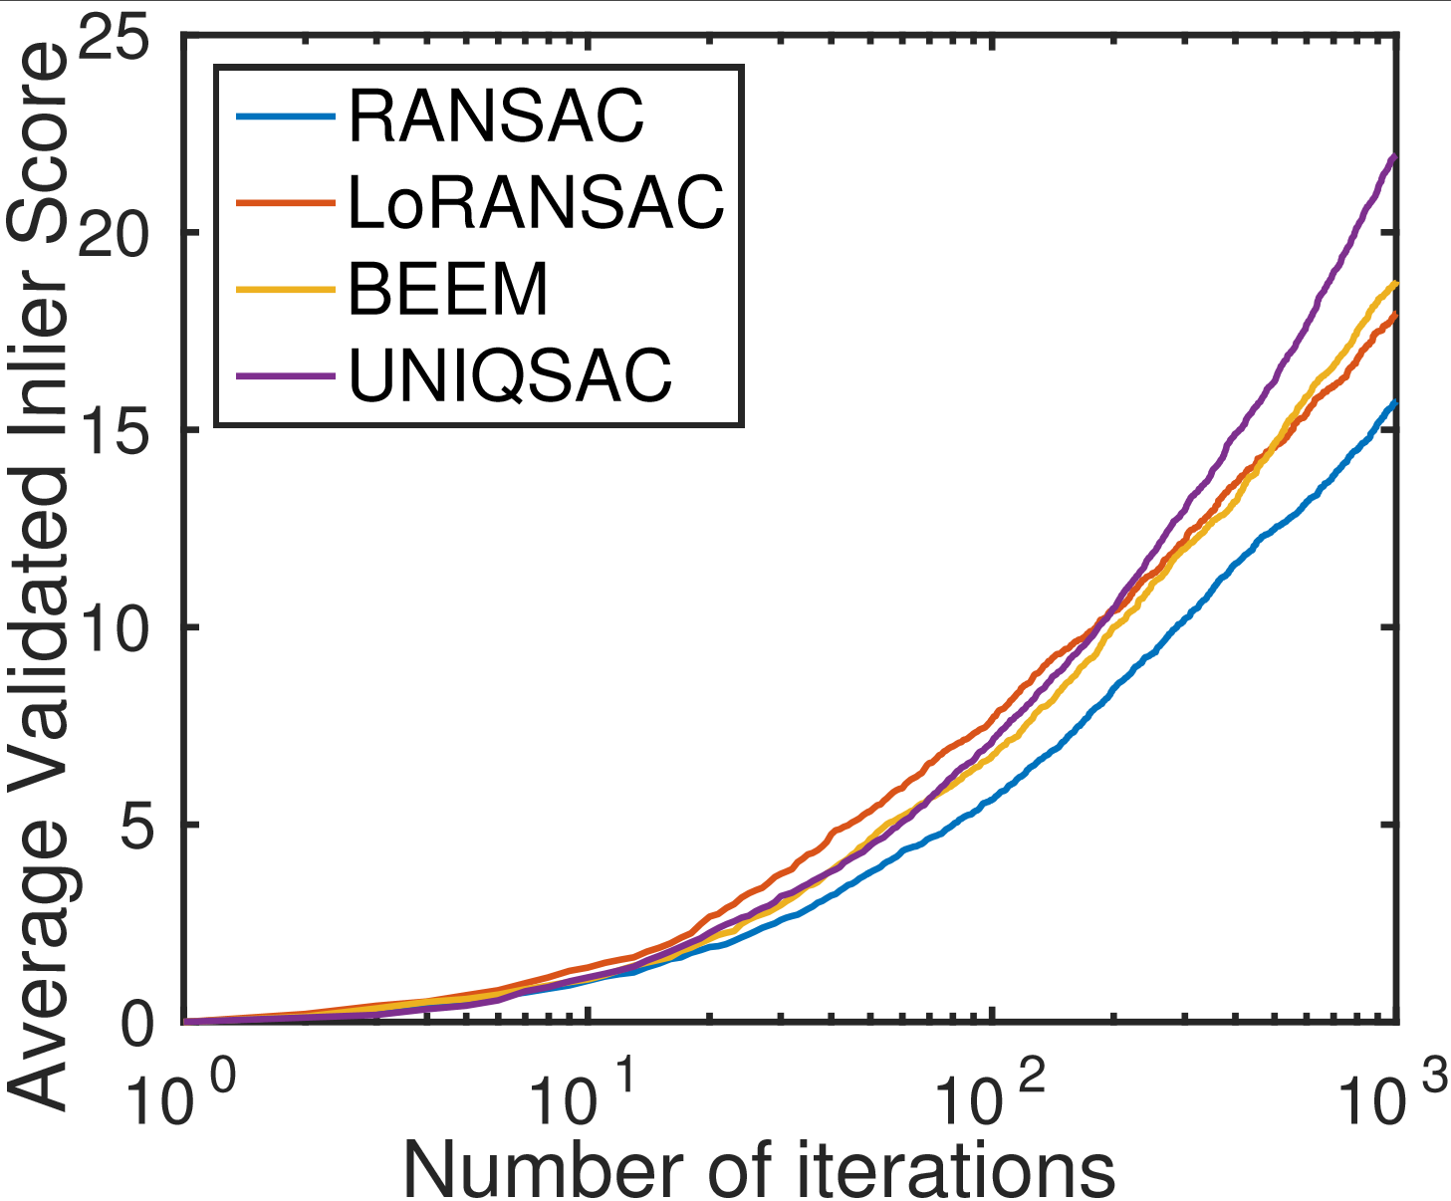
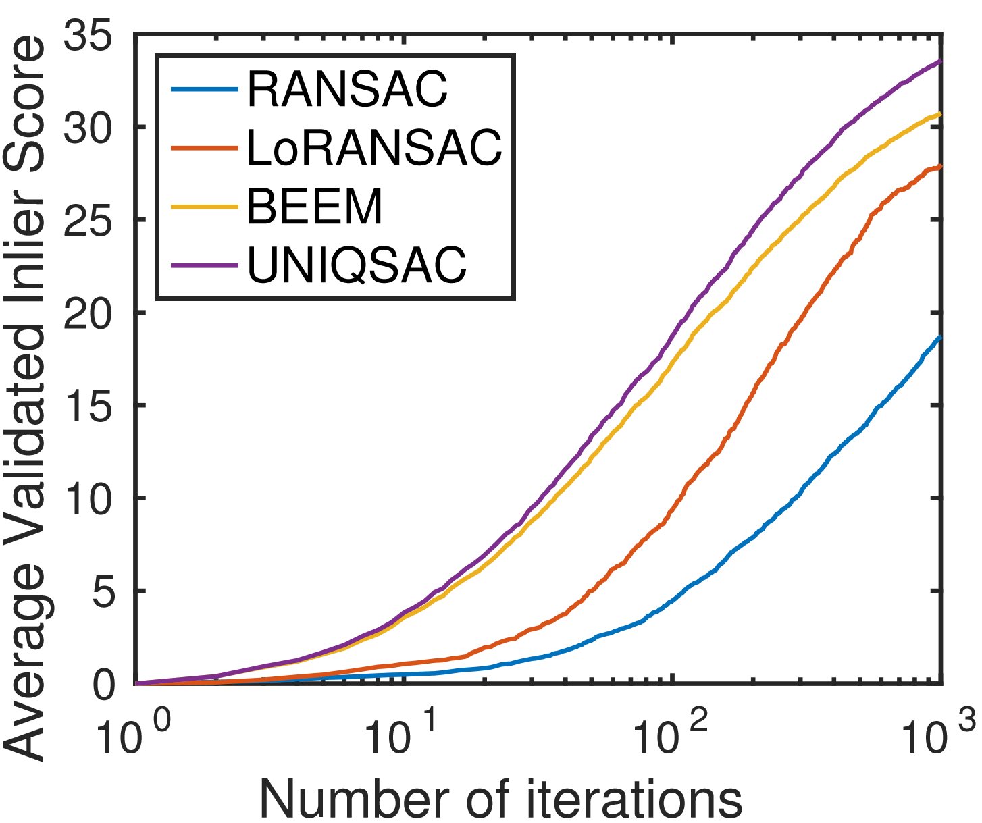
Wide-Baseline Stereo Estimation
1k Iterations
Grape Sorghum
We acquire the most accurate and time-efficient estimates while operating at very low inlier ratios (< 9%).

Slide 16
Thank You
Contact: stnuske@gmail.com

