Slide 1

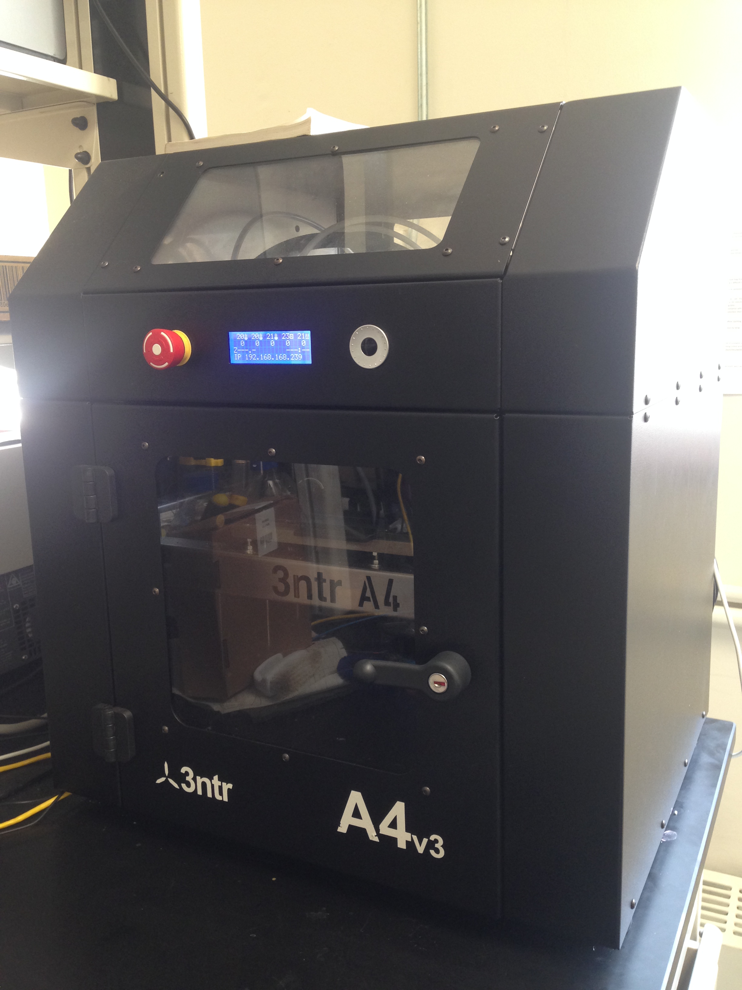
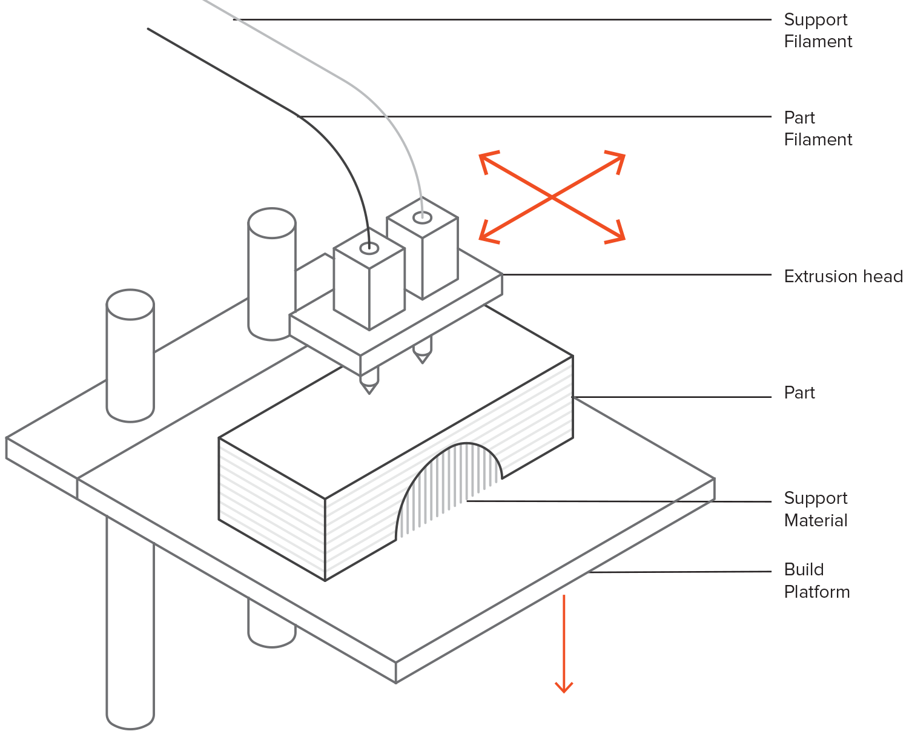
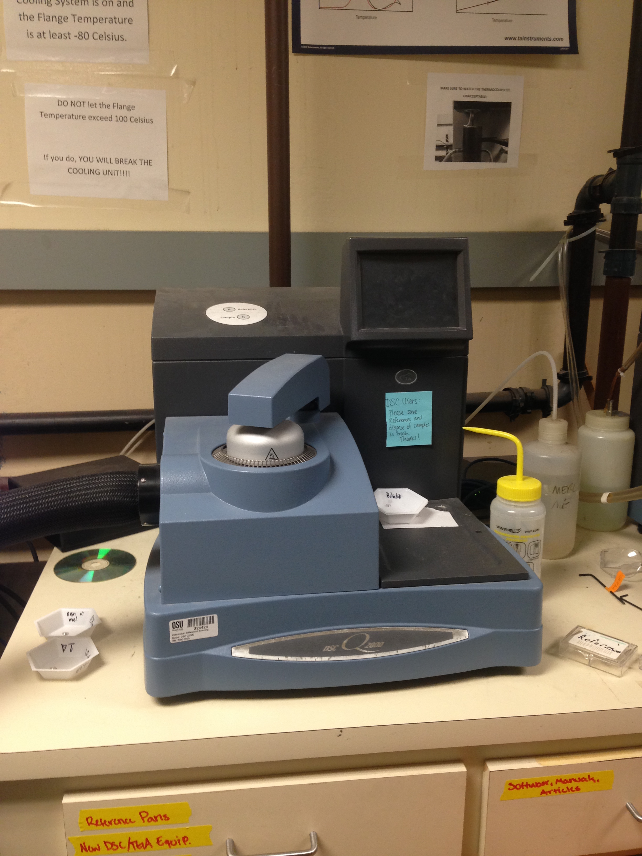
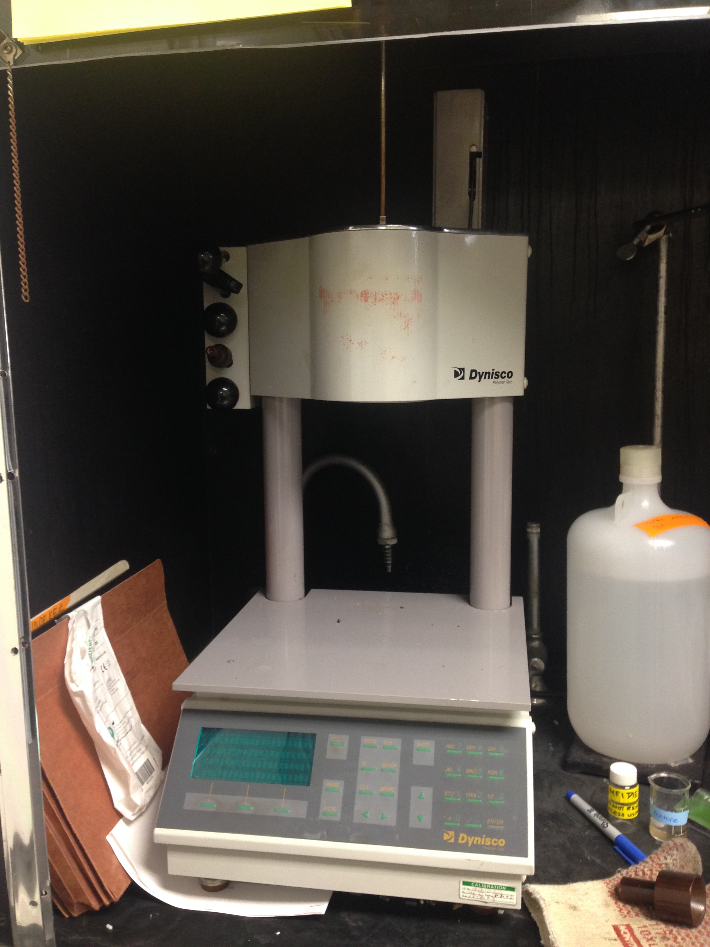
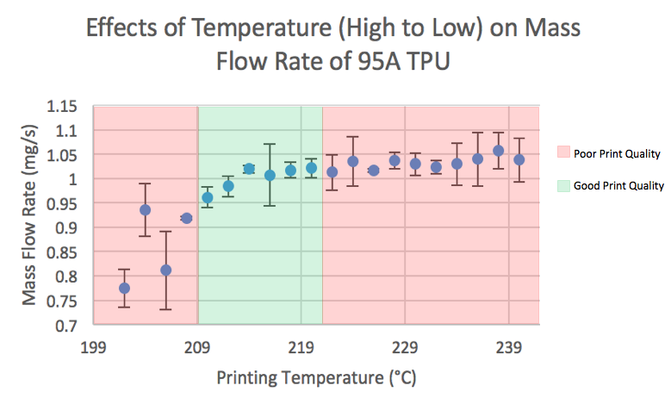
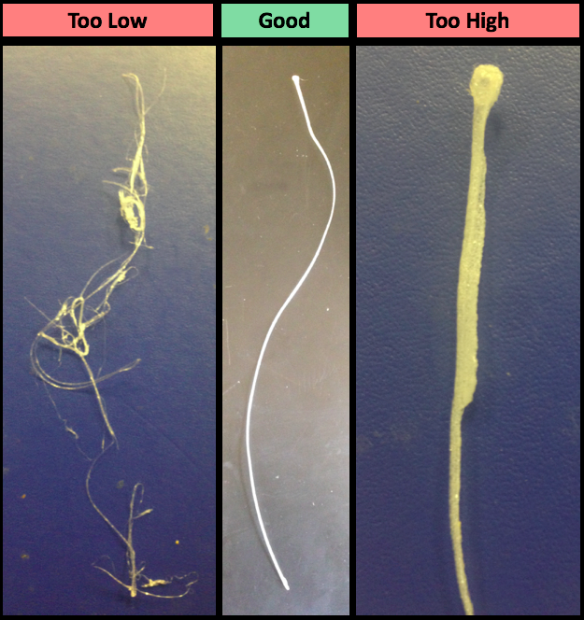
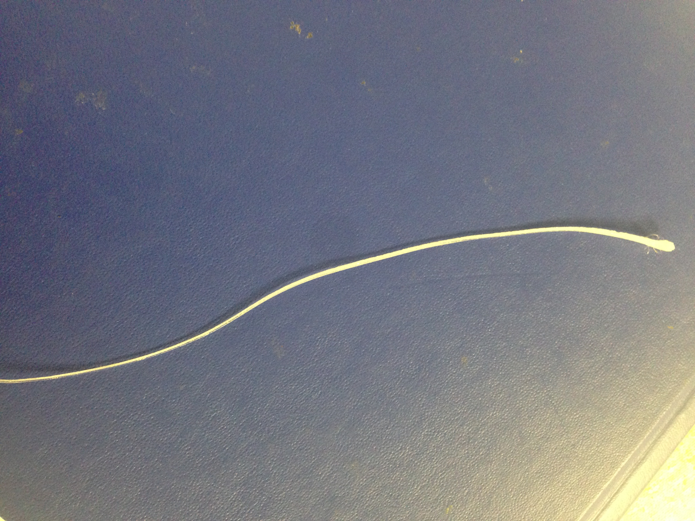
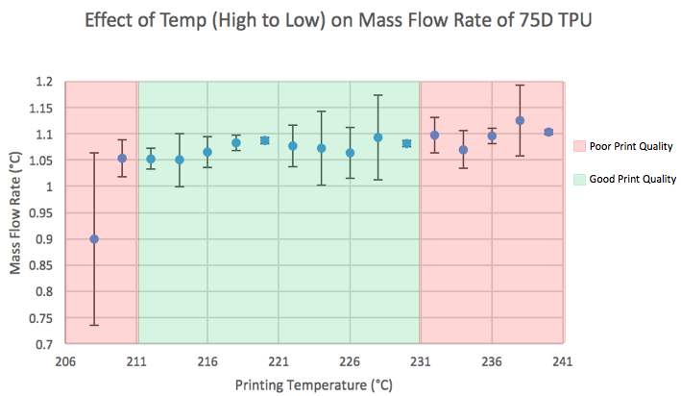
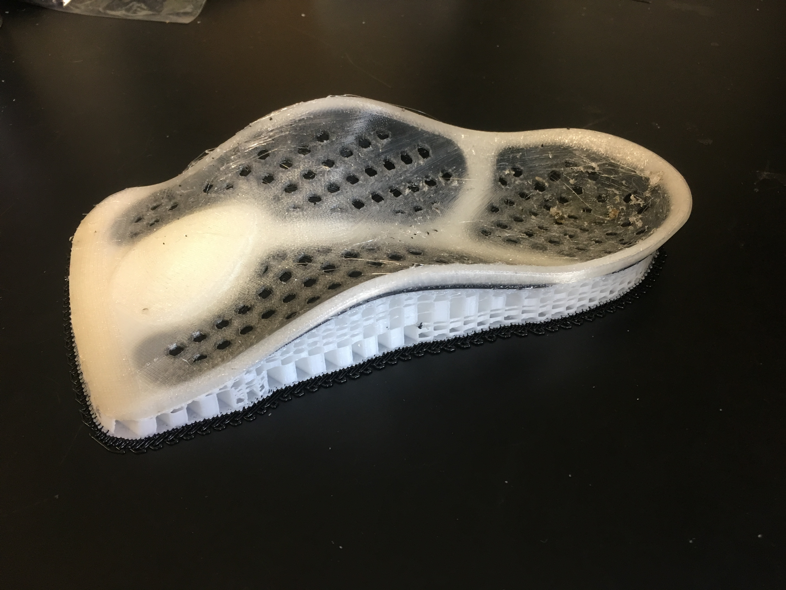
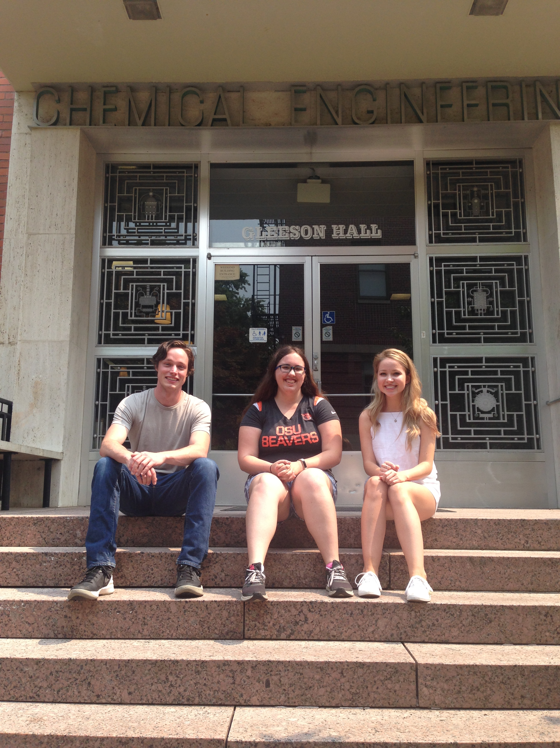
Material Characterization of Thermoplastic Polyurethanes for 3D Printing
Zoey Mikalatos
Mentors: Dr. Skip Rochefort, Conor Harris, Kelly Hollenbeck
Oregon State School of Chemical, Biological, and Environmental Engineering
Overview
Purpose
The characterization of thermoplastic polyurethanes (TPU) of different hardness as given by durometer readings of 95A and 75D for 3D printing. Establish the connection between thermal characterization of a polymer and the printing quality of the polymer at different temperatures.
TPU is not as widely printed as polymers such as ABS (acrylonitrile butadiene styrene) and ASA (acrylonitrile styrene acrylate). As a soft polymer it is more flexible than ABS, and is able to expand what is able to be 3D printed. There is not a wide availability of research on rate dependent polymers such as TPU. 3D printers heat polymer filaments at a high rate, which affects the printing temperature.
Application
TPU is capable of printing parts which need to be flexible, and increases the variety of applications for 3D printing. It can also be used as an adhesive between layers of other polymers such as ABS and ASA. TPUs of different durometer are able to be utilized for different parts. TPU can also be useful for printing parts which are needed in the lab.
The process which is used for relating the thermal characterization of TPUs to the printing temperatures could possibly be expanded to be used for determining printing temperatures for semi-crystalline polymers which are being printed.
Background
3D Printing
The printer in the lab is a fused deposition modeling (FDM) printer, which means that it melts the filament which has been loaded into it and deposits lines on the bed of the printer. It has three extruders and can print three different types of polymer in a part. The extrusion head can move left and right, while the printing bed, or build platform, can move up and down.
Figure 2: The inside of an
FDM printer
Figure 1: 3ntr A4v3 printer
Source: https://s3-eu-west-1.amazonaws.com/3dhubs-knowledgebase/intro-fdm-3d-printing/3-fdm-schematic.png
Experimental
DSC (Differential Scanning Calorimeter)
2 passes
95A TPU: -80°C to 280°C
75D TPU: -80°C to 250°C
MFI (Melt Flow Index)
Verification that the polymer flows
95A TPU: 230°C (MFI = 39.0 g/10 min)
75D TPU: 220°C (MFI = 19.8 g/10 min)
18°C above DSC melt temperature
1.1kg weight
240 seconds melt time
3 cuts, 20 seconds between each cut
3 trials for each TPU, 5g of polymer
Experimental cont.
Line Printing
3D printed lines
1mm by 250mm
3 lines for each temperature
Starting at 240°C
Go down in increments of 2°C
until polymer no longer
extrudes or adheres to printer
bed
Observations of print quality
at each temperature in order to
look at the ideal printing
temperature
Figure 3: Differential Scanning Calorimeter
Figure 4: Melt Flow Index
Effects of Temperature (High to Low) on Mass Flow Rate of 95A TPUt
Figure 5: DSC curve for 95A TPU (first pass)
Figure 6: Mass flow rate from 95A TPU printed strips
Effects of Temperature (High to Low) on Mass Flow Rate of 75D TPUt
Effects of Temperature (High to Low) on Mass Flow Rate of 75D TPUt
Figure 7: DSC curve for 75D TPU (first pass)
Figure 8: Mass flow rate from 75D TPU printed strips
208°C 220°C 238°C
Figure 9: Examples of good and poor quality 75D TPU printed strips
Results and Conclusions
By running the DSC, verifying the flow behavior with the MFI, and running the print quality and line print tests, we were able to determine the range of print parameters that have acceptable printing quality for those materials.
Future Work
Adhesion of different TPUs
TPUs of different durometer have different adhesion strengths to other polymers
Correlation of thermal characterization and print temperatures for different polymers
Can be used to characterize any new semi-crystalline polymers for printing
Acknowledgements
Mentors
Dr. Skip Rochefort
Kelly Hollenbeck
Conor Harris
Saturday Academy
Teacher Monitor, Sylvia Sorenson
Oregon State University
Rochefort Research Group
Figure 10: Orthotic insert printed with TPU and ABS

