Slide 1
Gulf Oil Spill An Engineering Challenge for Future Generations
….and that means YOU!
by
Dr. Skip Rochefort, Stephanie Silliman, and Audrey Oldenkamp
School of Chemical, Biological, and Environmental Engineering
Oregon State University

Slide 2
PLEASE..help me fly again!

Slide 3
Deepwater Horizon Blowout
Between April 20, 2010 and July 15, 2010 approximately 210 million gallons of oil leaked into the Gulf of Mexico.
The blowout was at a depth of 5,000ft (one mile below the surface of the ocean). Most of the oil rose to the surface because oil is less dense than water.
Some of the oil was trapped in underwater currents and travelled to shores and marshlands.

Slide 4
Waves of Oil

Slide 5
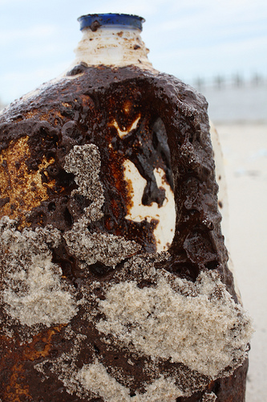
Oil on the Beach

Slide 6
Clean-up Methods
Dispersants: act like soap to break up large oil slicks into smaller more manageable particles.
Booms: long floating tubes that are put on the water surface to contain an oil spill (usually to protect the shoreline.)
Skimming: specially designed boats “scrape” the oil off of the surface.
Absorbants: materials that can help “suck-up” the oil to make it easier to recover.

Slide 7
Dispersants
Dispersants are chemical solvents or surfactants.
They don't eliminate oil, they make it less obvious by breaking it into small pieces which spread throughout the ocean.
The dispersant Corexit is being used by BP and has been proven to be toxic to microorganisms and fish eggs.

Slide 8
Booms Help contain the oil slicks on the ocean surface

Slide 9
Booms in Action

Slide 10
How can I help?

Slide 11
Human Hair & Sheep’s Wool
Wool adsorbs oil meaning the oil sticks to the hair but does not soak into it.
There are over 370,000 hair salons in the US and each cut about one pound of hair a day.
Boom Material Comparison

Slide 12
Recycled Cellulose Material
Made of recycled natural plant material.
It begins to absorb the moment it touches oil.
This material is hydrophobic so it repels water while absorbing only oil.

Slide 13
Oil Absorbing Polymer
Envirobond 403 is a polymer specifically formulated to bond to crude oil.
When the polymer comes in contact with a liquid hydrocarbon (oil) the free hydrocarbons bond to the polymer and form a gel.
The hydrophobic properties of the polymer prevent it from absorbing water.

Slide 14
Nonwoven Wool Blanket
Made using a needle-punch method from scrap wool & recycled yarns.
The blanket form of wool makes it easier to handle than loose wool.
Has the same general oil adsorbing properties as raw wool.

Slide 15
Oil Clean-up Experiment
Materials to be tested:
Wool
Recycled Cellulose
Oil Absorbing Polymer
Nonwoven Wool Blanket
Notes:
There are more detailed instructions on the hand outs.

Slide 16
Procedure
Obtain gloves and goggles
Fill plastic cup halfway with tap water
Using syringe, add 3 mL of simulated crude oil to cup.
Add wool to cup, swirl around, observe
Repeat steps 3 & 4 using cellulose
Repeat steps 3 & 4 using polymer
Repeat steps 3 & 4 using nonwoven wool

