Slide 1
Reaction Chemistry Cars: Kitchen Chemistry

Slide 2
Chemical Reaction

Slide 3
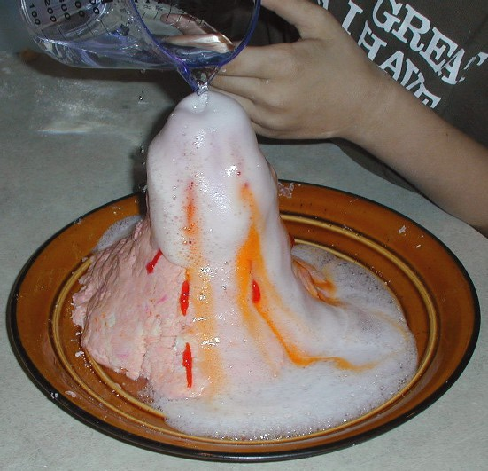
How does the reaction work?
Acid-base reaction
Water, carbon dioxide (CO2) products
The bubbles coming from the car are CO2

Slide 4
Materials
Bottle
Water
Sodium Bicarbonate (baking soda)
Acetic acid (vinegar)
Water
1000 mL graduated cylinder
Measuring spoon
Weigh boats
K’nex kits
Notes:
Every year, the US economy offers roughly 29 million “middle jobs” (positions that demand some additional schooling or certification beyond the 12th grade, but not the time or financial commitment of a bachelor’s degree
Do you see anything up here you might be interested in?
Want to mention the “Building Inspection Technology” option at PCC –
Anytime you buy/sell a house, you have to have someone come out and inspect it. Is it up to code, it is going to fall down on someone. One of the teachers in the room where I was giving this talk said that he had just bought a house, and he had to pay the Building Inspector $500 for an hour’s worth of work….$500! Do you think you could do that with just a high school diploma? No.
No matter what you do in life – do something after high school. It opens so many doors and opportunities for you.

Slide 5
Procedure
Measure reactants
6 g baking soda, 100 mL vinegar, 50 mL water
Build the car
Put the vinegar and water in the bottle
Go outside
When you’re ready to race your car quickly add the baking soda and let the bubbles build
Make sure the end is not pointing at a person
Release the bottle end and watch the car go
GENTLY SHAKE THE BOTTLES!

Slide 6
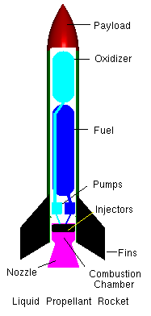
Thrust
Thrust is a mechanical force, so the propulsion system must be in physical contact with a working fluid to produce thrust
Thrust is generated most often through the reaction of accelerating a mass of gas
Use the water to give the car more thrust

Slide 7
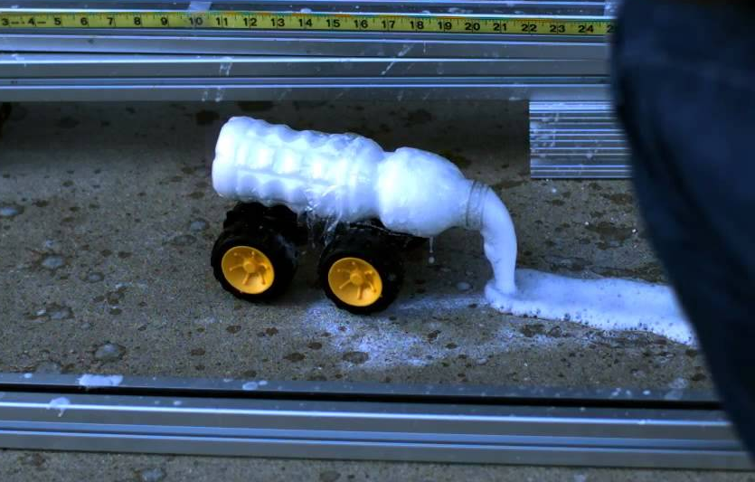
Building the Car: Things to Keep in Mind
Do you want the bottle opening point up, down, or horizontal
Wheel size
How much water to add
Adds thrust, but will also add weight
Make the car go straight
Secure the bottle to the car
Keep the car from flipping over

Slide 8
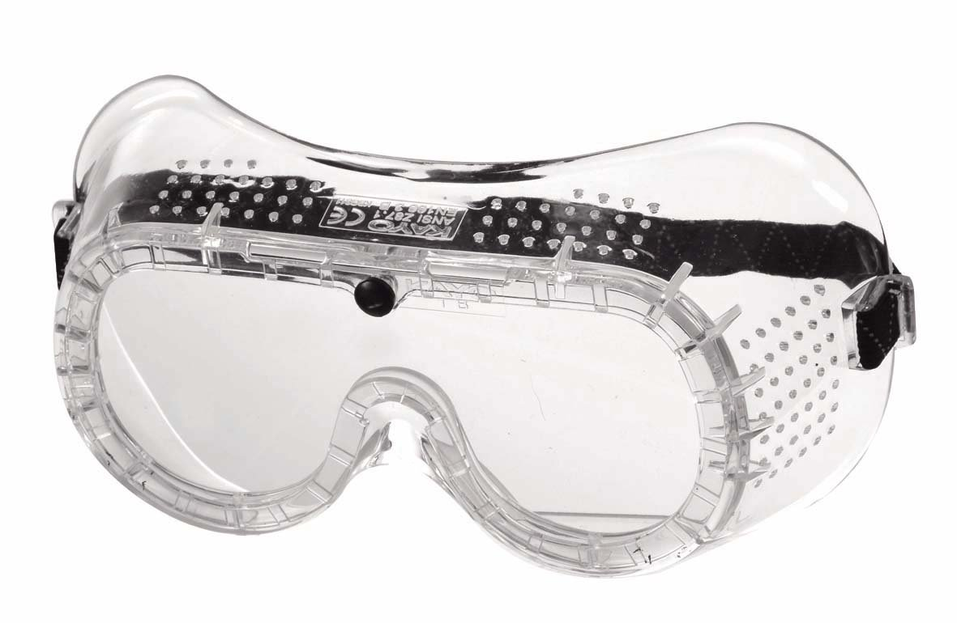
Safety
Do not add too much baking soda
Dilute the vinegar with water
Wear safety goggles at all times
When the baking soda is in the bottle don’t point the bottle at your team members
Do not shake the bottles too much

Slide 9
Go build!

