Slide 1

Material Characterization of Thermoplastic Polyurethanes for 3D Printing
Zoey Mikalatos
Mentors: Kelly Hollenbeck, Conor Harris, Dr. Skip Rochefort

Slide 2
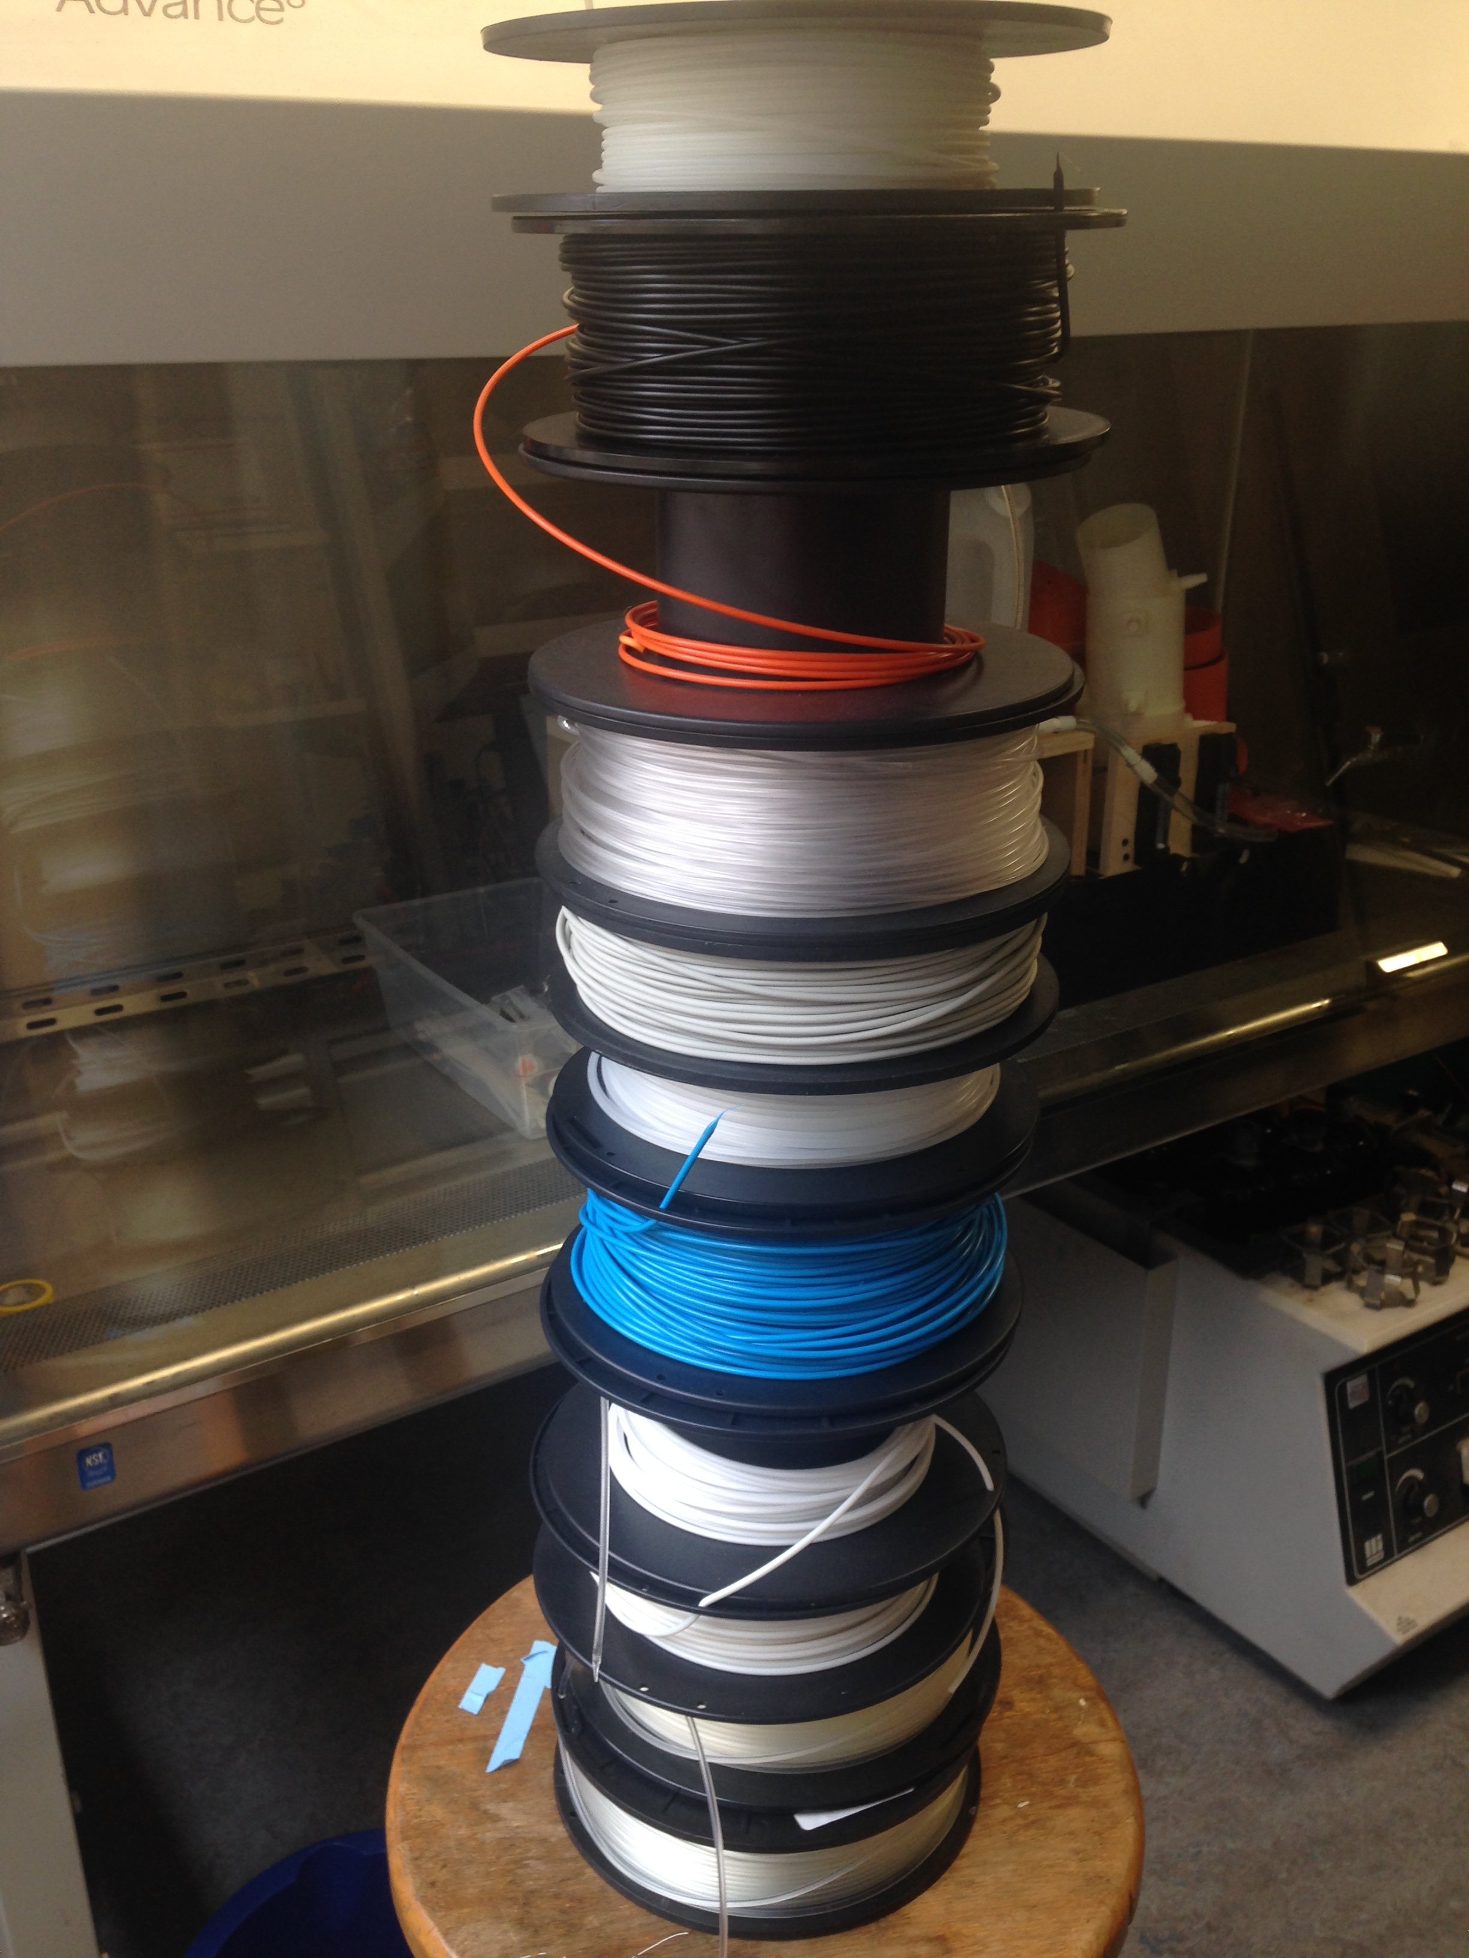
Introduction
3D Printing
Thermoplastic Polyurethane (TPU)
  Soft polymer
  Not commonly printed
  Different types
    95A and 75D

Slide 3
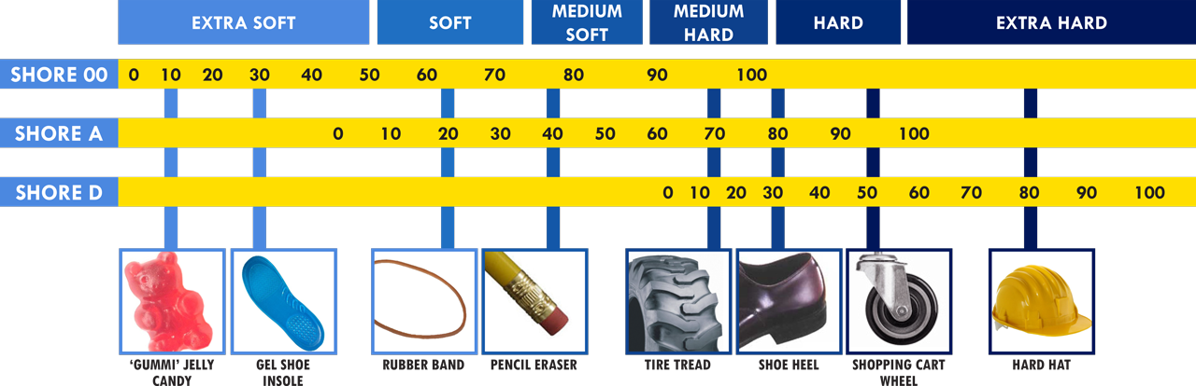
SHORE HARDNESS AND DUROMETER
https://www.smooth-on.com/pw/site/assets/files/30090/durometerchart.png

Slide 4
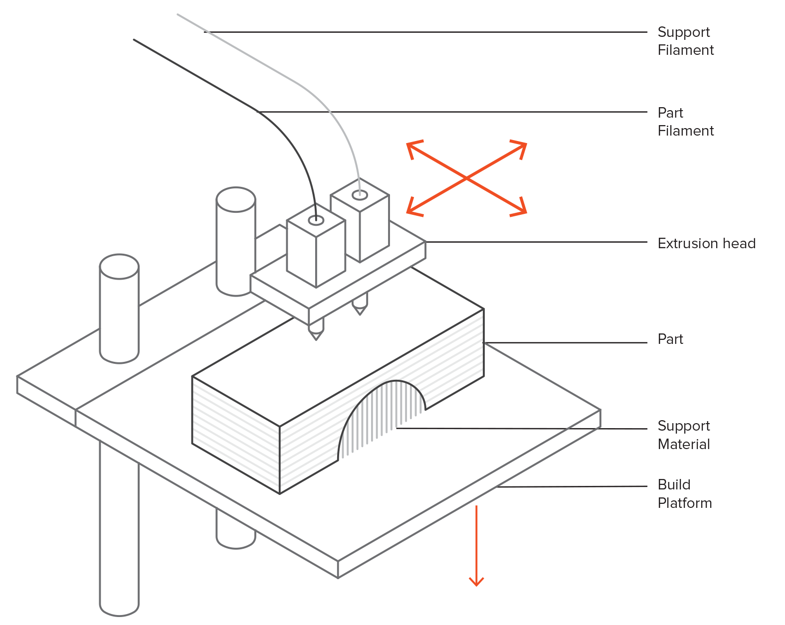
Background - Printer
Fused Deposition Modeling (FDM)
3 extruders
https://s3-eu-west-1.amazonaws.com/3dhubs-knowledgebase/intro-fdm-3d-printing/3-fdm-schematic.png

Slide 5
Overview
  Purpose
  Characterization of 95A and 75D TPU for printing
  Establish connection between thermal characterization of polymer and print quality at different print temperatures
  Method
  Differential Scanning Calorimeter (DSC)
  Melt Flow Index (MFI)
  Line printing on the 3D printer

Slide 6
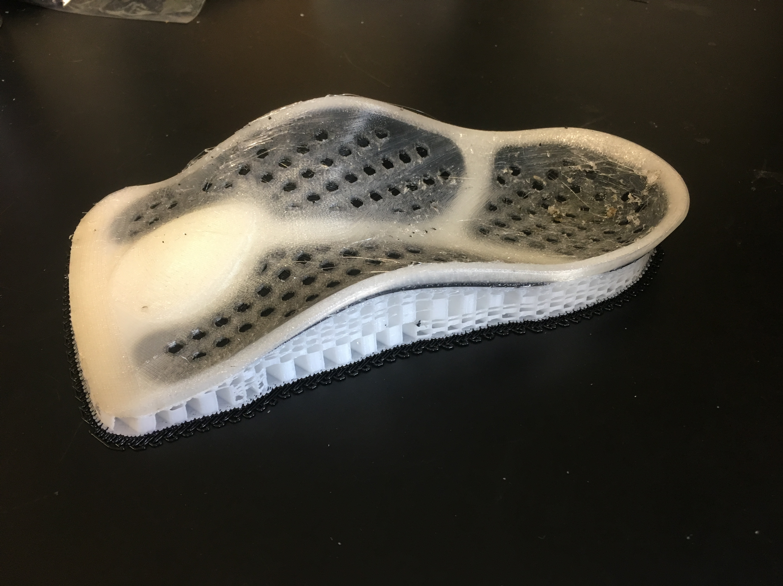
Applications
Capable of 3D printing parts which need to be flexible
  Parts for the lab
Adhesion between different polymers
Characterizing new polymers for 3D printing

Slide 7
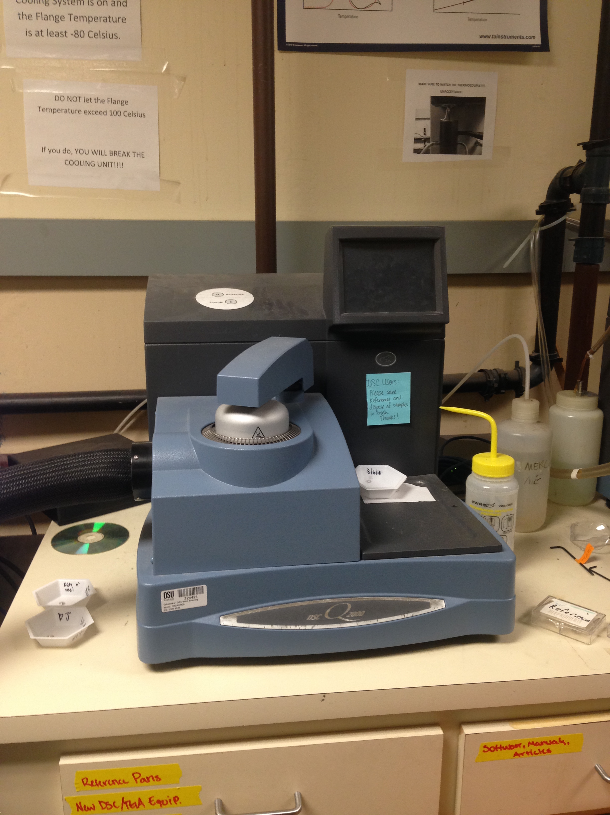
Differential Scanning Calorimetry (DSC)
Two passes
10-15mg of polymer
-80°C to 280°C (95A)
-80°C to 250°C (75D)
Controls
Sample
Flange

Slide 8
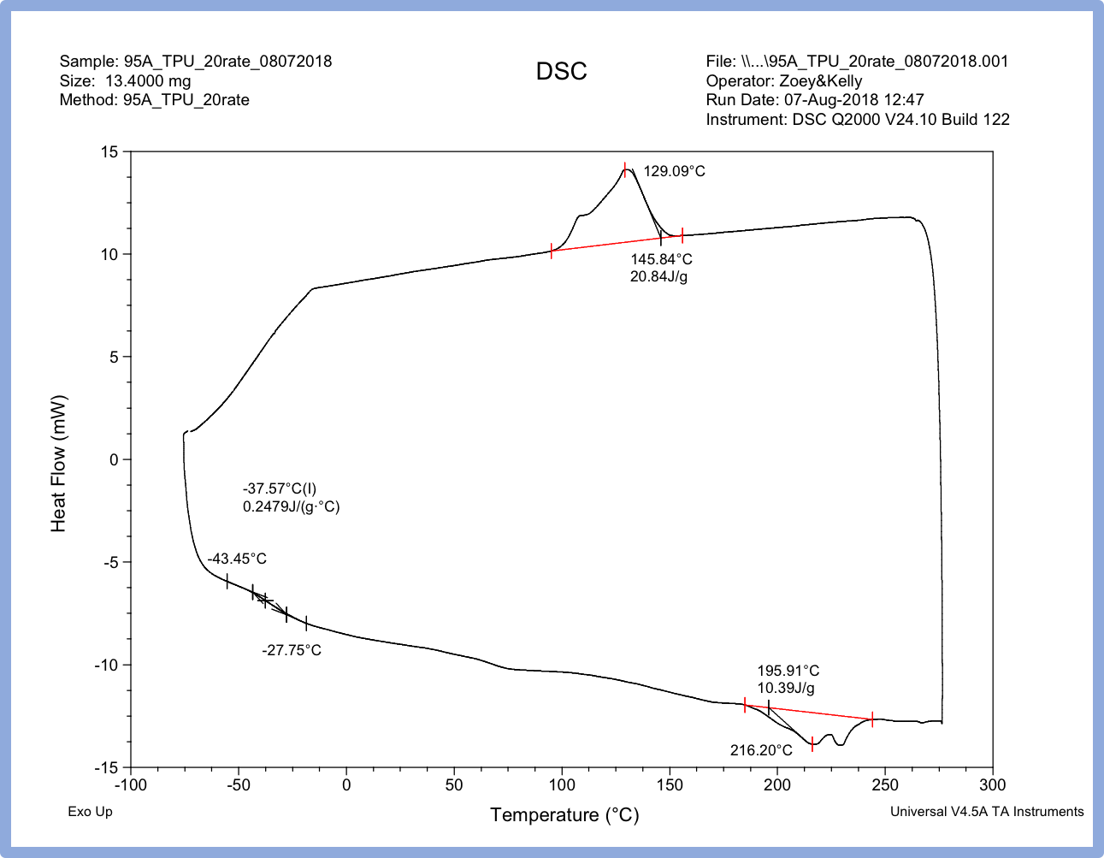

Slide 9
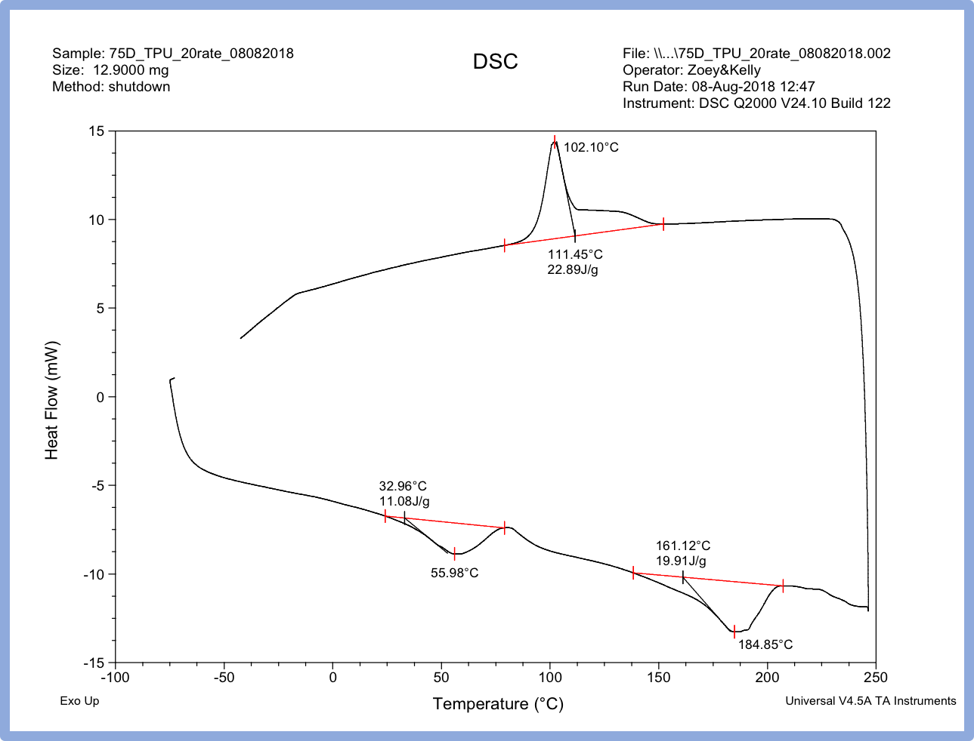

Slide 10
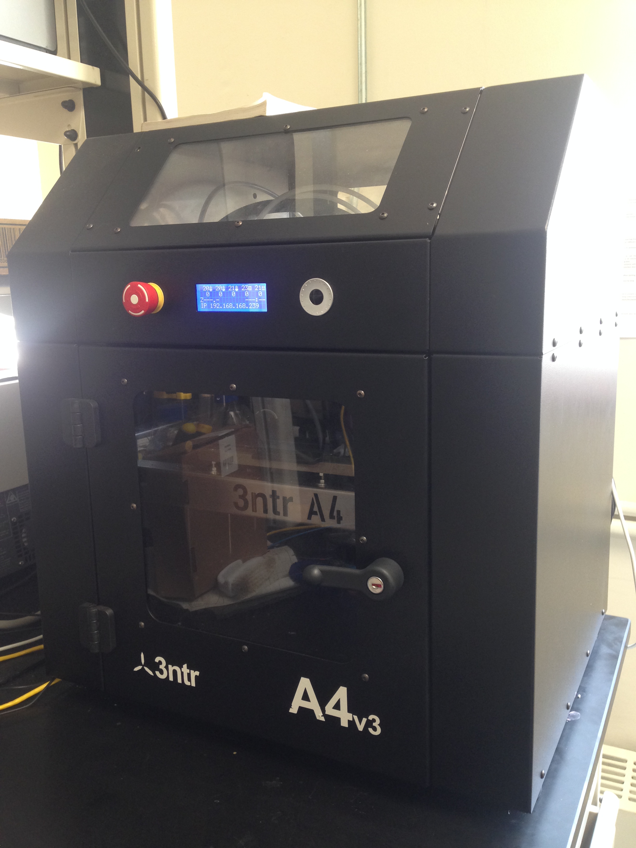
3ntr 3D Printer
Printed strips 1mm by 250mm
Starting at 240°C, moving down in increments of 2°C until polymer does not flow or adhere any longer
Time the printer as it prints the strips (105 seconds)
Find the mass of the strips
Mass over time gives mass flow rate
Look at quality of strips
Notes:
FDM printing – fused deposition modeling

Slide 11
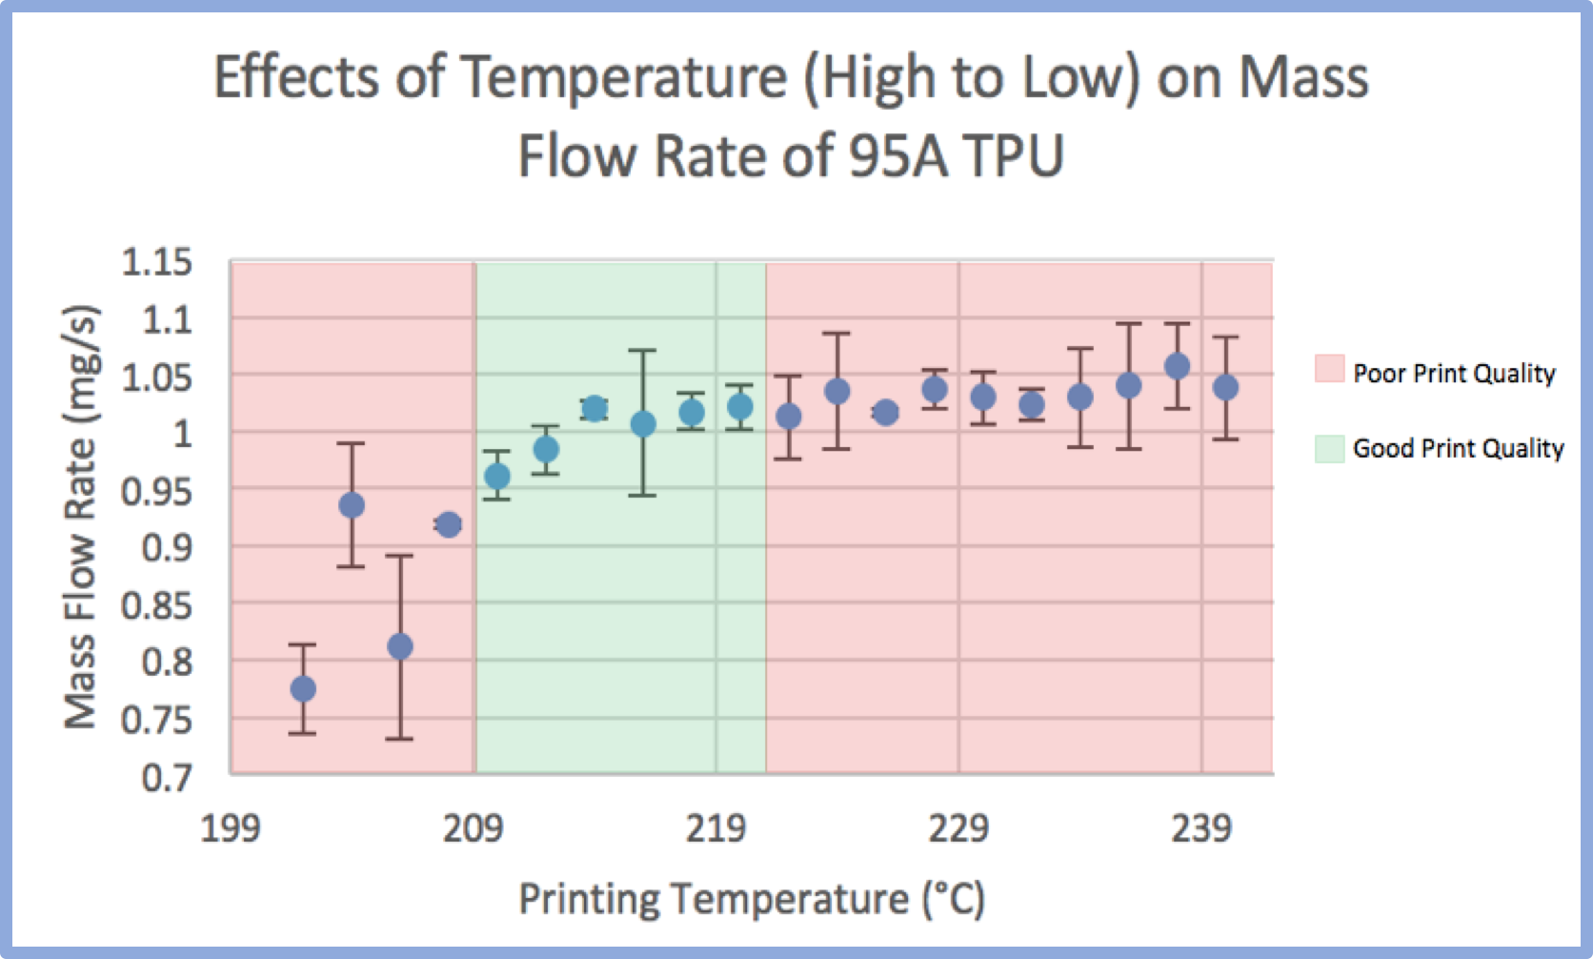

Slide 12
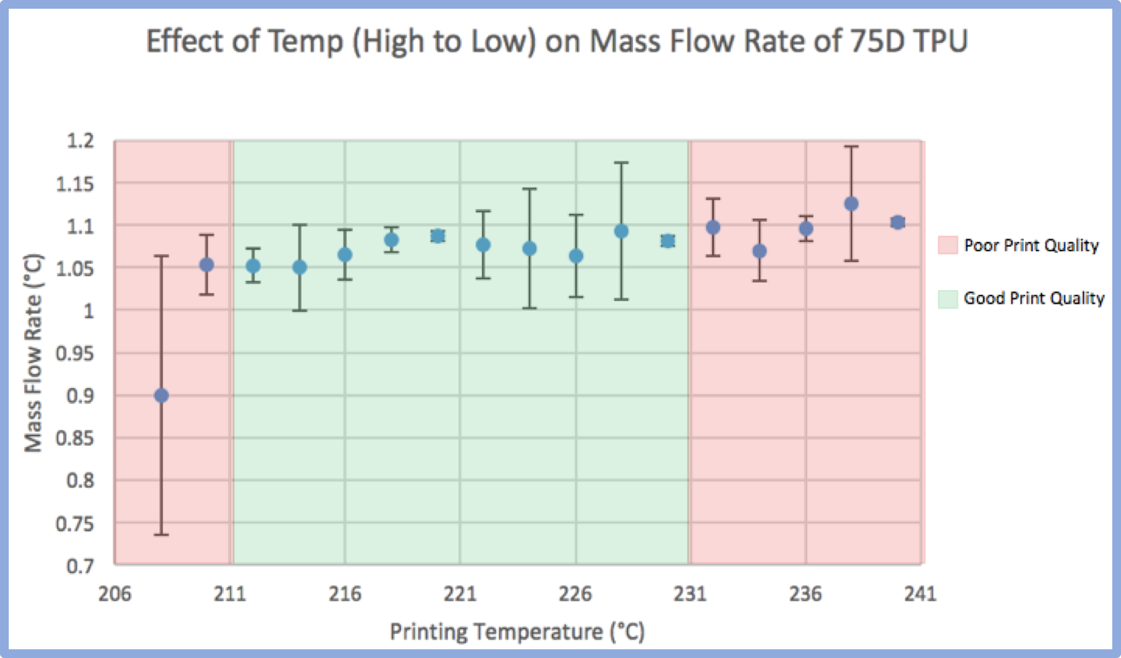

Slide 13
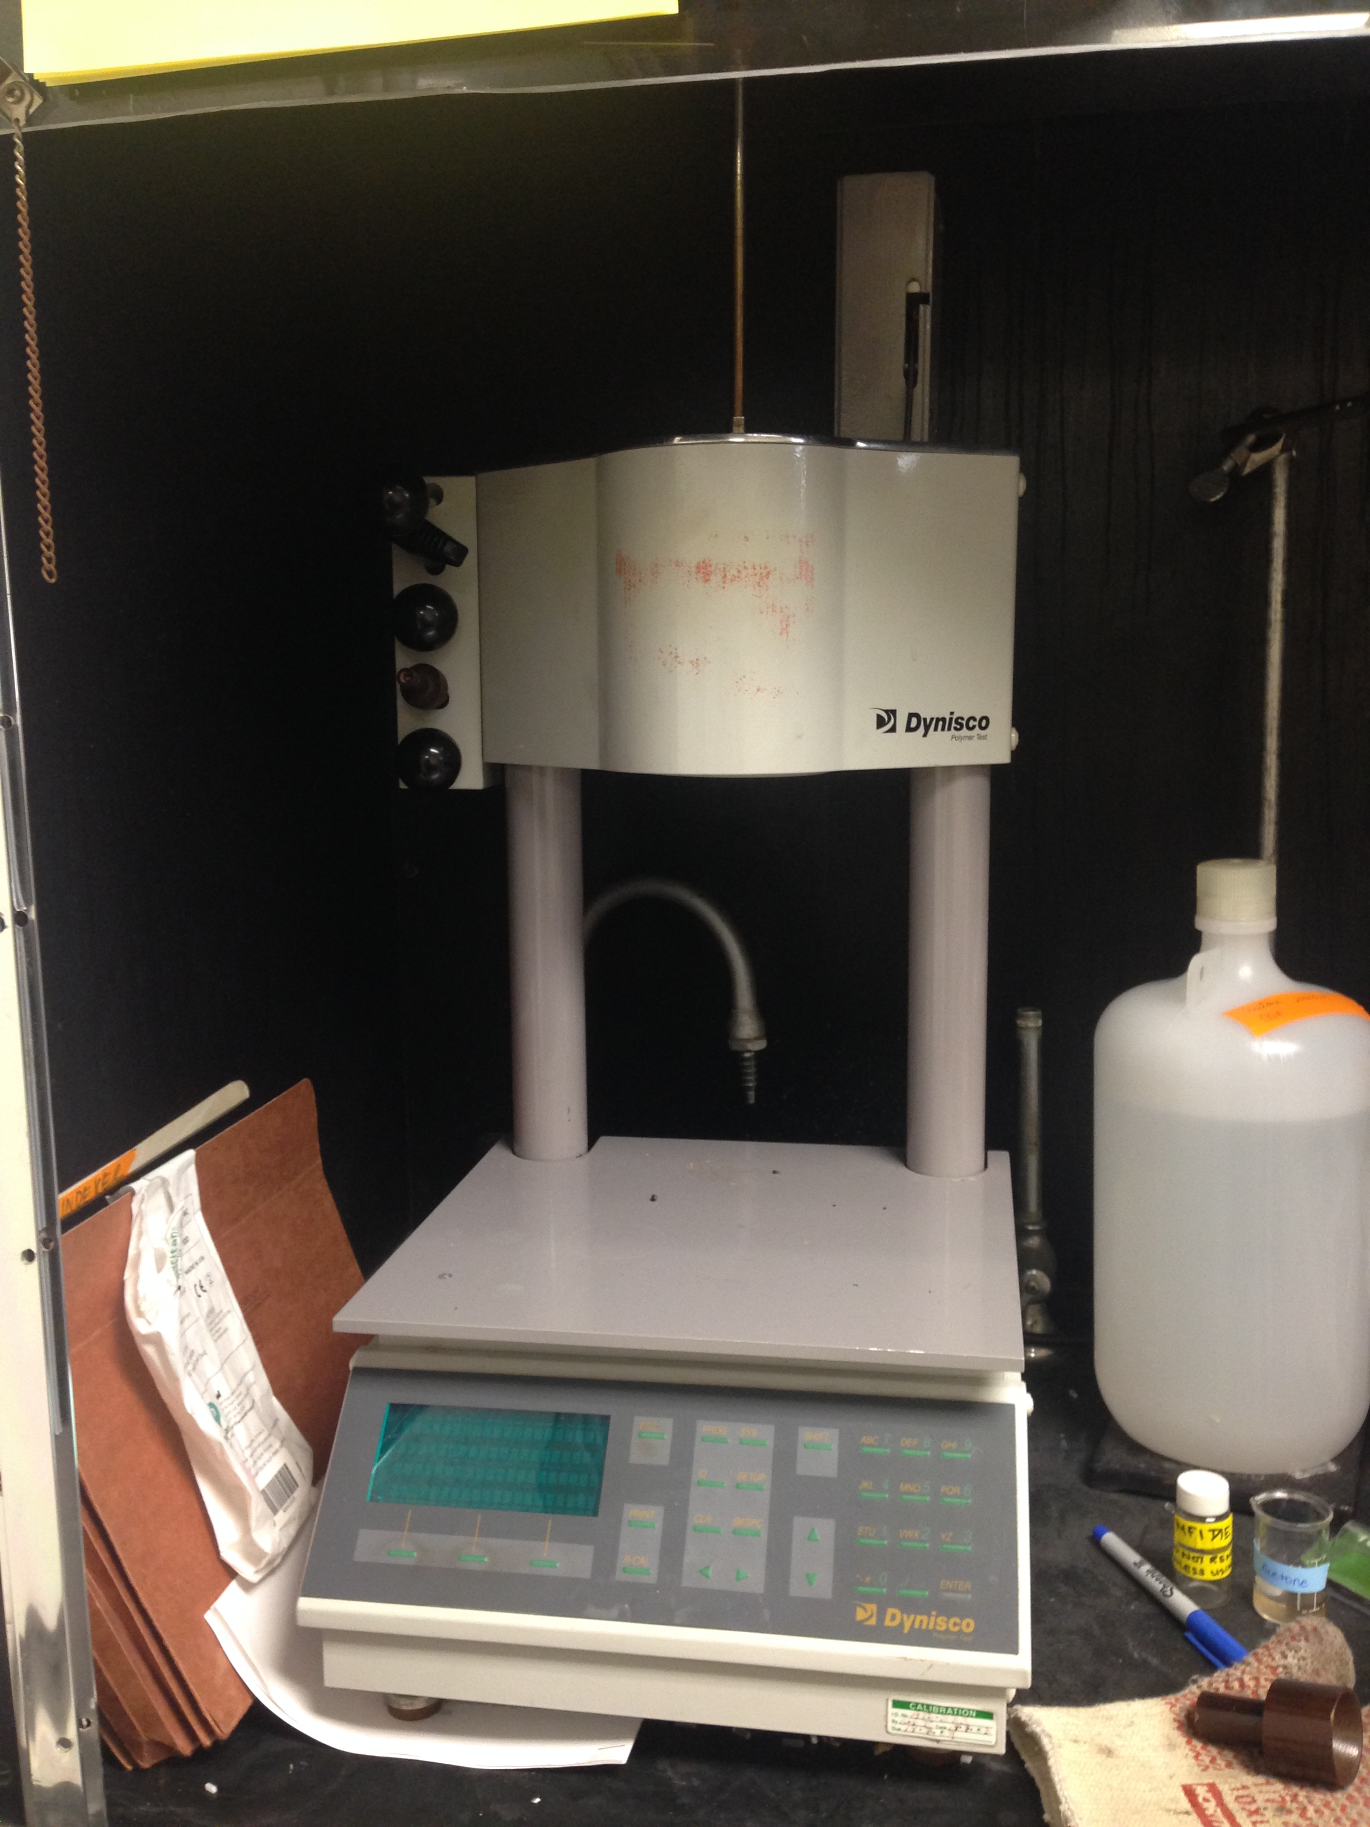
Melt Flow Index
Piston
Verification that the polymer flows
18°C above the DSC melt temperature
1.1kg weight on piston
240 seconds melt time
3 cuts, 20 seconds between cuts
3 trials for each polymer, 5g per trial
95A TPU at 230°C
  MFI = 39.0 g/10 min
75D TPU at 220°C
  MFI = 19.8 g/10 min
Heated Barrel
Die
Controls

Slide 14
Conclusions
DSC, MFI, and line printing tests
Printing parameters for different hardness TPUs
  95A: Good print quality from 210°C to 220°C, best flow rate at 220°C
  75D: Good print quality from 212°C to 230°C, best flow rate at 228°C

Slide 15
Future Work
Differences in adhesion in different types of TPU
  95A adhesion compared to 75D adhesion
Correlation of characterization and printing quality for different polymers

Slide 16
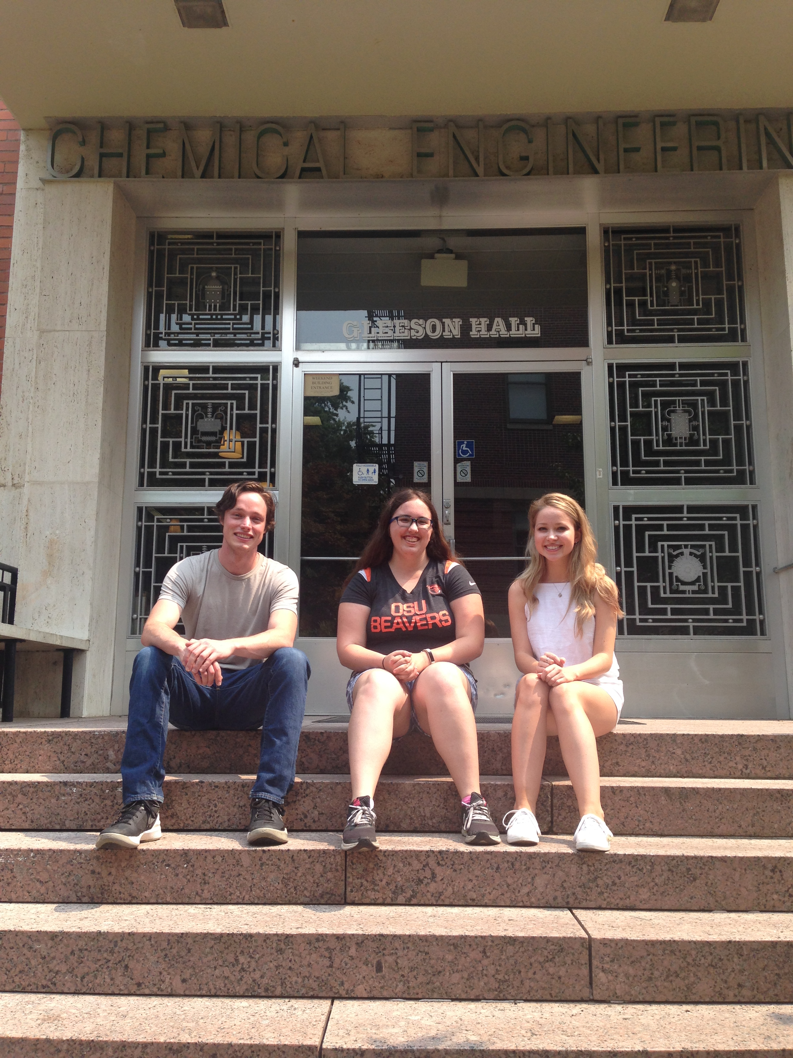
Acknowledgements
Dr. Skip Rochefort
Kelly Hollenbeck
Conor Harris
Sylvia Sorenson
Oregon State University
Saturday Academy

Slide 17
Questions?

