Slide 1
CS 569 Case Studies
How to observe

Slide 2
Stuff to include in observations:
We are observing the:
Space
Description
Meaning
Appropriateness
Objects (technological and not technological)
Description
Meaning
Appropriateness
People/activities
Description
Meaning/Role
Success/failure

Slide 3
People and Objects
My first “victim” was a male between 19/22 years old. He was about 5.9 feet tall and he was thin. He was wearing khaki short and a black T-shirt. He had black sport shoes. He was carrying with him his skate board. He had a big black back pack but it seemed almost empty. He had a lot of brown curly hair.
Because of his age and his skate board, I assumed he was a student; he “looked like” all the other teens. Furthermore, he seemed to know exactly where he was going, what he was looking for and how to get it. He never stopped during the time he was there and never gave the impression to be lost.

Slide 4
Actions
c
At 4:40pm, he came in from the A entrance and was looking toward the computer area. He decided to take a right just after Section 2. He walked a few steps and stopped. I assumed he realized no more desks were available in this are. It didn’t bother him, he didn’t feel embarrassed and turned back and went back from where he entered the area. He didn’t hesitate once then because he had seen a free desk. He chose to sit down in the Section 2 on a stool.

Slide 5
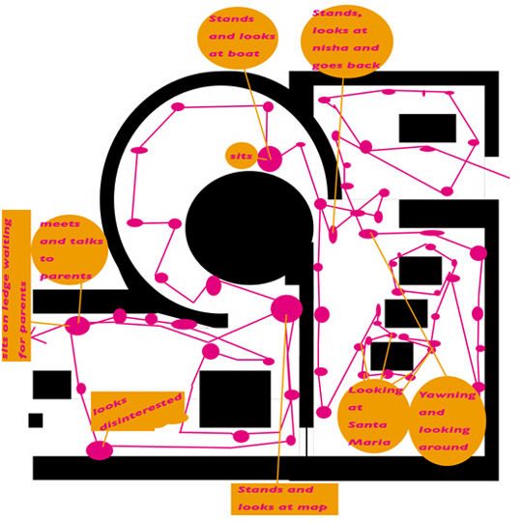
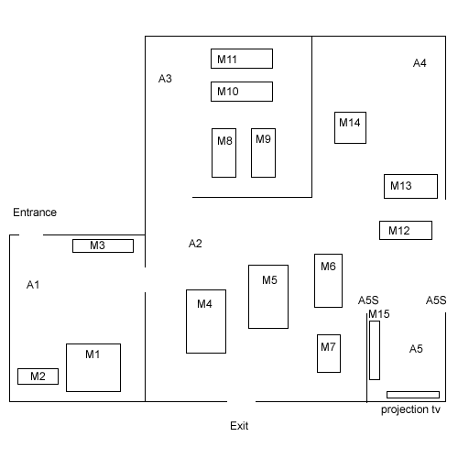
Space (and people)
Diagrams are worth 1000 words

Slide 6
Examples
Do they make us feel “there”?
What can we see in these, in detail?
Note desc/meaning/appropriateness.
Examples:
Observing software tutorial for teachers
Observing in KEC atrium

Slide 7
You and the observation
You:
Have your stuff ready. (extra pen, camera ...)
Dress like them. Explain: Not an evaluation of them, but rather to lean about X.
Don’t talk to your partner!
Fill in your notes immediately after.
Collect other data for triangulation, eg:
Official descriptions and sketches
eg: KEC atrium drawing. eg: e-cafe menus.
Artifacts subjects created.
eg: their doodles on their scratchpad.

Slide 8
In-class activity
<Demo>: The following people should:
group 1: learn from the demo.
group 2: observe the demo’er.
group 3: observe group 1.
Goal: How to help users like the ones you’re observing succeed at what they’re doing?
Observe (use paper for your notes)
Discuss a few (doc cam)
Does it make us feel “there”?
Reveals new info/subtleties, ie Insights?

