Slide 1
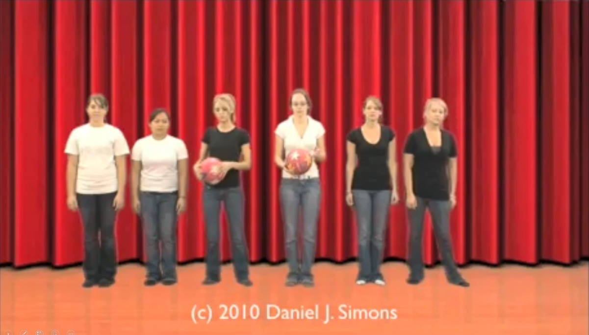
How many times does the white team pass the ball?

Slide 2


Slide 4
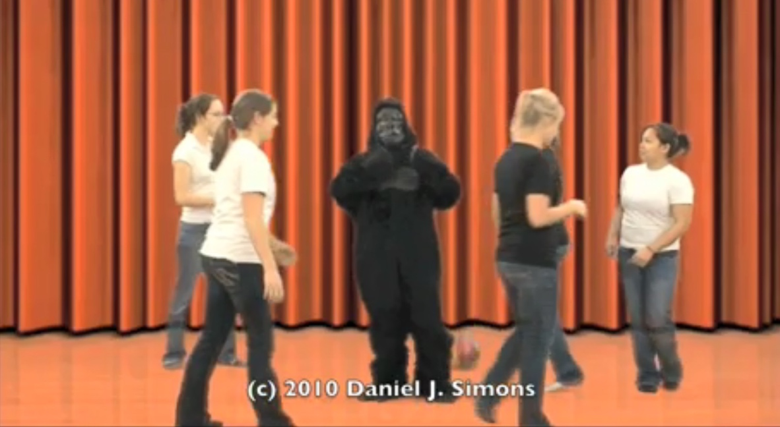
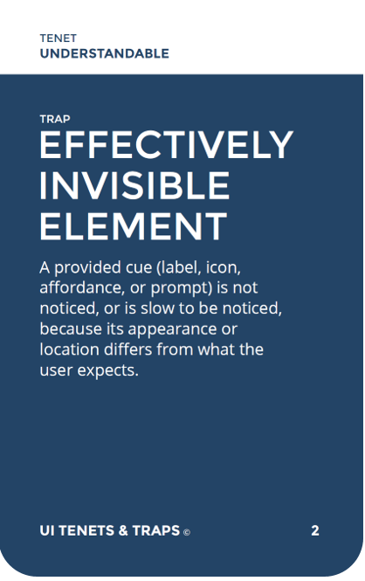
Expectations drive attention.
“I’ll see it when I believe it.” - Thane Pittman
Notes:
Bottom-up (passive) + Top-down (active); Dialog to receptors;
Optical nerve – Lateral geniculate nucleus – Primary visual cortex
Association, Action priming; GOAL-BASED
“95% of what you ‘see’ is what is already in your head”
Awareness is a model of reality. It is not reality.

