Slide 1
Intro Visual Navigation
Stefan Lee - Fall 2019
Notes:
10:41

Slide 2


Visual Navigation
Visual Navigation: Navigate from A to B in environment E using egocentric perception.
STOP
A
B
arxiv.org/abs/1807.06757

Slide 3
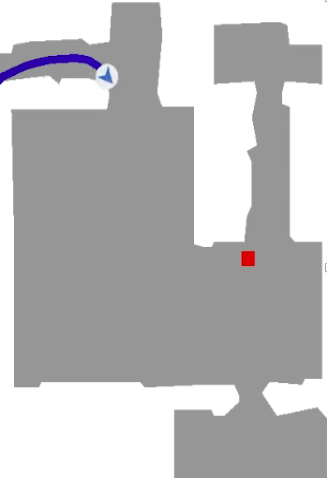
Ablations of this Problem
How to get to the red point?
Given a map
Path Planning
A* / RRT
Given location

Slide 4
Ablations of this Problem
How to get to the red point without a map?
Not given a map
Given location

Slide 5
Ablations of this Problem
How to get to the red point without a map?
Camera FOV

Slide 6
Ablations of this Problem
How to get to the red point without a map?

Slide 7
Ablations of this Problem
How to get to the red point without a map?
Path Planning
A* / RRT

Slide 8
Ablations of this Problem
How to get to the red point?

Slide 9
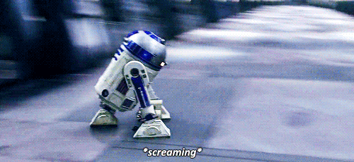
Ablations of this Problem
How to get to the red point?

Slide 10
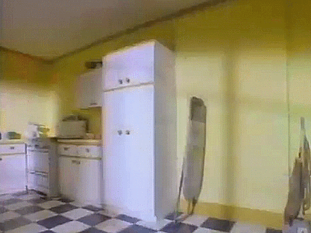
Ablations of this Problem
How to get to the red point?

Slide 11
Ablations of this Problem
How to get to the red point without a map?

Slide 12
Ablations of this Problem
How to get to the red point without a map?
Redo Path Planning
A* / RRT

Slide 13
Ablations of this Problem
How to get to the red point without a map?
(but with perfect localization)
While not at goal:
Project estimated free-space from current observation to map
If existing plan is no longer valid:
Assume rest of world is free-space and find new path
Take next step of plan

Slide 14
Ablations of this Problem
How to get to the red point without localization?
Given a map

Slide 15
Ablations of this Problem
How to get to the red point without localization?
Estimated Locations
Observation

Slide 16
Ablations of this Problem
How to get to the red point without localization?
Observation

Slide 17
Ablations of this Problem
How to get to the red point without localization?
Observation

Slide 18
Ablations of this Problem
How to get to the red point without localization?
Observation

Slide 19
Ablations of this Problem
How to get to the red point without localization?
(but with a perfect map)
While not at goal:
Project estimated free-space from current observation to map
Refine estimate of location based on alignment with map
Sample likely location and path plan to goal
Take next step of plan

Slide 20
Ablations of this Problem
How to get to the red point without a map or localization?
Not given a map
?
Only start location

Slide 21
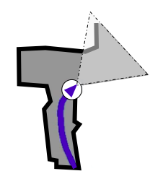
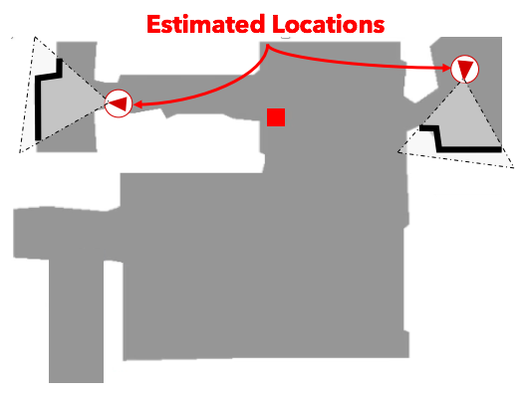
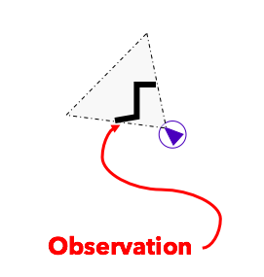
Ablations of this Problem
How to get to the red point without a map or localization?
Mapping
Localization

Slide 22
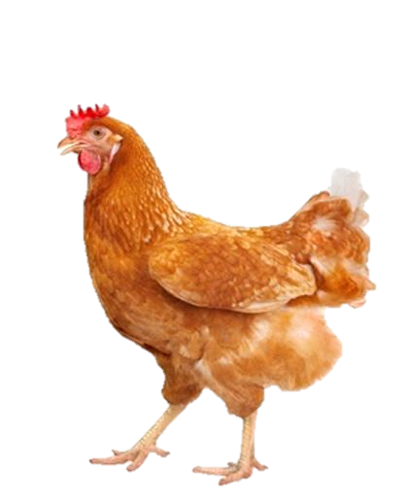
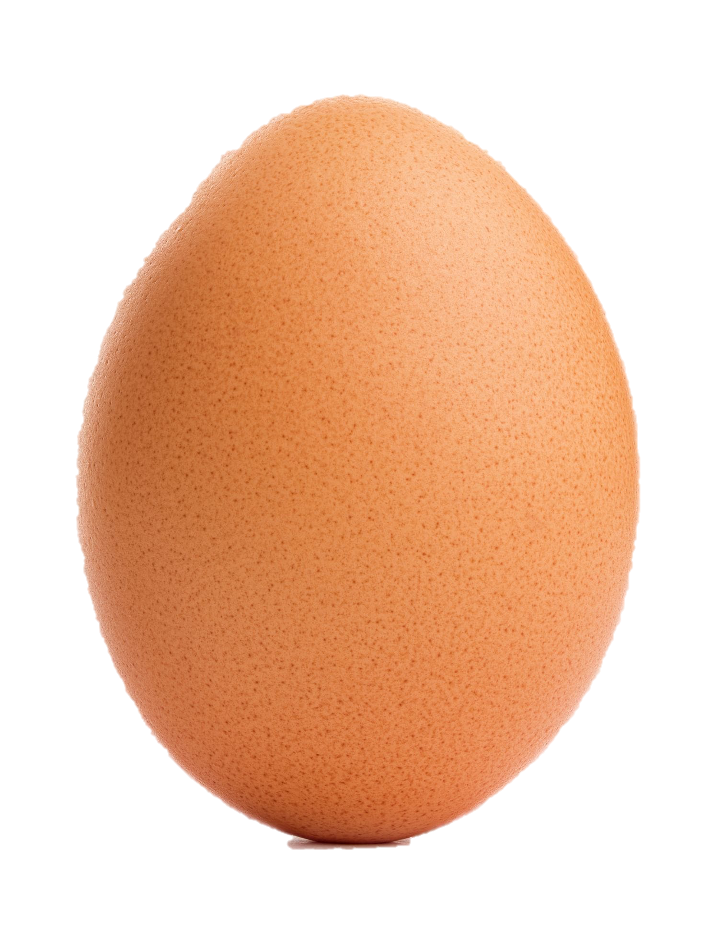
Ablations of this Problem
How to get to the red point without a map or localization?
Mapping
Localization

Slide 23
Ablations of this Problem
How to get to the red point without a map or localization?
Simultaneous Localization and Mapping (SLAM)
Mapping
Localization

Slide 24
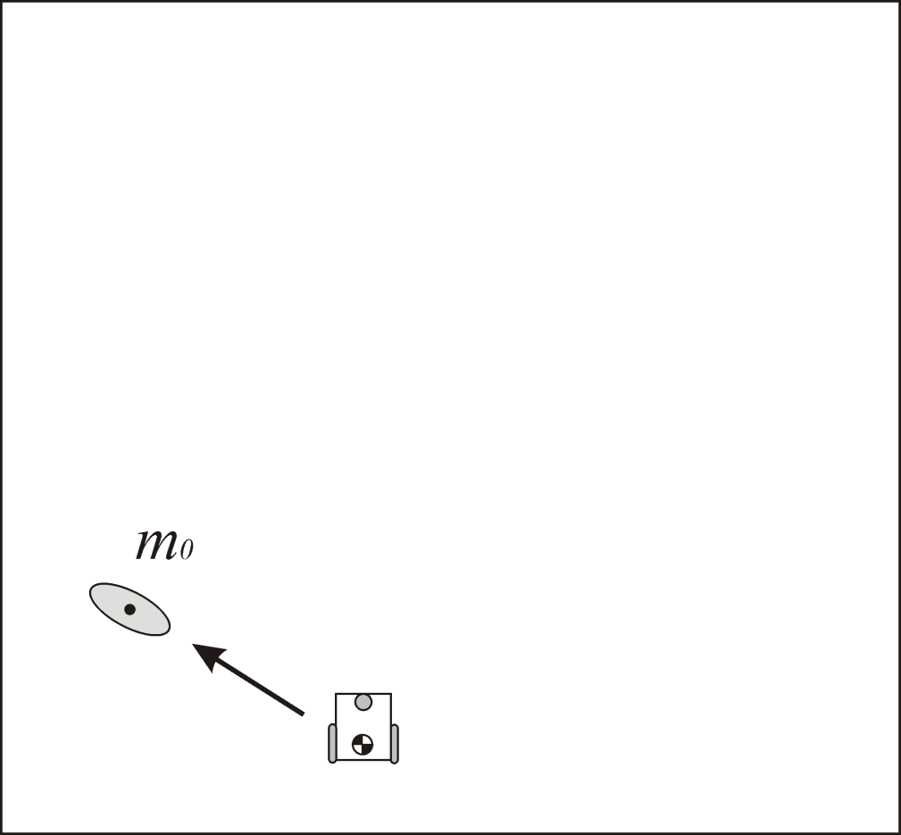
Simultaneous Localization and Mapping (SLAM)
Center coordinate frame
on start location

Slide 25
Simultaneous Localization and Mapping (SLAM)
Observe some
landmark

Slide 26
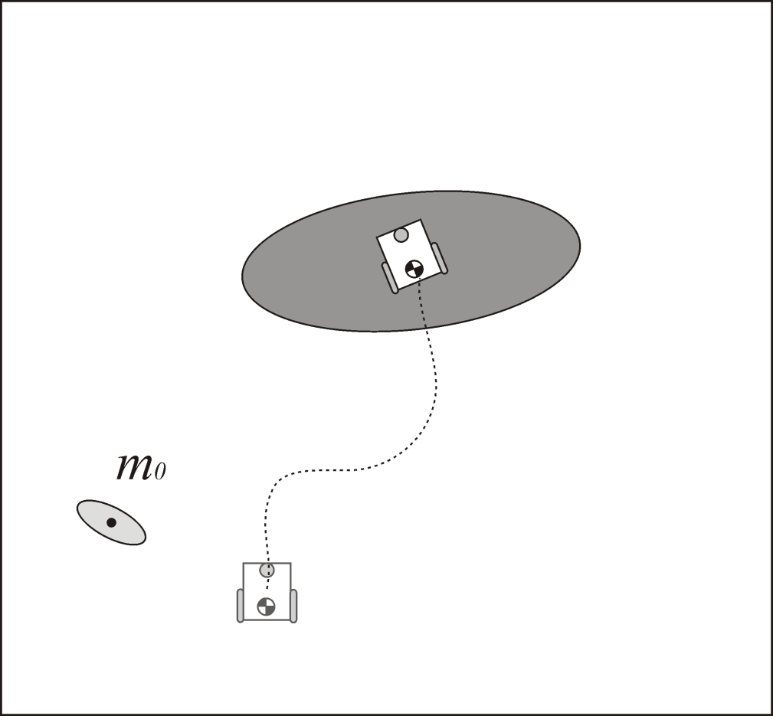
Simultaneous Localization and Mapping (SLAM)
Noisy estimate
of new location
Move

Slide 27
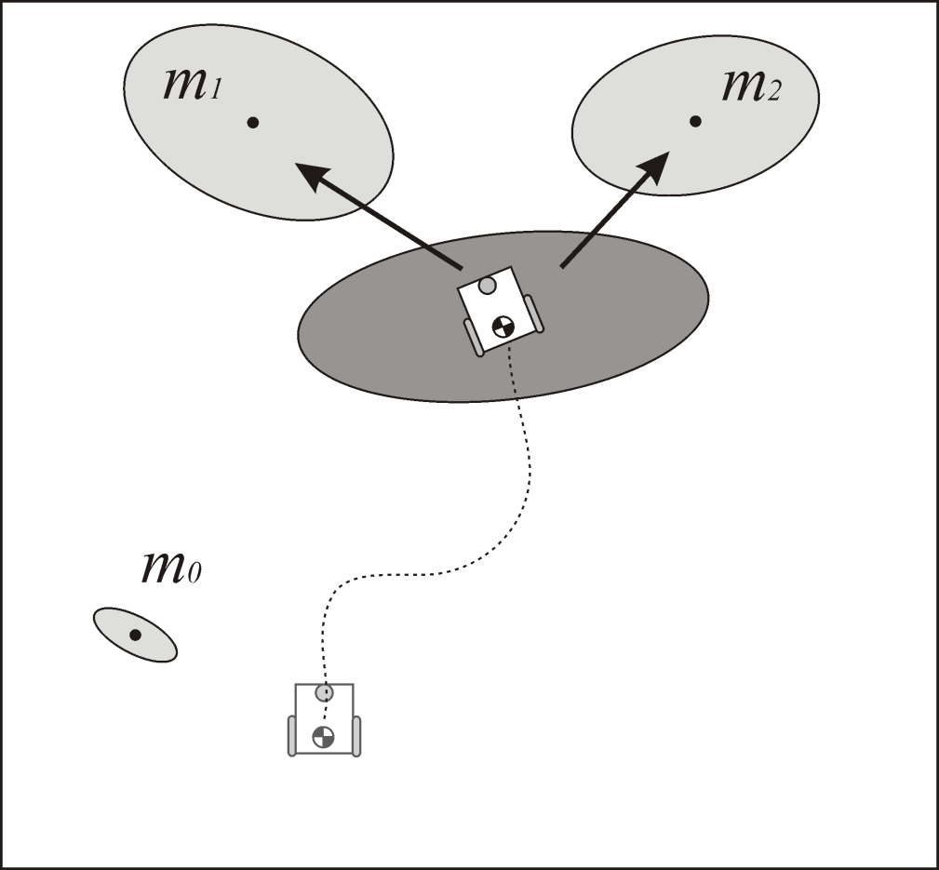
Simultaneous Localization and Mapping (SLAM)
New landmarks

Slide 28
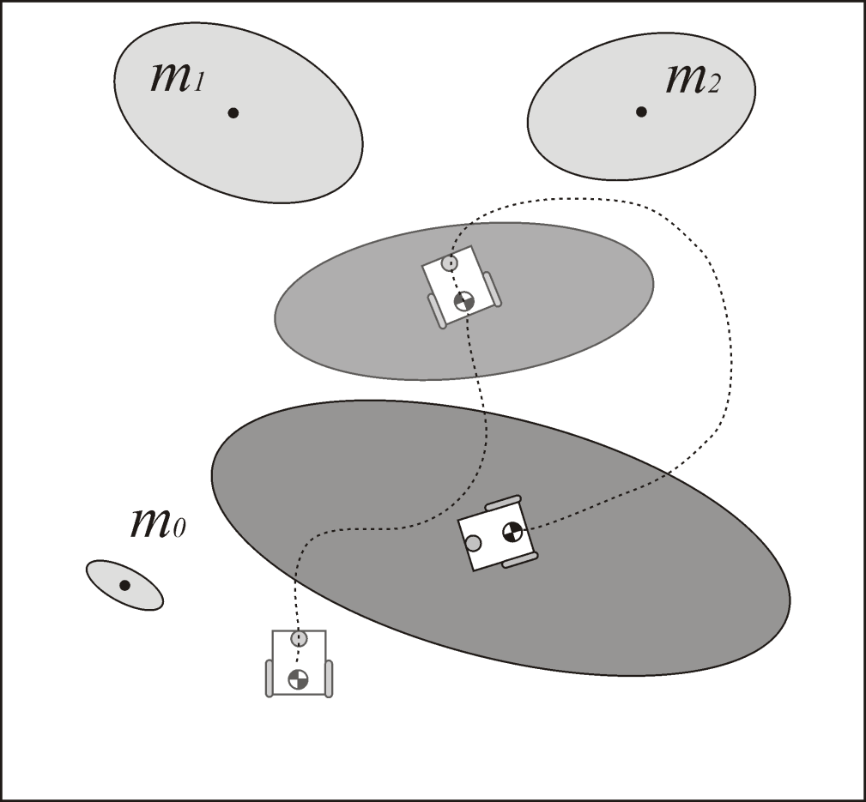
Simultaneous Localization and Mapping (SLAM)
Move
Noisy estimate
of new location

Slide 29
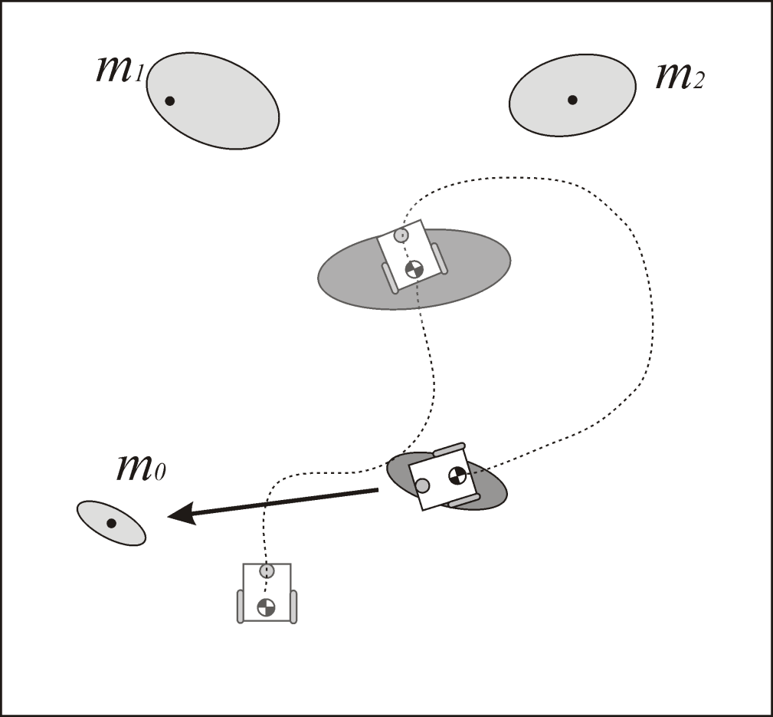
Simultaneous Localization and Mapping (SLAM)
Loop Closure

Slide 30
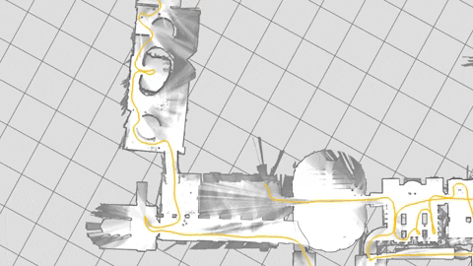
Simultaneous Localization and Mapping (SLAM)

Slide 31
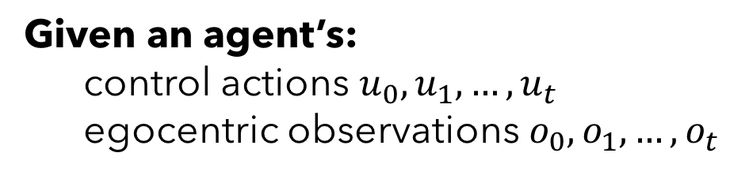
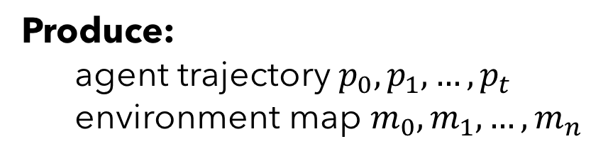
Simultaneous Localization and Mapping (SLAM)
SLAM Problem Definition:
Given an agent’s:
control actions $u_{0}, u_{1}, …, u_{t}$
egocentric observations $o_{0}, o_{1}, …, o_{t}$
Produce:
agent trajectory $p_{0}, p_{1}, …, p_{t}$
environment map $m_{0}, m_{1}, …, m_{n}$
$$m_{0:n}, p_{0:t }=argmax P\left(m_{0:n}, p_{0:t}\right|u_{0:t},o_{0:t})$$

Slide 32
Simultaneous Localization and Mapping (SLAM)
Given an agent’s:
control actions $u_{0}, u_{1}, …, u_{t}$
egocentric observations $o_{0}, o_{1}, …, o_{t}$
Produce:
agent trajectory $p_{0}, p_{1}, …, p_{t}$
environment map $m_{0}, m_{1}, …, m_{n}$

Slide 33
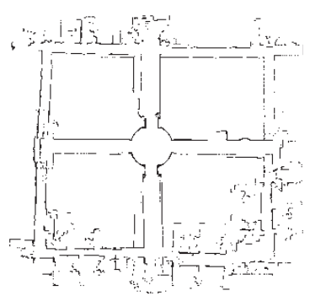
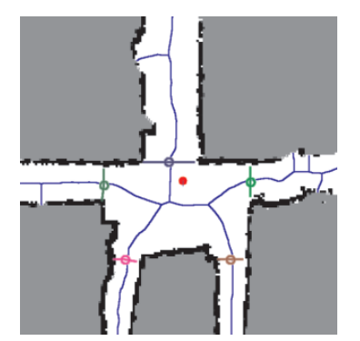
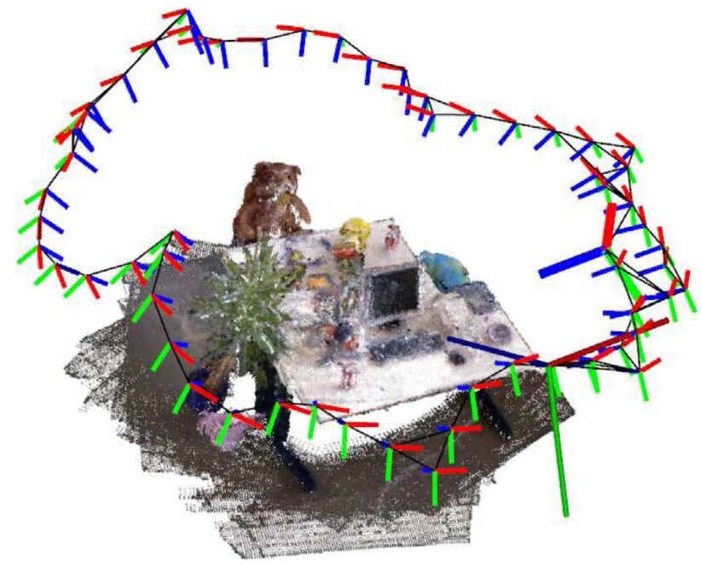
Simultaneous Localization and Mapping (SLAM)
Output Map:
Metric
Topological
Reconstruction

Slide 34

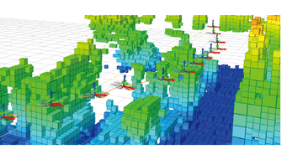
Simultaneous Localization and Mapping (SLAM)
Navigation often requires only free-space / occupancy map:
2D
3D

Slide 35
Simultaneous Localization and Mapping (SLAM)
Major approaches to the problem:
Extended Kalman Filtering SLAM (EKF SLAM)
Particle Filtering SLAM (FAST-SLAM)
Graph-based SLAM

Slide 36
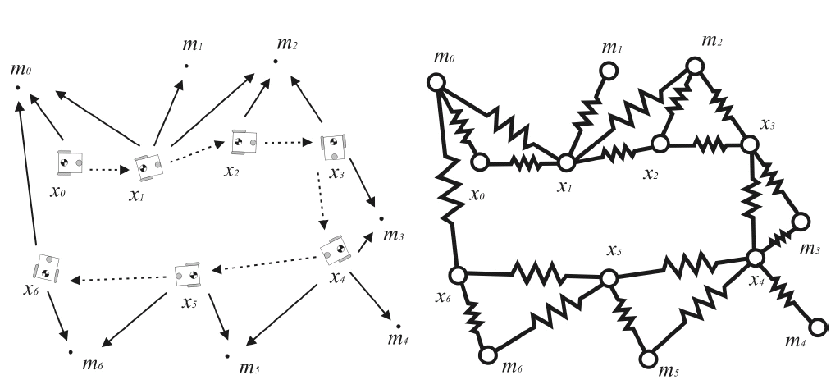
Simultaneous Localization and Mapping (SLAM)
Major approaches to the problem:
Extended Kalman Filtering SLAM (EKF SLAM)
Particle Filtering SLAM (FAST-SLAM)
Graph-based SLAM

Slide 37
Simultaneous Localization and Mapping (SLAM)
OrbSLAM2 https://bit.ly/31V9aCG

Slide 38
Classic Approach to Visual Navigation
Notes:
10:41

Slide 39
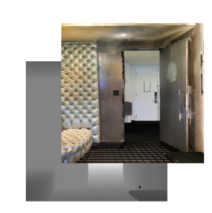
Classic Approach to Visual Navigation
[X, Y]
SLAM
Planning
Locomotion
forward

Slide 40
Classic Approach to Visual Navigation
2D Free-Space Map
SLAM
3 DOF Pose

Slide 41
Classic Approach to Visual Navigation
[X, Y]
2D Free-Space Map
Path
Planning
3 DOF Pose

Slide 42
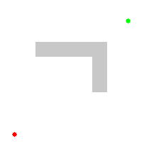
Classic Approach to Visual Navigation
Planning
[X, Y]
A* Path Planning

Slide 43
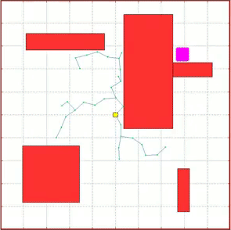
Classic Approach to Visual Navigation
Planning
[X, Y]
RRT* Path Planning

Slide 44
Classic Approach to Visual Navigation
Path
Locomotion
forward

Slide 45
Classic Approach to Visual Navigation
[X, Y]
SLAM
Planning
Locomotion
forward

Slide 46
Classic Approach to Visual Navigation

Slide 47
Classic Approach to Visual Navigation
Benchmarking Classic and Learned Navigation in Complex 3D Environments
[X, Y]
OrbSLAM2
D* Lite
Custom Heuristic
Mapping
2D Map
Planning
Locomotion
6-DOF
Pose
Path
2-DOF Pose
Localization
3-DOF Pose
Action

Slide 48
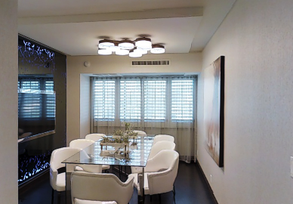
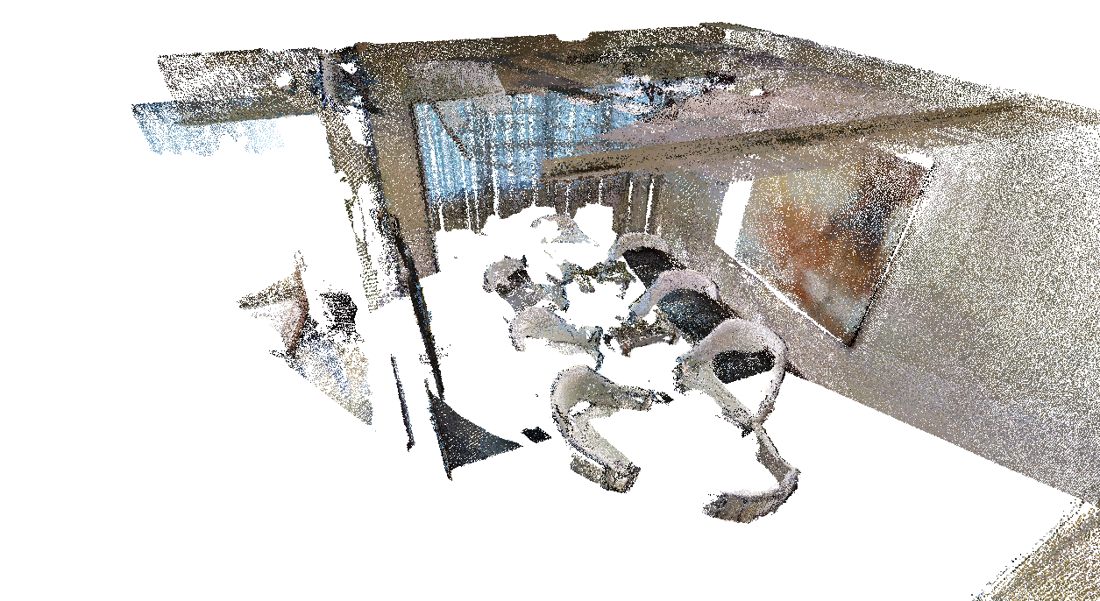

Classic Approach to Visual Navigation -- Mapping
Mapping
2D Map
Planning
RGB-D Image
Projected Pointcloud
Projection
$$[x,y,z, R]$$
Discretize the XY map plane. Count number of points over certain height.

Slide 49
Classic Approach to Visual Navigation
Benchmarking Classic and Learned Navigation in Complex 3D Environments
[X, Y]
OrbSLAM2
D* Lite
Custom Heuristic
Mapping
2D Map
Planning
Locomotion
6-DOF
Pose
Path
2-DOF Pose
Localization
3-DOF Pose
Action

Slide 50
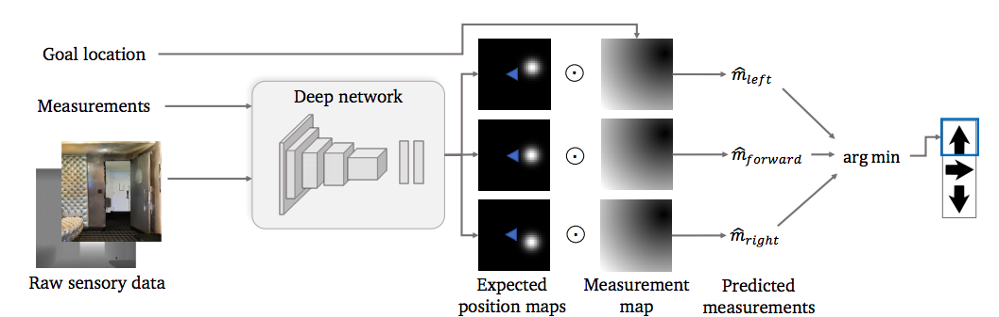
Classic Approach to Visual Navigation
Benchmarking Classic and Learned Navigation in Complex 3D Environments

Slide 51
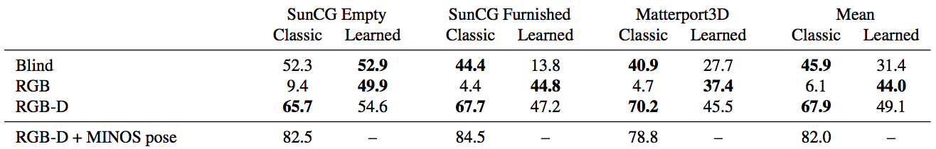
Classic Approach to Visual Navigation

Slide 52
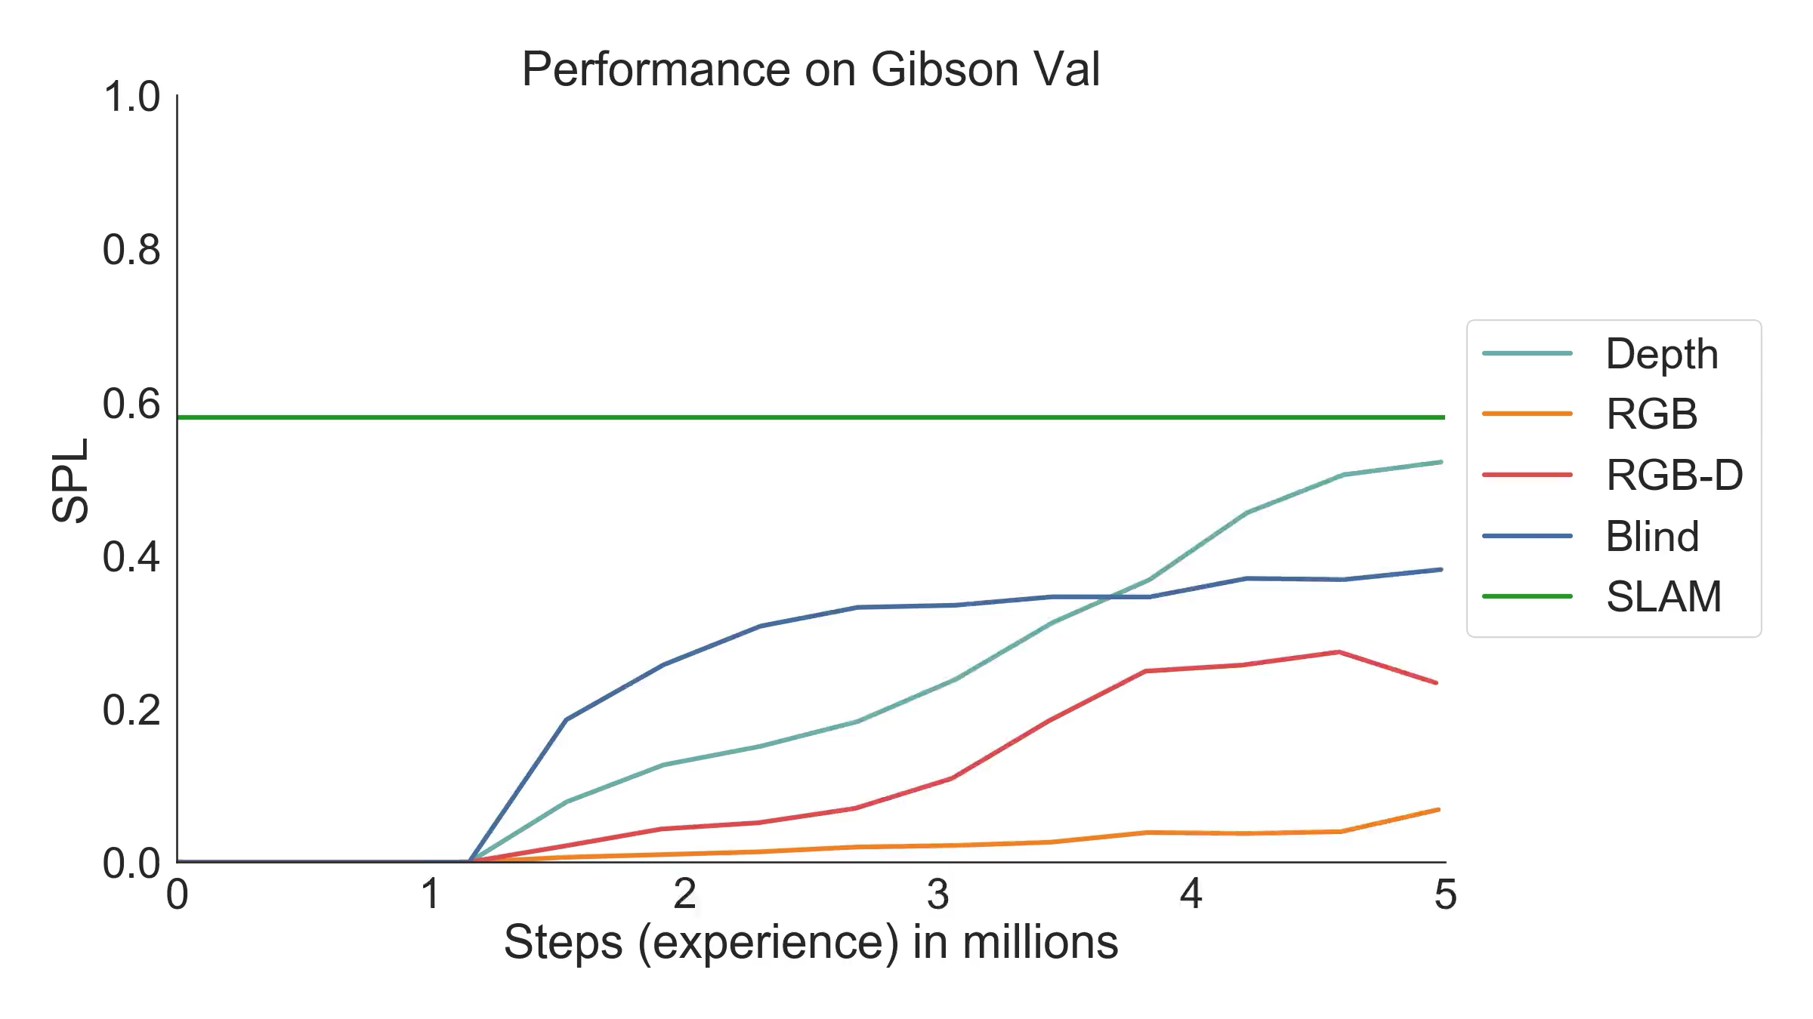
SLAM
w/ Pose

Slide 53
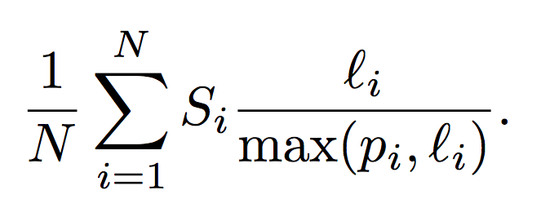
Visual Navigation: Evaluation
Success Rate
  Percentage of episodes where agents actually reach the goal
  ”reach” is typically defined as epsilon meters away (~0.2m)
Success weighted by Path Length
  Cares not only about success, but also efficiency
Binary Success
Shortest Path Length
Average Over Episodes
Agent Path Length

Slide 54
Papers for this Module
Notes:
10:41

Slide 55
Papers for this Module
Why these papers?
Learning to Navigate in Complex Environments arxiv.org/pdf/1611.03673.pdf
Habitat: A Platform for Embodied AI Research arxiv.org/pdf/1904.01201.pdf
Semi-parametric Topological Memory for Navigation arxiv.org/pdf/1803.00653.pdf
Cognitive Mapping and Planning for Visual Navigation arxiv.org/pdf/1702.03920.pdf

Slide 56
Papers for this Module – Environment Quality
Synthetic Environments
Realistic Environments
Learning to Navigate in Complex Environments
Habitat: A Platform for Embodied AI Research
Semi-parametric Topological Memory for Navigation
Cognitive Mapping and Planning for Visual Navigation

Slide 57
Papers for this Module – Environment Exposure
Seen Test Environments
Unseen Test Environments
Learning to Navigate in Complex Environments
Habitat: A Platform for Embodied AI Research
Semi-parametric Topological Memory for Navigation
Cognitive Mapping and Planning for Visual Navigation

Slide 58
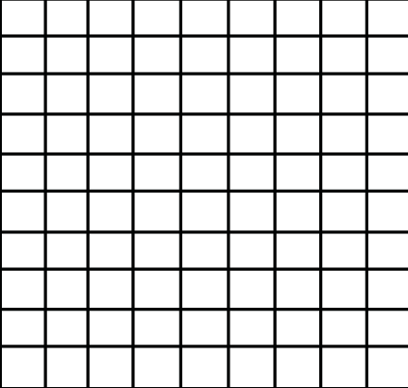
Papers for this Module – Environment Representation
Unstructured
Topological
Spatial
Learning to Navigate in Complex Environments
Semi-parametric Topological Memory for Navigation
Cognitive Mapping and Planning for Visual Navigation
Habitat: A Platform for Embodied AI Research

Slide 59
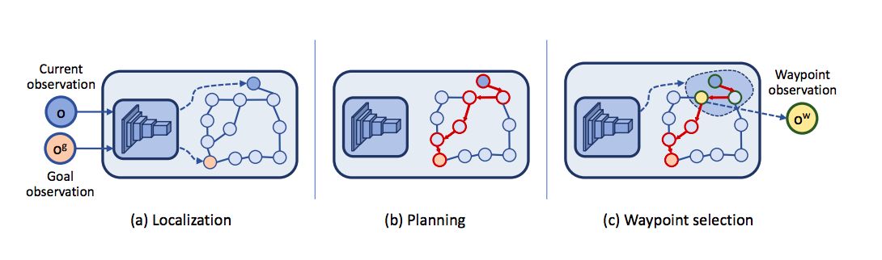
Papers for this Module – Environment Representation
Unstructured
Topological
Spatial
Learning to Navigate in Complex Environments
Semi-parametric Topological Memory for Navigation
Cognitive Mapping and Planning for Visual Navigation
Habitat: A Platform for Embodied AI Research

Slide 60
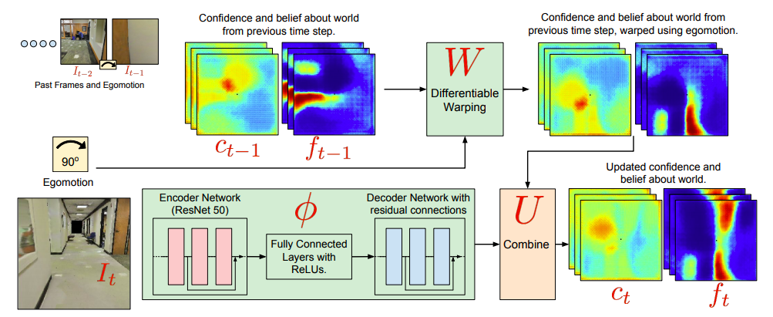
Papers for this Module – Environment Representation
Unstructured
Topological
Spatial
Learning to Navigate in Complex Environments
Semi-parametric Topological Memory for Navigation
Cognitive Mapping and Planning for Visual Navigation
Habitat: A Platform for Embodied AI Research

Slide 61
Papers for this Module – How to train?
Imitation Learning
Reinforcement Learning
Semi-parametric Topological Memory for Navigation
Learning to Navigate in Complex Environments
Behavior
Cloning
A3C
Cognitive Mapping and Planning for Visual Navigation
Habitat: A Platform for Embodied AI Research
DAGGER
PPO

Slide 62
Papers for this Module – To Plan or Not to Plan?
Explicit Planning
Purely Policy
Semi-parametric Topological Memory for Navigation
Learning to Navigate in Complex Environments
Dijkstra
Cognitive Mapping and Planning for Visual Navigation
Habitat: A Platform for Embodied AI Research
Value
Iteration

Slide 63
Papers for this Module – Navigation Target
PointNav
ObjectNav
AreaNav (visual)
Learning to Navigate in Complex Environments
Cognitive Mapping and Planning for Visual Navigation
Semi-parametric Topological Memory for Navigation
Habitat: A Platform for Embodied AI Research
Cognitive Mapping and Planning for Visual Navigation

Slide 64
Papers for this Module – Goals Specification
Explicit Goals
Implicit Goals
Habitat: A Platform for Embodied AI Research
Learning to Navigate in Complex Environments
Semi-parametric Topological Memory for Navigation
Cognitive Mapping and Planning for Visual Navigation

