Slide 1
Notes:
Brett/Nicole

Slide 2
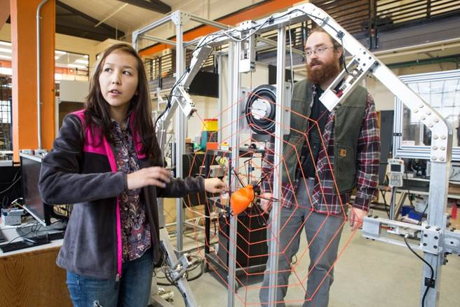
The College of Engineering at Oregon State
Approximately 8000 undergraduates
Largest college at OSU
1/4 of the student population
Over 200 tenure faculty members
Over $3 million in scholarships for engineering students each year
Cutting edge research in every field of engineering

Slide 3
Engineering Majors at Oregon State University
Bioengineering
Chemical Engineering
Environmental Engineering
Ecological Engineering
Civil Engineering
Construction Engineering Management
Mechanical Engineering
Manufacturing Engineering
Industrial Engineering
Energy Systems Engineering
Electrical & Computer Engineering
Computer Science
Nuclear Engineering
Radiation Health Physics

Slide 4
Meet ATRIAS
Notes:
If the video will not play from the slide, the heading has a hyperlink that will take you to the youtube page.
ATRIAS is a bipedal robot built by OSU students in the Dynamic Robotics Laboratory. The OSU Dynamic Robotics Lab has been developing robots that are able to hop, jump, bounce, walk and many other functions that legs are used for. Students observe the control methods that birds, such as ostriches, use for navigating through terrain. They apply what they observe to develop robots that can mimic these motions. The dynamic robotics lab also does research creating delicate robots for bomb-defusing, lower and upper extremity prosthetic limbs, exoskeletons for military use, and assisted mobility for disabled persons.

Slide 5
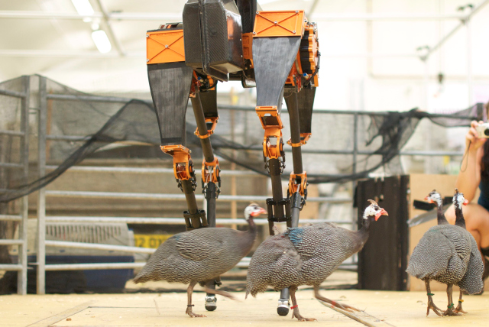
Which Engineers Designed ATRIAS?
Mechanical Engineers
Design engineers
Electrical Engineers
Hardware engineers
Computer Scientists
Programming engineers
Manufacturing & Industrial Engineers
Efficiency engineers
Notes:
Talk with your neighbor and try to come up with some ideas of who you think is a part of designing a robot like ATRIAS?
--Give candy to participants who share their answers with the class--
Show the answers after ideas have been thrown out and briefly describe each role. Can be general or related to the robot. Talk about how engineers collaborate with each other and engineers in other fields to complete a project. (Stress TEAMWORK!)

Slide 6
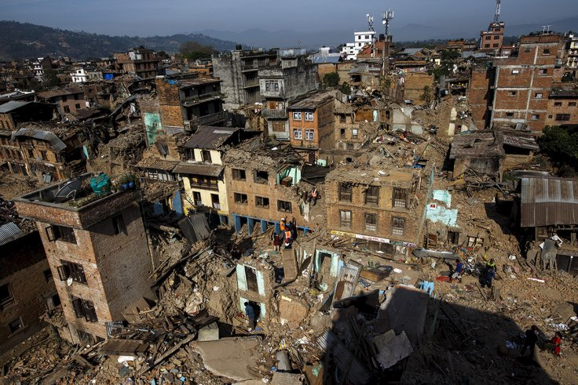
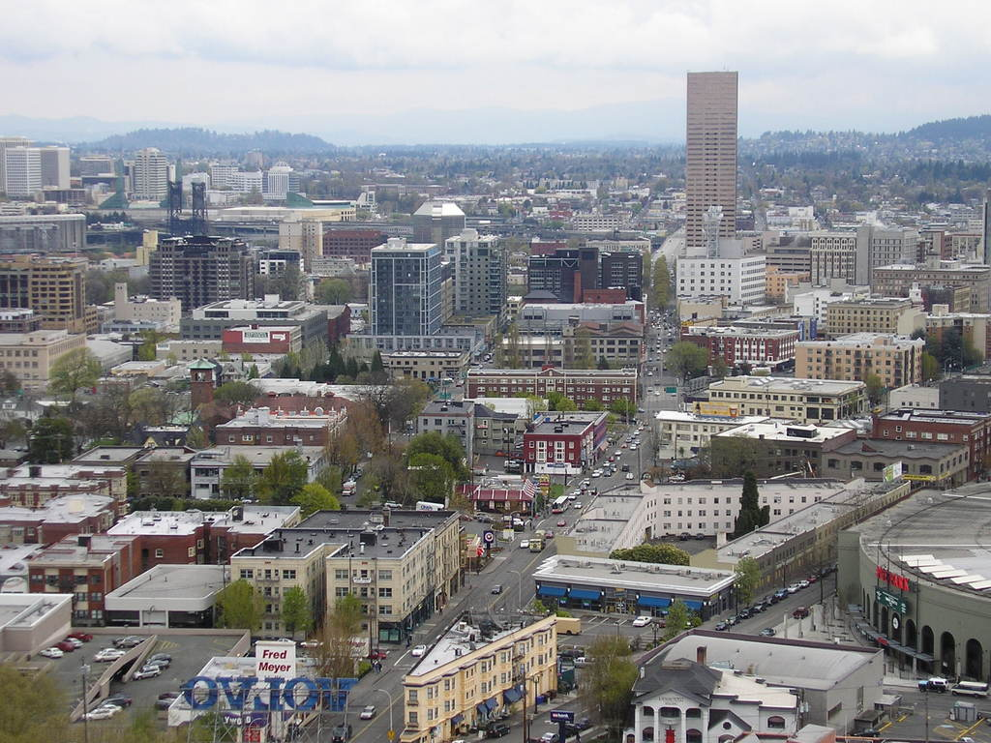
April 2015 Nepal Earthquake
Civil Engineers
Analyze how structures reacted to the earthquake and how the building materials could be improved.
Computer Scientists
Process 3D scans a sampling in order to create a model that can be used and tested by civil engineers at Oregon State to improve infrastructure here in the Northwest
Notes:
The building materials used in Nepal are very similar to those used here in the PNW. Civil Engineering students traveled to Nepal and took samples and 3D scans of the aftermath and now are working to analyze their data to build structures with features to prevent such a catastrophic event from taking place here.

Slide 7
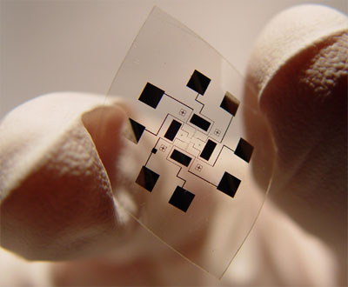
Nanowire Sensors
Chemical Engineers
Use material science applications to engineer a series of nanowires to collect data from the patients blood
Bioengineers
Use biological processes to interpret the collected data quickly and accurately
Notes:
Nanowire sensors can be used to provide and accurate measure of blood glucose concentrations.
This technology is developing in order to help type 1 diabetes patients to manage this blood sugar levels quickly and easily.

Slide 8
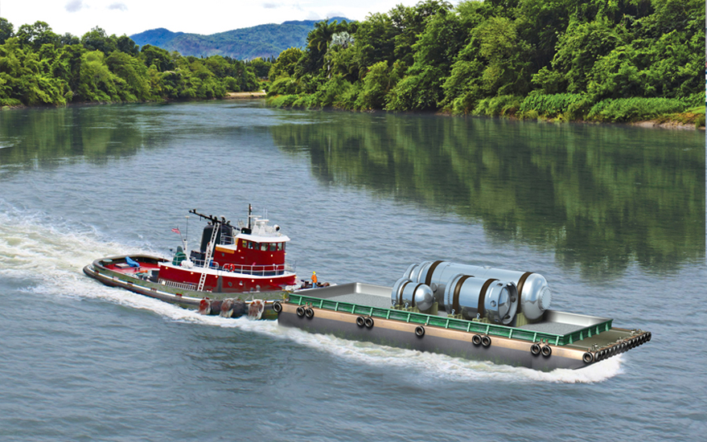
NuScale Modular Reactors
Nuclear Engineers
Designing small mobile reactors that could be deployed to emergency situations to supply immediate power.
Industrial and Manufacturing Engineers
Streamline reactors in order to make them reproducible and affordable.
Notes:
These are small reactors that could be set up in an array to power whole cities effected by natural disasters. This company was started and is mostly staffed by OSU alumni.

Slide 9
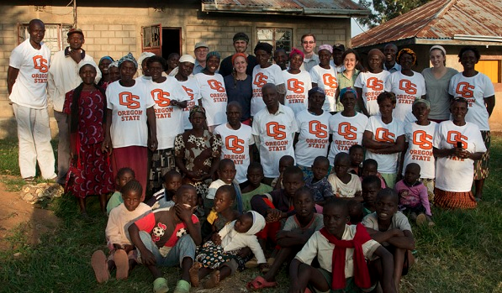
Humanitarian Engineering
Engineering based solutions to improve the human condition
New minor offered to ANY engineering student
Take classes to help make a difference

Slide 10
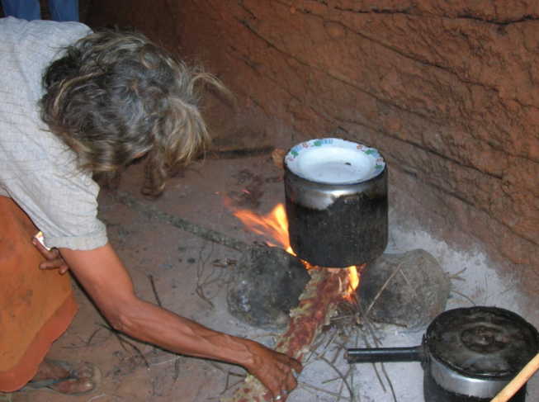
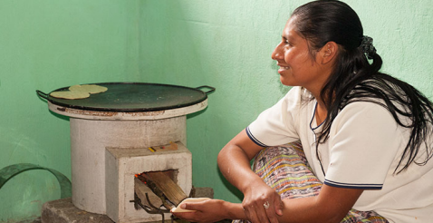
Why Cookstoves?
Three Stove Fires
Harmful to health
Smoke and Burns
Climate Change
Labor Intensive work for women and children of the villages
Cookstoves
Use supplies villages have easy access to like animal waste, coffee husks, and similar items that would otherwise be waste.
Significantly reduced smoke
Little to no environmental damage.
Tradition Three Stone Fires
StoveTeam International Cookstoves
Notes:
Talk with your neighbor and try to come up with three reasons why three stone fires are not a good option for families?
--Give candy to participants who share their answers with the class--

Slide 11
Where Engineers Work?
Semiconductor production
Intel, ON Semiconductor, HP
Pharmaceuticals
- Genentech, Bend Research, W.R. Grace (Albany)
Consumer Products & Food
- Oregon Freeze Dry, NIKE, Garmin
Oil, Chemical, Materials
Chevron, Shell, Exxon-Mobil, Wah-Chang (metals), ENTEK
Pulp and paper
Georgia-Pacific
…..many smaller companies
Biofuels, medical products,
Microsoft, Google, Facebook,

Slide 12
Great Salaries!
Average Starting Salaries in 2015 (estimates)
Nuclear Engineering $68,000
Chemical Engineering $66,000
Biomedical Engineering $63,000
Computer Engineering $65,000
Electrical Engineering $63,000
Mechanical Engineering $61,000
Industrial Engineering $58,000
Construction Engr. Mangmt. $55,000
Civil Engineering $55,000
Chemistry $40,000
Biology $32,000

Slide 13
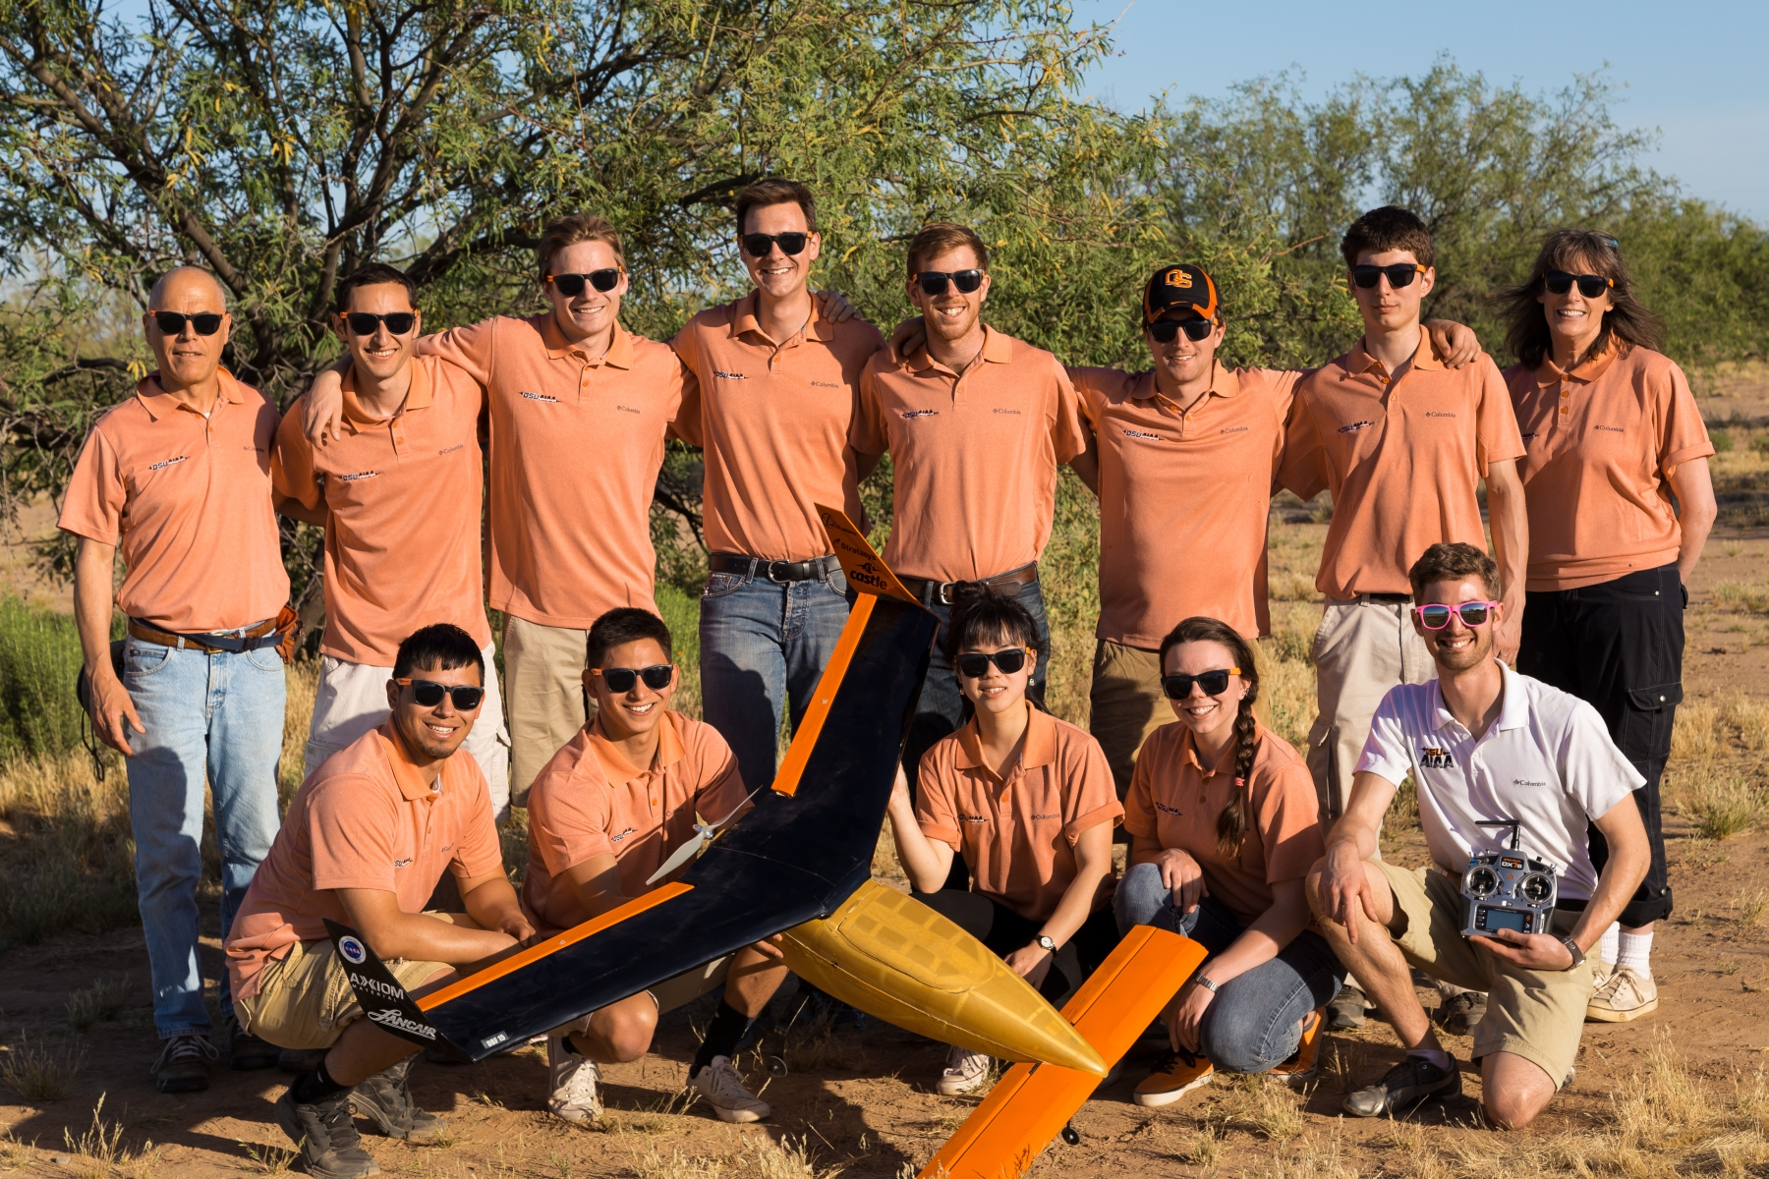
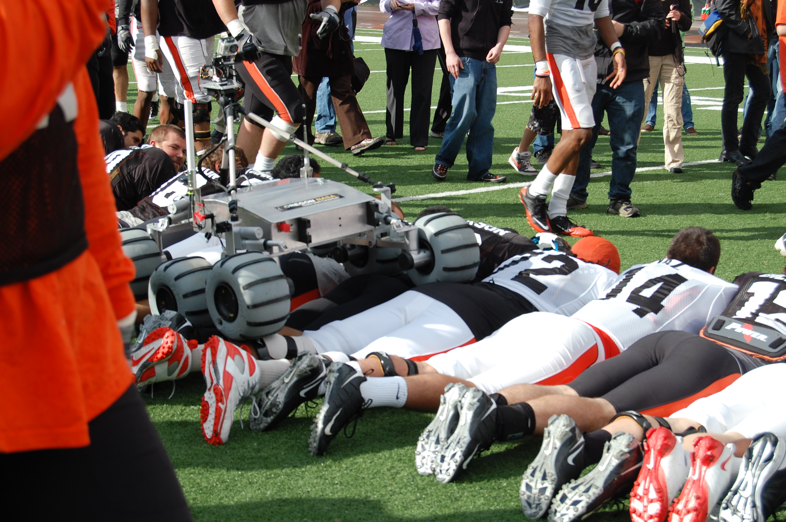
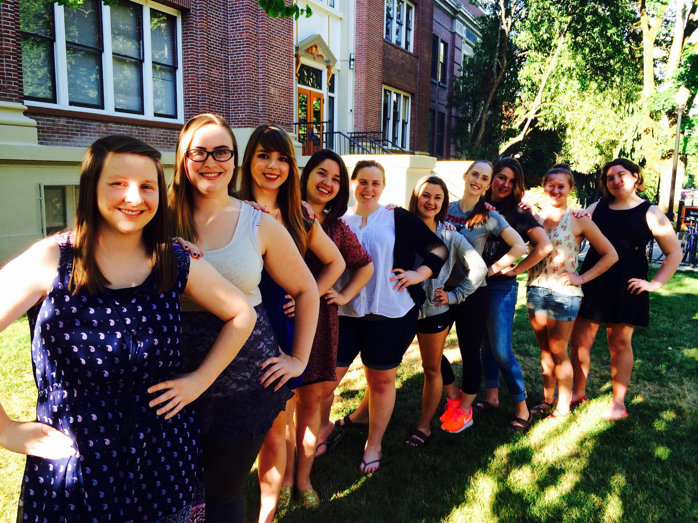
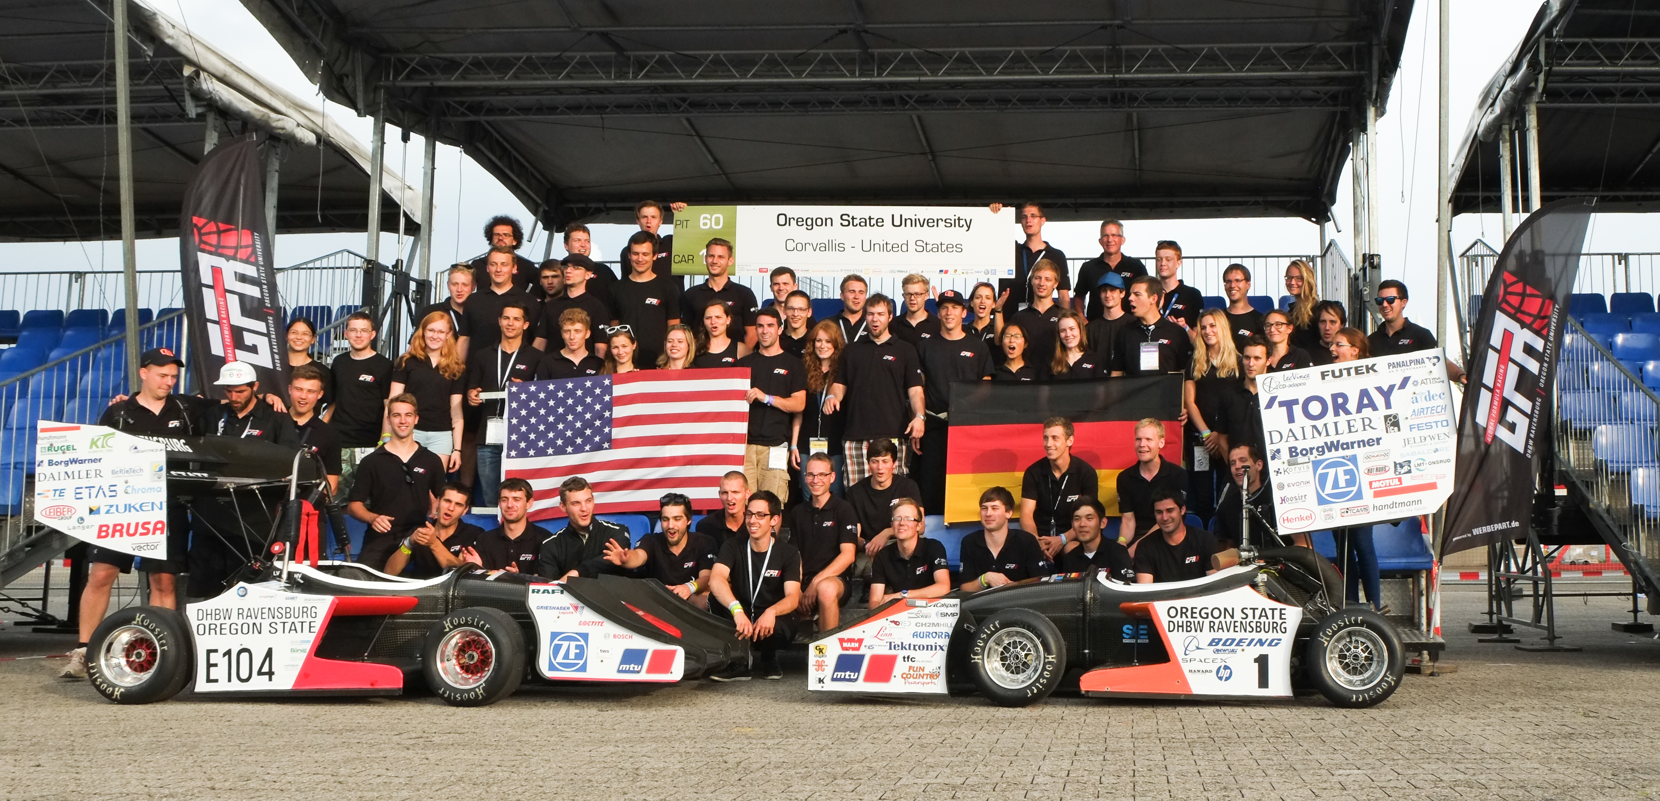
Clubs on Campus!

Slide 14
What Can You Do Now?
Keep taking MATH and SCIENCE classes!
Get Involved
Summer Camps
Research on your own
Notes:
Stress taking math and science classes whether or not they plan on pursuing a STEM field – no such thing as too far behind to start engineering. Give examples of how they can get involved in engineering clubs or something completely different. A well rounded engineer is a better engineer. Mention the SESEY Summer camp at OSU over the summer. Research potential majors before starting college. This is good advice for anyone!

Slide 15
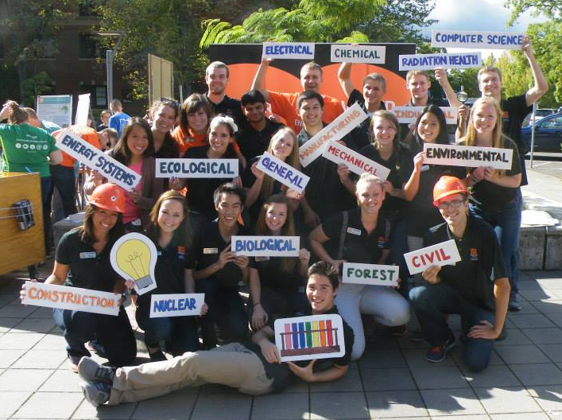
Come see us!
Daily Tours at 2:00 PM
askengineering@oregonstate.edu

Slide 16
Engineers in Action
Fun with Science – Ping-Pong on Space Station
https://www.youtube.com/watch?v=TLbhrMCM4_0
OSU Robotics – Atrias Bipedal Robot
https://www.youtube.com/watch?v=YFEJvb8iM7A
Atrias Robot (Stephen Colbert on OSU Robotics)
http://www.youtube.com/watch?v=XLv2X0-JwZ0&sns=em
Cassie – Latest OSU Bipedal Robot
https://www.youtube.com/watch?v=Is4JZqhAy-M
Dean Kamen – Inventor (SlingShot)
https://www.youtube.com/watch?v=PMBB97raUGY
Dean Kamen Prosthetic Arm TED Talks
https://www.ted.com/talks/dean_kamen_previews_a_new_prosthetic_arm
Dean Kamen – iBot and Segway
https://techcrunch.com/2016/05/23/ibot-wheelchair/
Daniel Project - Helping People Help Themselves
https://www.youtube.com/watch?v=SDYFMgrjeLg

