Slide 1
EEPROM Memory
4K bytes of EEPROM exist on the Mega128
EEPROM exists in a separate address space
Can only address single bytes using special registers
EEPROM Address Register (EEARH, EEARL)
EEPROM Data Register (EEDR)
EEPROM Control Register (EECR)
Endurance is 100,000 cycles per byte
Write access time is very slow: approx. 8.5mS (136,000 cycles at 16Mhz!)
Read time is fast: one cycle
CPU halts temporarily when EEPROM is read or written (2-4 cycles)

Slide 2
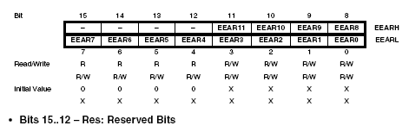


EEPROM Memory
EEPROM Address Registers EEARH, EEARL
EEPROM Data Register EEDR
master write enable
EEPROM Control Register EECR
write enable

Slide 3
EEPROM Memory
EEPROM Write Access
Wait until EEWE is zero. (previous writes have completed)
Load EEPROM address register
Load EEPROM data register
Set EEMWE (master write enable) while writing a zero to EEWE.
Within 4 CPU cycles, set EEWE (write enable) in control register
When EEWE has returned back to zero, write access is done. (~8.5mS)
Use eeprom.h routines to simplify your code:
#include <avr/eeprom.h>
eeprom_write_byte (uint8_t *addr,uint8_t value);
eeprom_write_word (uint16_t *addr,uint16_t value);

Slide 4
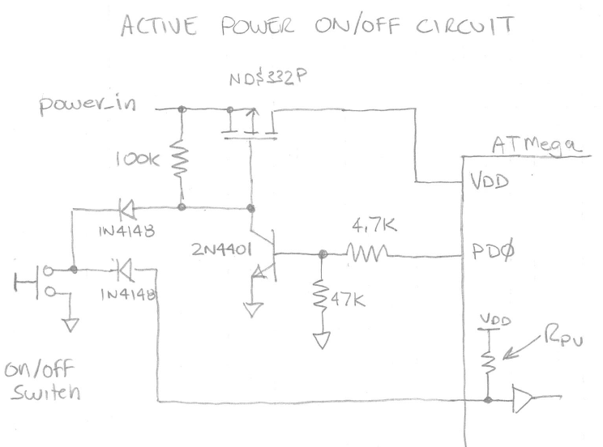
EEPROM write before power down
EEPROM Memory
An active on/off circuit:

Slide 5
EEPROM Memory
EEPROM write before power down
if(debounce_on_off_switch() == 1){ //was on/off switch pushed?
save_settings(); //save user volume
kill_power(); //spin waiting for powerdown
//*************************************************************
// save_settings
//
//Saves the user settings into EEPROM when power is going down.
//Interrups are disabled when this process is started.
//
void save_settings() {
eeprom_write_byte(&eeprom_alarm_volume, alarm_volume);
}//save_settings
//*************************************************************

Slide 6
EEPROM Memory
EEPROM write before power down (cont.)
//*************************************************************
// kill_power
//
//Turns off the NPN transistor that keeps the P-Ch MOSFET
//turned on after the on/off pushbutton is released. Vcc to
//system will then drop once switch is released. System is put
//into an endless spin loop till the power goes away.
void kill_power() {
PORTD &= ~(1<<PD0); //set portD bit 0 to 0, killing power
while(1){}; //spin till death
}//kill_power
//*************************************************************

Slide 7
EEPROM Memory
EEPROM Read Access
Make sure EEWE is not set. (write in progress)
Load EEPROM address register (EEAR).
Set EERE (read enable) bit in control register EECR).
Data will be available one cycle later in the data register (EEDR)
#include <avr/eeprom.h
main(){
//restore the previous alarm and volume levels
alarm_volume = eeprom_read_byte(&eeprom_alarm_volume);

